Slide 1
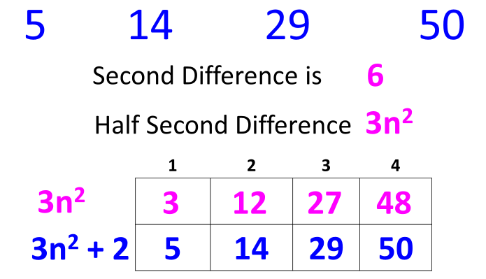
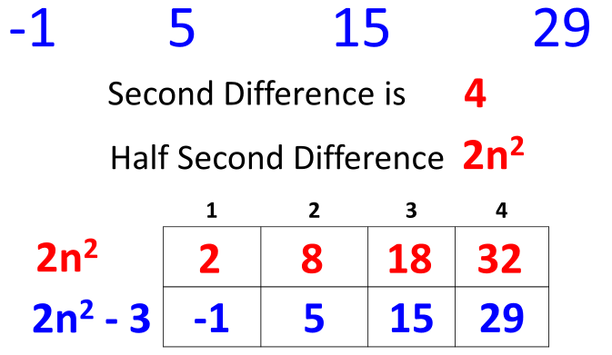
Quadratic Sequences
 | Step 1: Find the second difference Step 2: Half the second difference to find the value of n² Step 3: Find the first few terms of 3n² Step 4: Compare the new sequence with the original sequence…..in this case you need to +2
 | Step 1: Second difference 4 Step 2: 2n² Step 3: 2, 8, 18, 32 Step 4: 2n² – 3

Slide 2
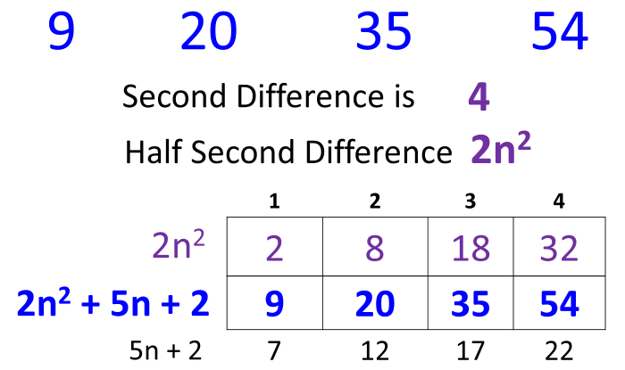
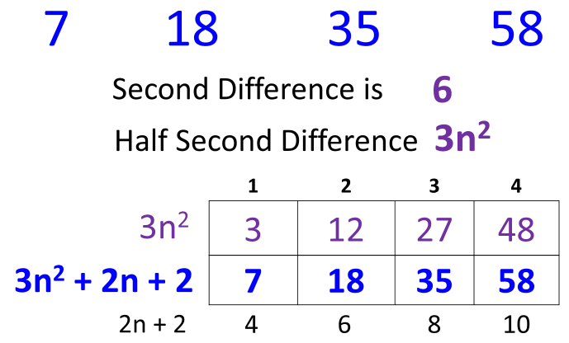
Quadratic Sequences - Harder
 | Step 1: Find the second difference Step 2: Half the second difference to find the value of n² Step 3: Find the first few terms of 3n² Step 4: Compare the new sequence with the original sequence…..difference is 7, 12, 17, 22 Step 5: Find the nth term of 7, 12, 17, 22 which is 5n + 2
 | Step 1: 6 Step 2: 3n² Step 3: 7, 18, 35, 58 Step 4: 4, 6, 8, 10 which is 2n +2 Step 5: 3n² + 2n + 2

Slide 3
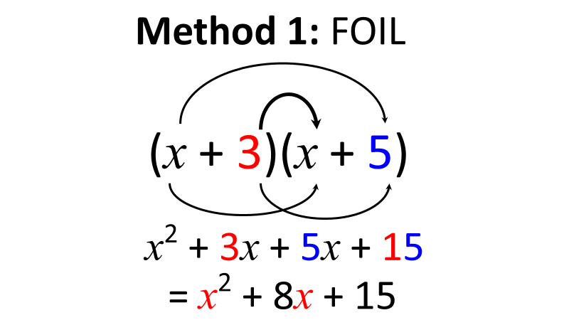
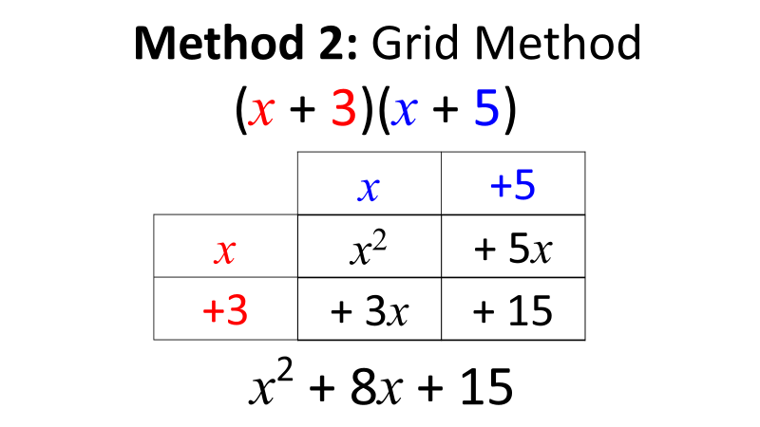
Expanding Double Brackets
(x – 2)(x + 7) = x² + 5x – 14 | (x + 2)(x – 7) = x² – 5x – 14
(x – 2)(x – 7) = x² – 9x + 14 | (2x – 2)(x – 7) = 2x² – 14x – 2x + 14 = 2x² – 16x + 14

Slide 4
Factorising Quadratics
x² + 8x + 15 = (x + 3)(x + 5) | Sum = 8 and Product = 15 3 x 5 = 15 3 + 5 = 8
x² + 3x – 10 = (x + 5)(x – 2) | Sum = 3 and Product = –10 5 x –2 = –10 5 + –2 = 3
x² – 5x – 14 = (x + 2)(x – 7) | Sum = –5 and Product = –14 2 x –7 = –14 2 + –7 = –5
x² – 9 = (x + 3)(x – 3) | Sum = 0 and Product = –9 3 x –3 = –9 3 + –3 = 0

Slide 5
Solving Quadratics by Factorising
x² + 2x – 15 = 0 (x + 5)(x – 3) = 0 x = –5 or x = 3 | Sum = 8 and Product = 15 3 x 5 = 15 and 3 + 5 = 8 (–5 + 5) = 0 or (3 – 3) = 0
x² – 9x + 14 = 0 (x – 2)(x – 7) = 0 x = 2 or x = 7 | Sum = –9 and Product = 14 –2 x –7 = 14 and –2 + –7 = –9 (2 – 2) = 0 or (7 – 7) = 0
x² = 10 – 3x x² + 3x – 10 = 0 (x + 5)(x – 2) = 0 x = –5 or x = 2 | Rearrange so that the quadratic is equal to zero Sum = 3 and Product = –10 –2 x 5 = –10 and –2 + 5 = 3 (– 5 + 5) = 0 or (2 – 2) = 0

