Slide 1
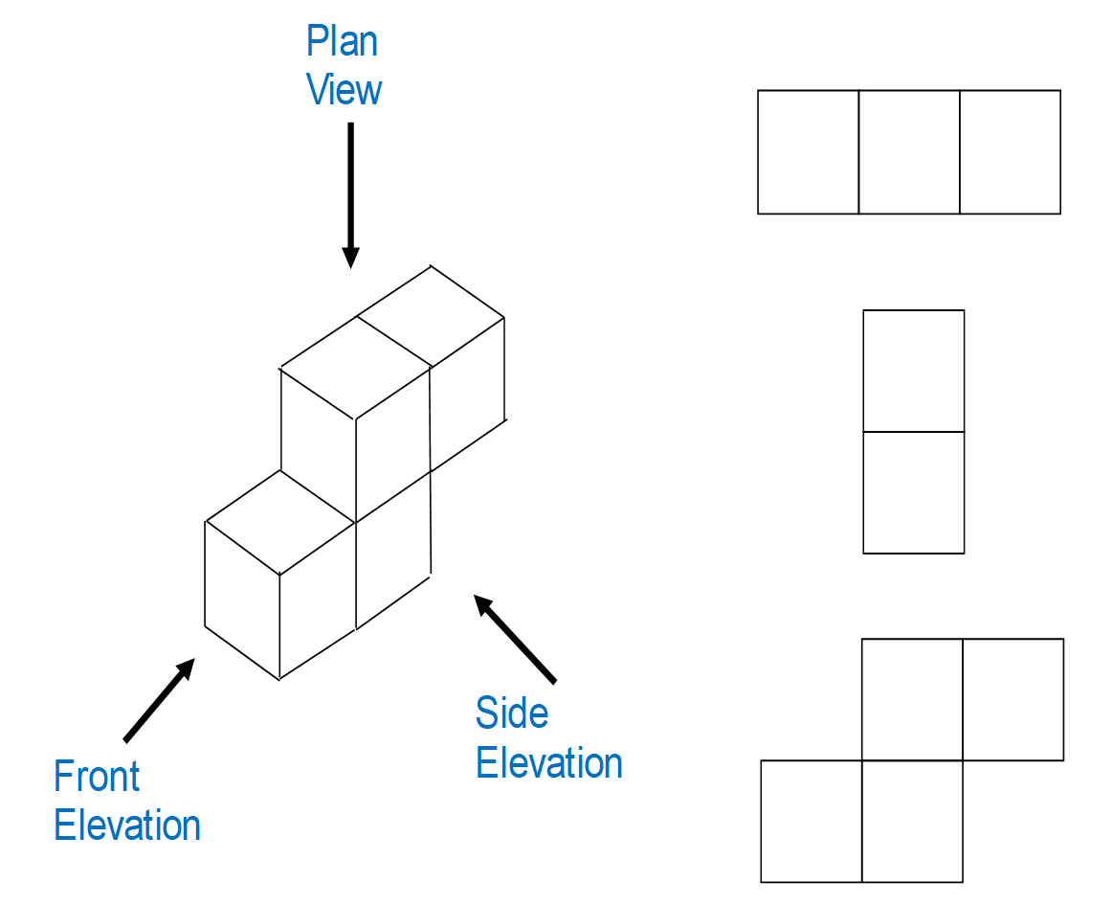
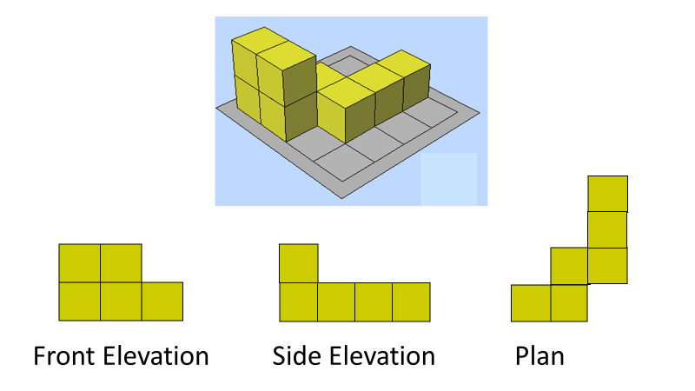
Plans and Elevations
 | Plan view is from the top
 | Front view will always be indicated
 | Side view will always be indicated
 | Count the number of squares that you can see

Slide 2
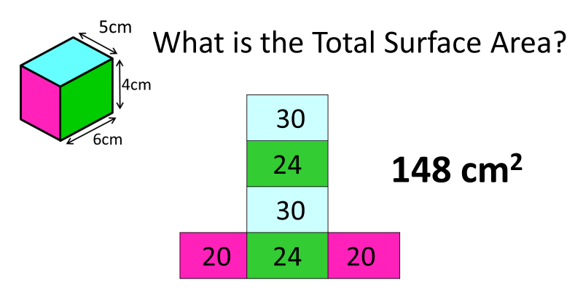
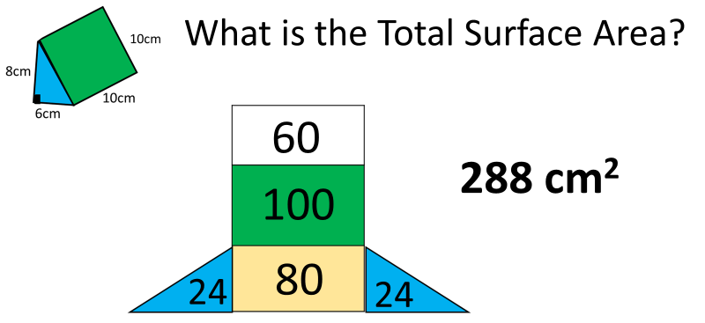
Surface Area - Prisms
Surface Area is the area that covers a 3D shape. | Calculate the area of each face and add the total
 | Top and bottom = (6 x 5) x 2 = 60 Front and back = (4 x 5) x 2 = 40 Side and Side = (6 x 4) x 2 = 48 Total = 60 + 40 + 48 = 148
 | Two triangles = (½ x 8 x 6) x 2 = 48 Back = 8 x 10 = 80 Front = 10 x 10 = 100 Bottom = 6 x 10 = 60 Total = 48 + 80 + 100 + 60 = 288

Slide 3
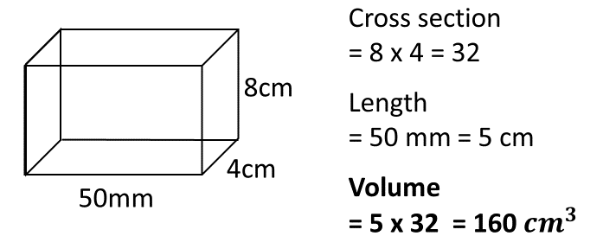
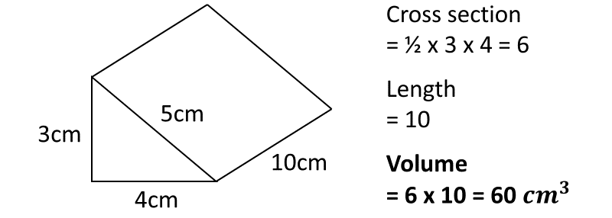
Volume- Prisms
Volume of a Prism = cross sectional area x length
 | Always give the units with your final answer.
 | Make sure all the units are the same. If not then convert then all to the same unit.
 | You do not have to use all measurements given. Only use the ones you need.

Slide 4
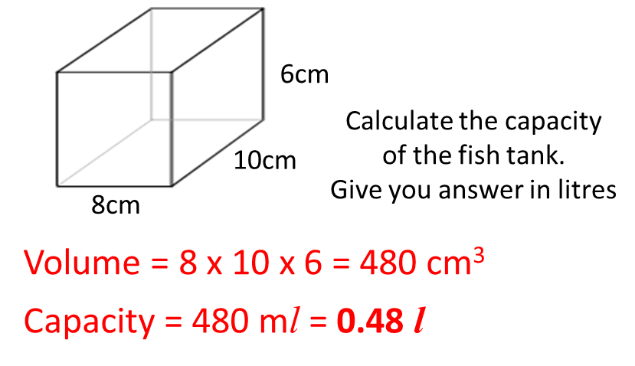
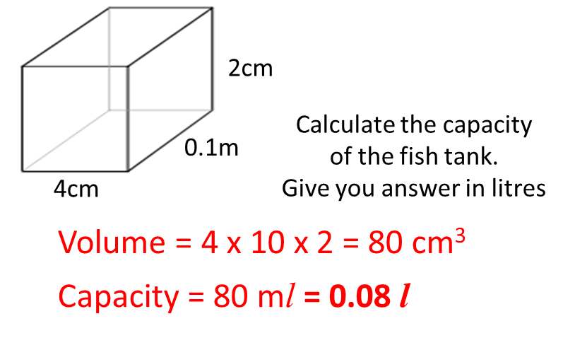
Volume - Capacity
You need to remember $${1 cm}^{3}=1ml$$ 1000ml = 1 litres | Capacity is how much liquid a 3D shape can contain.
 | First calculate the volume of the cuboid then convert to ml by changing the units then convert to litres by dividing by 1000
 | Make sure all measurements are in the same unit. 4cm 0.1m 2cm become 4cm 10cm 2cm

Slide 5
Circles – Circumference
Circumference = $π$ x diameter | Circumference is the perimeter of a circle. C = 2$π$r is also the formula because diameter is 2 x radius.
What is the circumference? Give answer to 1 dp | Make sure you use the diameter (or radius x 2)
What is the circumference? Give your answer in terms of $π$ | If you are asked to give your answer in terms of $π$ then you don’t need to use your calculator (so it is a good thing).
What is the diameter? Give answer to 1 dp | Diameter = Circumference ÷ $π$ Watch out if you are asked for the radius. Just half the diameter.

Slide 6
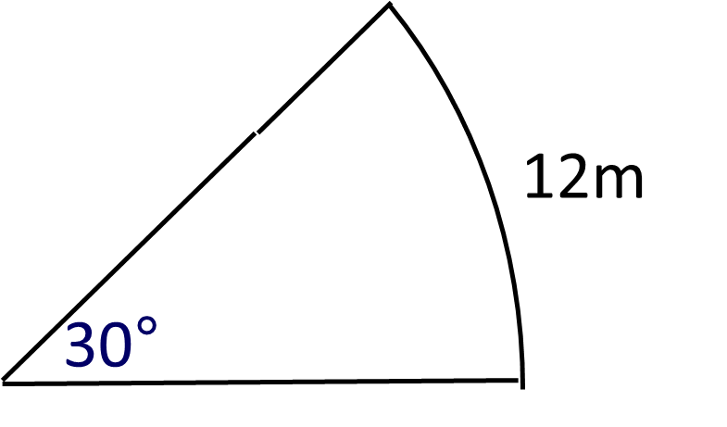
Circles – Arcs
 | Theta represents the angle
Find the length of the arc. Give your answer to 1dp
Find the perimeter of the sector. Give your answer to 1dp 48.6cm | Radius + Radius + Arc 18 + 18 + 12.6
Find the diameter of the sector. Give your answer to 1dp

Slide 7
Circles – Areas
Area = $π \text{x} {radius}^{2}$ = $πr^{2}$ | Square the radius and then multiply by $π$
Find the area of the circle. Give your answer in terms of 𝜋 | Make sure you use the radius and not the diameter.
Find the area of the semi-circle. Give your answer in terms of 𝜋 | $$\frac{1}{2}πr^{2}$$
Find the area of the quarter-circle. Give your answer in terms of 𝜋 | $$\frac{1}{4}πr^{2}$$

Slide 8
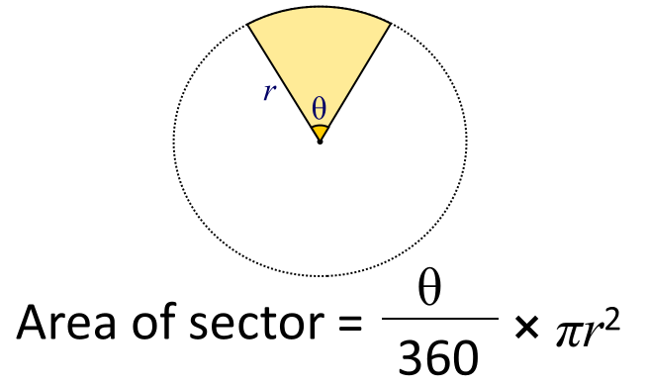
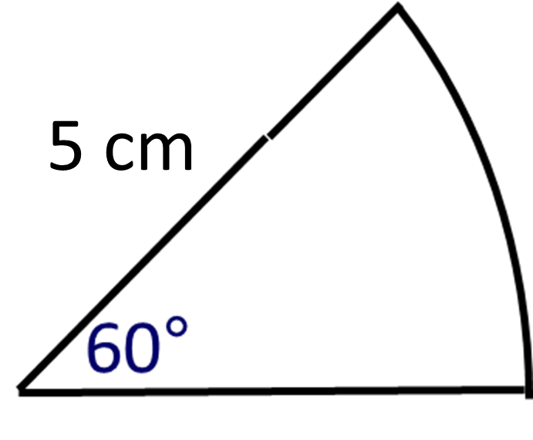
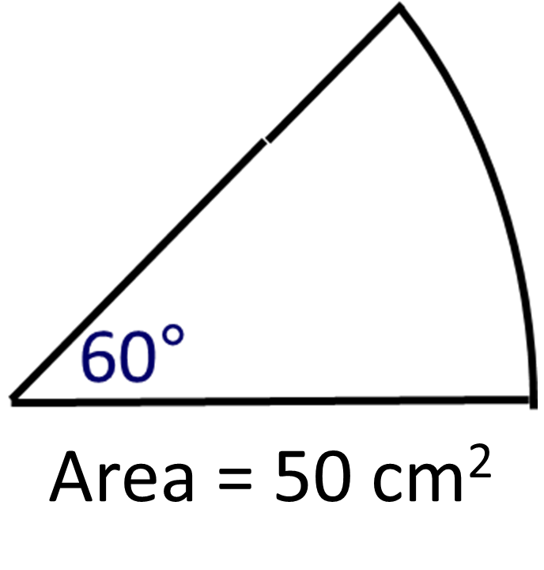
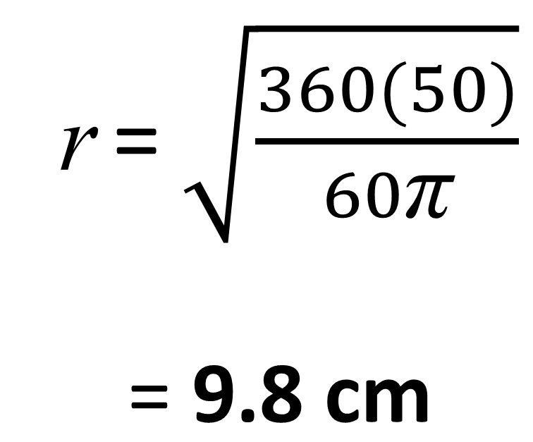
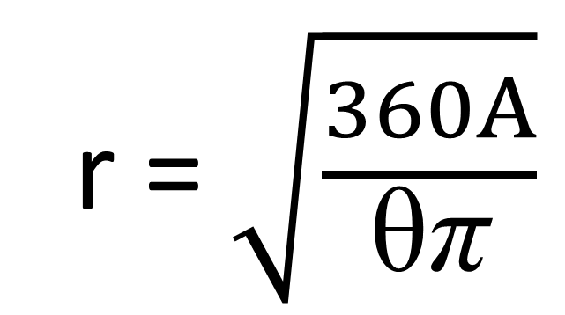
Circles – Sectors
 | Theta represents the angle
Find the area of the sector. Give your answer to 1dp Area = $\frac{\text{60}}{\text{360}}\text{π}$5² = 13.1 cm²
What is the radius? Give your answer to 1dp

Slide 9
Cylinders
What is the volume of cylinder in terms of $π$? | Volume = ${πr}^{2}$ x height
What is the surface area of cylinder in terms of $π$? | Area of Circles = $πr^{2}$
 | Area of Rectangle = circumference x height = $πd$ x height = $16π$ x 10
 | Total Surface = 2 circle + rectangle = $2πr^{2}+2πrh$

Slide 10
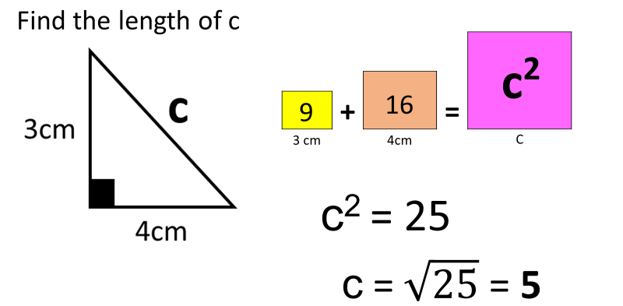
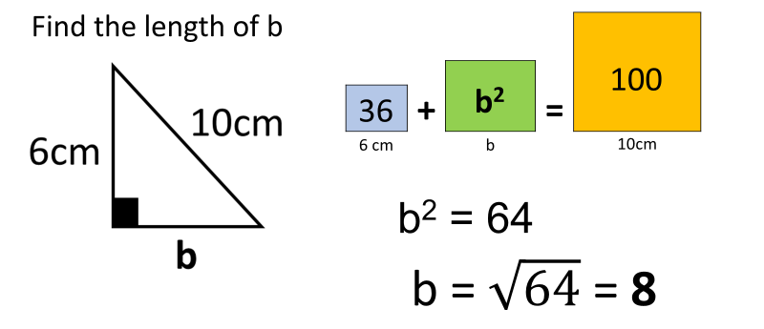
Pythagoras
a² + b² = c² | a and b are the two shorter sides. c is the longest side (opposite the right angle)
 | 3² + 4² = c² 9 + 16 = c² c² = 25 c = $\sqrt{25}$ = 5
 | 6² + b² = 10² 36 + b² = 100 b² = 100 – 36 = 64 b = $\sqrt{64}$ = 8

Slide 11
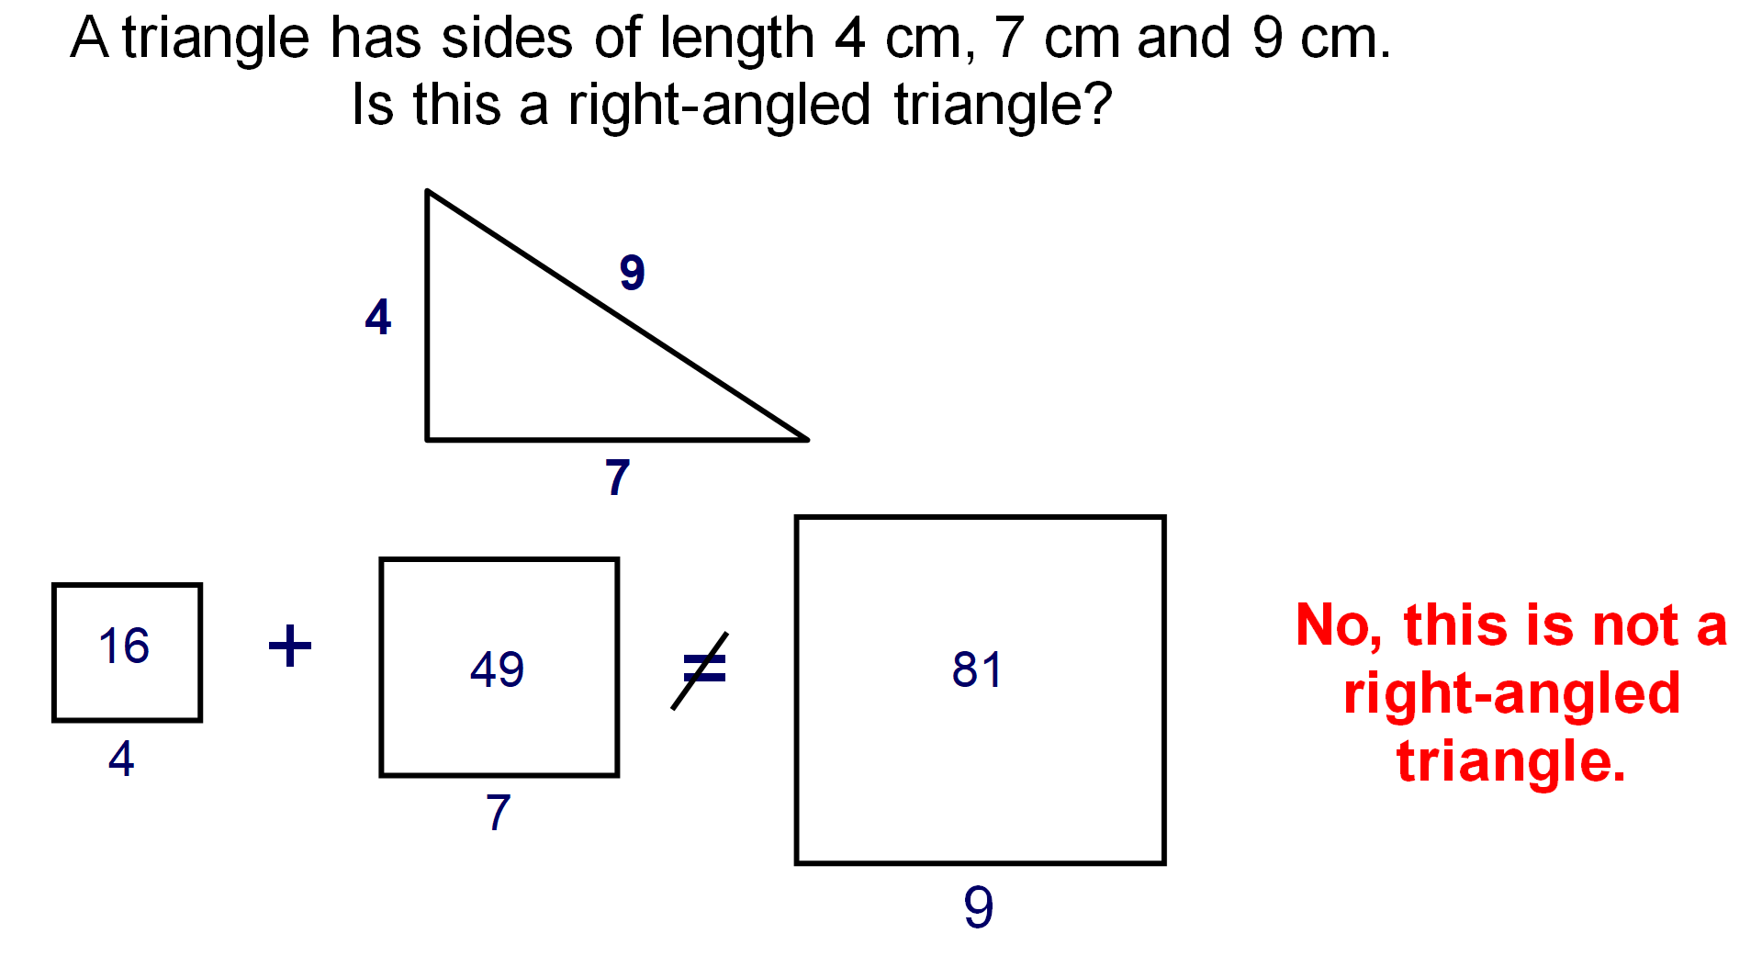
More Pythagoras
 | If a triangle is right angles then it must follow the rule of Pythagoras. a² + b² = c² must be true for the triangle to be true.
Pythagoras Triples | Pythagoras triples are whole numbers that work for a² + b² = c² 18² + 24² = 30²
a | b | c
3 | 4 | 5
6 | 8 | 10
9 | 12 | 15
18 | 24 | 30

