Slide 1
FM: Transforming the Unit Square

Slide 2
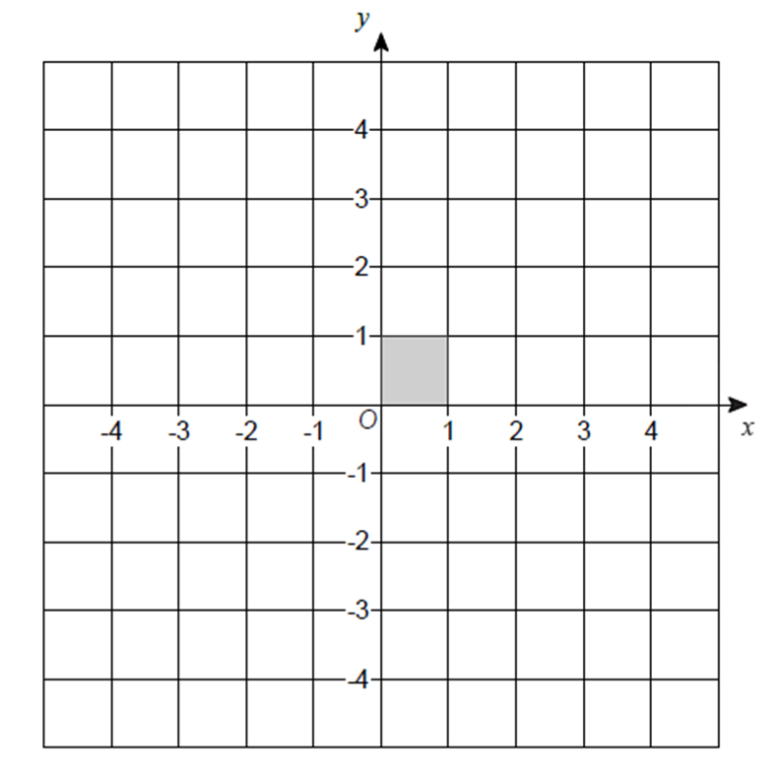
For more complex transformations it’s not sufficient to look at the effect on just one point: you can’t fully see what the matrix is doing.

Slide 3
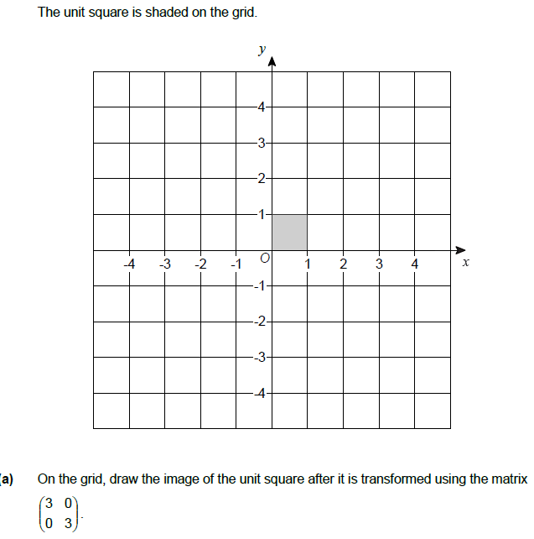
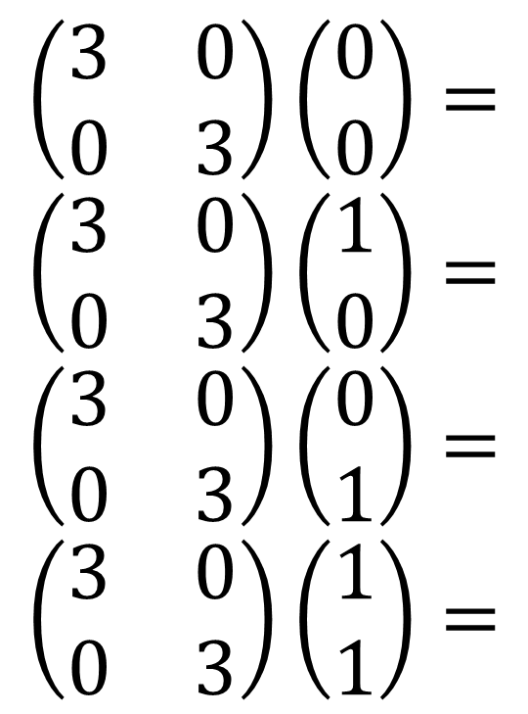
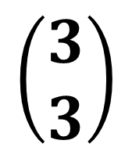
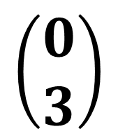
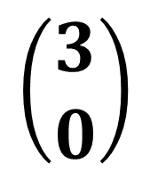
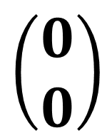
Apply the transformation to each point of the unit square.
$$\left(\begin{matrix}3 & 0 \\ 0 & 3\end{matrix}\right)\left(\begin{matrix}0 \\ 0\end{matrix}\right)= \\ \left(\begin{matrix}3 & 0 \\ 0 & 3\end{matrix}\right)\left(\begin{matrix}1 \\ 0\end{matrix}\right)= \\ \left(\begin{matrix}3 & 0 \\ 0 & 3\end{matrix}\right)\left(\begin{matrix}0 \\ 1\end{matrix}\right)= \\ \left(\begin{matrix}3 & 0 \\ 0 & 3\end{matrix}\right)\left(\begin{matrix}1 \\ 1\end{matrix}\right)=$$
$$\left(\begin{matrix}0 \\ 0\end{matrix}\right)$$
$$\left(\begin{matrix}3 \\ 0\end{matrix}\right)$$
$$\left(\begin{matrix}0 \\ 3\end{matrix}\right)$$
$$\left(\begin{matrix}3 \\ 3\end{matrix}\right)$$

Slide 4
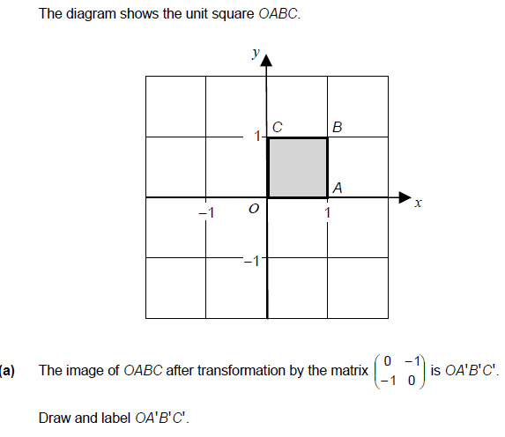
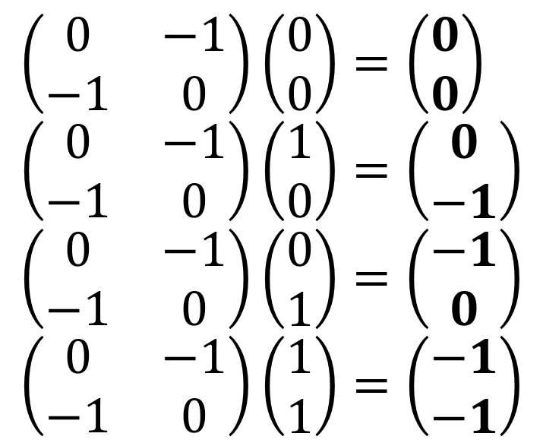
$$\left(\begin{matrix}0 & −1 \\ −1 & 0\end{matrix}\right)\left(\begin{matrix}0 \\ 0\end{matrix}\right)=\left(\begin{matrix}0 \\ 0\end{matrix}\right) \\ \left(\begin{matrix}0 & −1 \\ −1 & 0\end{matrix}\right)\left(\begin{matrix}1 \\ 0\end{matrix}\right)=\left(\begin{matrix}0 \\ −1\end{matrix}\right) \\ \left(\begin{matrix}0 & −1 \\ −1 & 0\end{matrix}\right)\left(\begin{matrix}0 \\ 1\end{matrix}\right)=\left(\begin{matrix}−1 \\ 0\end{matrix}\right) \\ \left(\begin{matrix}0 & −1 \\ −1 & 0\end{matrix}\right)\left(\begin{matrix}1 \\ 1\end{matrix}\right)=\left(\begin{matrix}−1 \\ −1\end{matrix}\right)$$
$$A′$$
$$B′$$
$$C′$$

