Slide 1
FM: Sketching Quadratics

Slide 2
What makes a graph sketch a ‘sketch’?
$$y$$
The general shape is the most important feature
No scale on axes! But you need to indicate points where a curve intercepts the axes.
$$1$$
$$x$$
$$−2$$

Slide 3
Features needed in sketch of quadratic:
$$y$$
Roots
$$x$$
General shape: Happy or Sad?
$y$-intercept
Turning point

Slide 4
Things to think about:
roots
y = 0 so solve the equation ideally by factorising
$y$-intercept
Identify the constant of the equation.
General shape
Is it happy or sad!
Turning point
Complete the square.

Slide 5
Using completed square for turning point.
$$y=x^{2}−6x+10$$
$$={\left(x−3\right)}^{2}+1$$
How could we use this completed square to find the minimum point of the graph?
(3, 1)
?
Think about transformations of graphs.

Slide 6
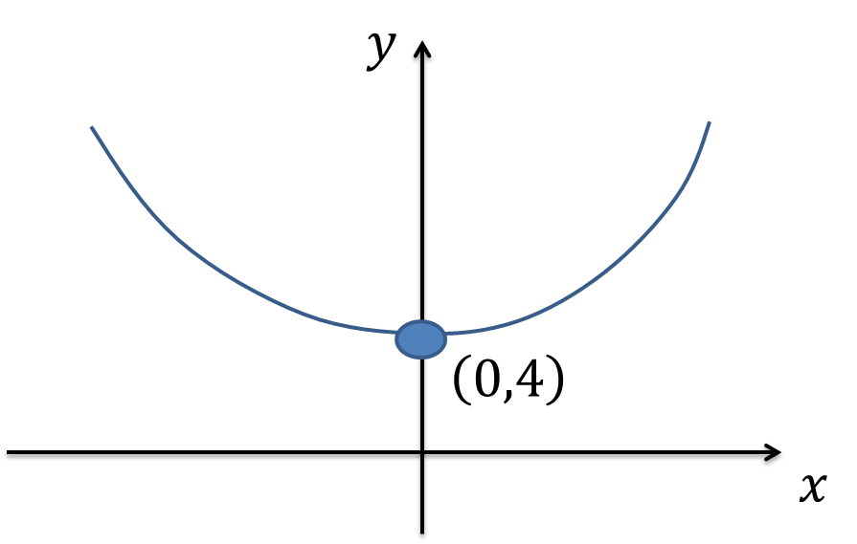
Sketch the graph $y=x^{2}+4$,
indicating any intercepts with the axis and the turning point.

Slide 7
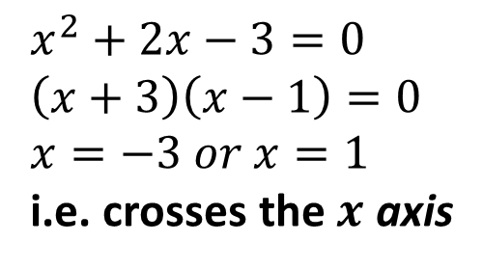
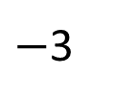
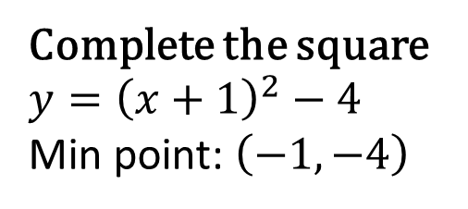
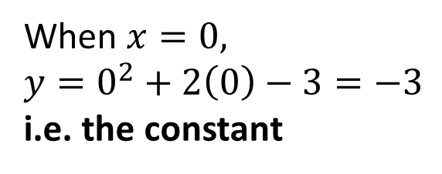
Sketch the graph of $y=x^{2}+2x−3$
and find the coordinates of the turning point.
Roots:
$$x^{2}+2x−3=0 \\ \left(x+3\right)\left(x−1\right)=0 \\ x=−3 or x=1$$
i.e. crosses the $x$ axis
$$y$$
$y$-intercept:
When $x=0,$ $$y=0^{2}+2\left(0\right)−3=−3$$
i.e. the constant
$$x$$
$−$3
1
Turning point:
Complete the square $$y={\left(x+1\right)}^{2}−4$$
Min point: $\left(−1,−4\right)$
$−$3
$$\left(−1,−4\right)$$

Slide 8
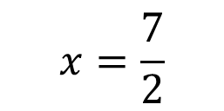
Sketch the graph $y=x^{2}−7x+10$,
indicating any intercepts with the axis,
and the equation of the line of symmetry.
$$x=\frac{7}{2}$$
10
$$x$$
2
5

Slide 9
Sketch the graph $y=x^{2}+4x+11$
indicating any intercepts with the axis, the turning point.
$$y$$
11
$$\left(−2,7\right)$$
$$x$$

Slide 10
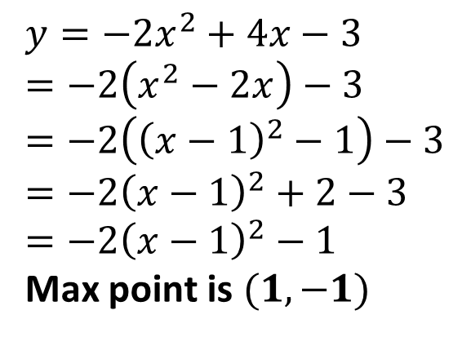
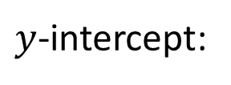
Sketch the graph of $y=4x−2x^{2}−3$
and find the coordinates of the turning point.
Roots:
$$−2x^{2}+4x−3=0 \\ a=−2, b=4, c=−3$$
No Solutions so does not cross the x axis
$$y$$
$y$-intercept:
$$−3$$
$$x$$
Turning point:
$$y=−2x^{2}+4x−3 \\ =−2\left(x^{2}−2x\right)−3 \\ =−2\left({\left(x−1\right)}^{2}−1\right)−3 \\ =−2{\left(x−1\right)}^{2}+2−3 \\ =−2{\left(x−1\right)}^{2}−1$$
Max point is $(1,−1)$
$$\left(1,−1\right)$$
-3

