Slide 1
FM: Algebraic Indices

Slide 2
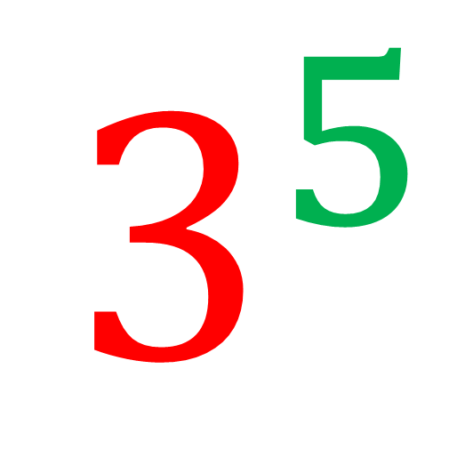
Exponent or Power or Index
$$3^{5}$$
Base Value

Slide 3
$$a^{m}×a^{n}=a^{m+n}$$
$$a^{m}÷a^{n}=a^{m−n}$$
$${\left(a^{m}\right)}^{n}=a^{mn}$$
$${\left(ab\right)}^{n}=a^{n}b^{n}$$

Slide 4
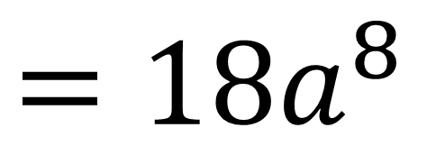
Simplify ${\left({3a}^{3}\right)}^{2}×2a^{2}$
$$={9a}^{6}×2a^{2}$$
$$=18a^{8}$$

Slide 5
Simplify ${\left(4x^{3}y\right)}^{3}$
$$=64x^{9}y^{3}$$

Slide 6
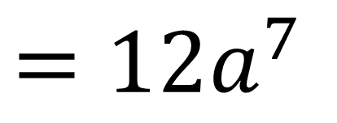
Simplify ${\left(\frac{2a^{5}}{a^{2}}\right)}^{2}×3a$
$$={\left(2a^{3}\right)}^{2}×3a$$
$$=4a^{6}×3a$$
$$=12a^{7}$$

Slide 7
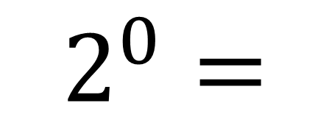
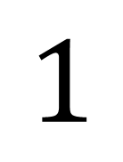
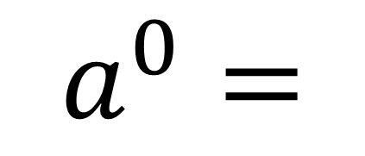
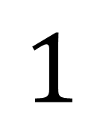
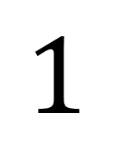
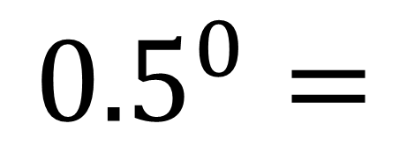
Zero Indices
$$a^{0}=$$
$$1$$
$$2^{0}=$$
$$1$$
$${0.5}^{0}=$$
$$1$$

Slide 8
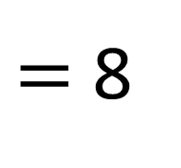
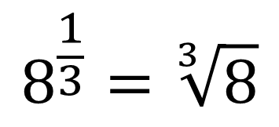
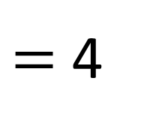
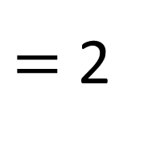
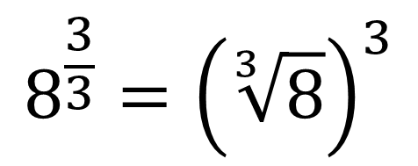
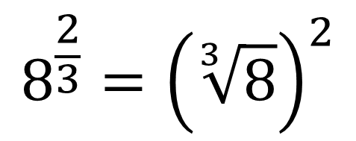
Fractional Indices
$$a^{\frac{n}{m}}={\left(\sqrt[m]{a}\right)}^{n}$$
$$8^{\frac{1}{3}}=\sqrt[3]{8}$$
$$8^{\frac{2}{3}}={\left(\sqrt[3]{8}\right)}^{2}$$
$$8^{\frac{3}{3}}={\left(\sqrt[3]{8}\right)}^{3}$$
$=$ 2
$=$ 4
$=$ 8

Slide 9
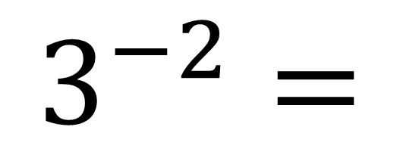
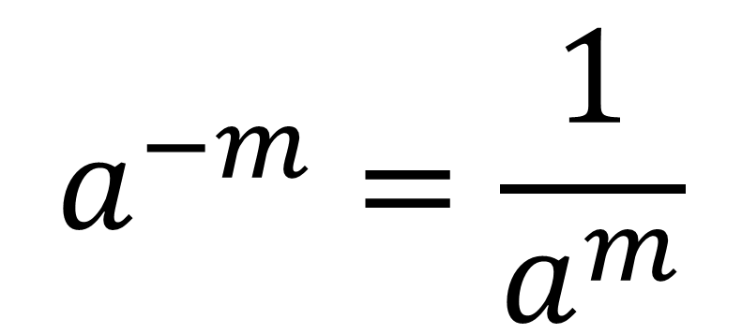
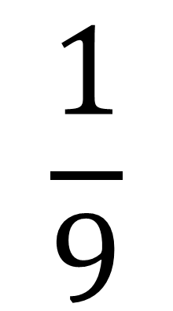
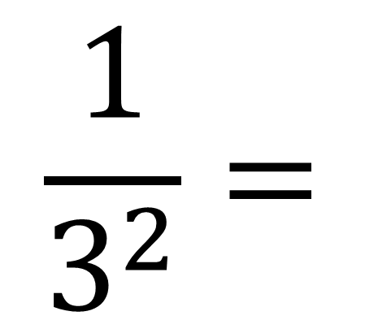
Negative Indices
$$a^{−m}=\frac{1}{a^{m}}$$
$$\frac{1}{3^{2}}=$$
$$\frac{1}{9}$$
$$3^{−2}=$$

Slide 10
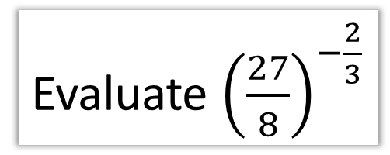
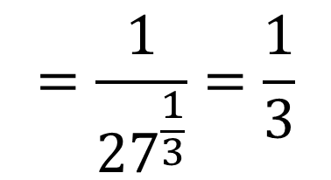
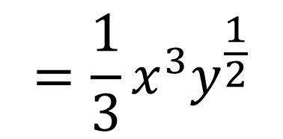
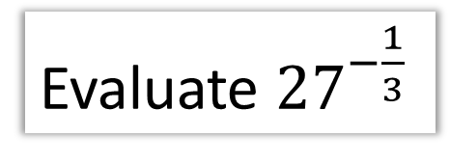
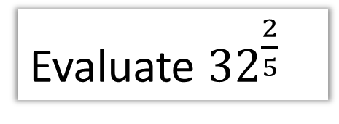
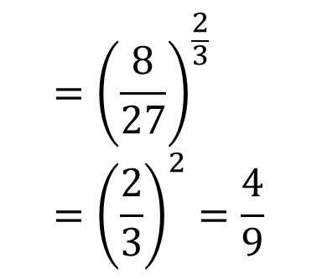
Evaluate ${27}^{−\frac{1}{3}}$
Evaluate ${32}^{\frac{2}{5}}$
$$=\frac{1}{{27}^{\frac{1}{3}}}=\frac{1}{3}$$
$$=2^{2}=4$$
Simplify ${\left(\frac{1}{9}x^{6}y\right)}^{\frac{1}{2}}$
Evaluate ${\left(\frac{27}{8}\right)}^{−\frac{2}{3}}$
$$={\left(\frac{8}{27}\right)}^{\frac{2}{3}}={\left(\frac{2}{3}\right)}^{2}=\frac{4}{9}$$
$$=\frac{1}{3}x^{3}y^{\frac{1}{2}}$$

Slide 11
If $9^{x}=3^{8}$
Determine the value of $x$
$9^{x}=3^{8}$
$$2x=8$$
${(3^{2})}^{x}=3^{8}$
$$2x=4$$
$3^{2x}=3^{8}$

Slide 12
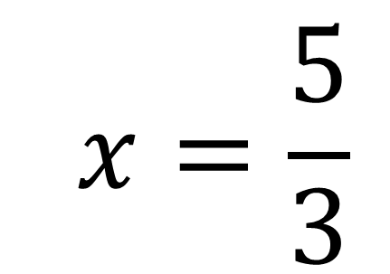
If $8^{x+1}=2^{8}$
Determine the value of $x$
$8^{x+1}=2^{8}$
$$3x+3=8$$
${(2^{3})}^{x+1} =2^{8}$
$$2x=\frac{5}{3}$$
$2^{3x+3}=2^{8}$

Slide 13
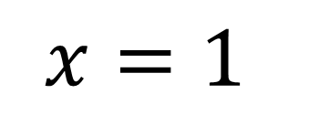
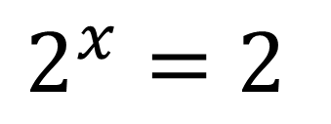
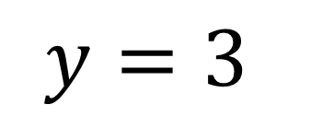
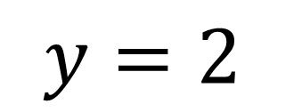
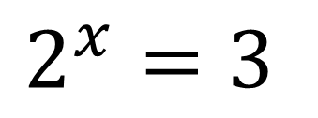
${ (2^{x})}^{2} − {5(2}^{x})+6=0$
Determine any integers values of $x$
${ (y)}^{2} − 5(y)+6=0$
$$y=2$$
$$y=3$$
$$2^{x}=2$$
$$2^{x}=3$$
$$x=1$$
No integer solutions

