Slide 1
Solving Quadratics - Factorising
x² + 2x – 15 = 0 (x + 5)(x – 3) = 0 x = –5 or x = 3 | Sum = 8 and Product = 15 3 x 5 = 15 and 3 + 5 = 8 (–5 + 5) = 0 or (3 – 3) = 0
x² – 9x + 14 = 0 (x – 2)(x – 7) = 0 x = 2 or x = 7 | Sum = –9 and Product = 14 –2 x –7 = 14 and –2 + –7 = –9 (2 – 2) = 0 or (7 – 7) = 0
x² = 10 – 3x x² + 3x – 10 = 0 (x + 5)(x – 2) = 0 x = –5 or x = 2 | Rearrange so that the quadratic is equal to zero Sum = 3 and Product = –10 –2 x 5 = –10 and –2 + 5 = 3 (– 5 + 5) = 0 or (2 – 2) = 0

Slide 2
Solving Quadratics - Factorising (Harder)
Solve 2x² − 5x − 12 = 0 b = −5, ac = −24 2x² − 8x + 3x – 12 = 0 2x(x − 4) + 3(x − 4) = 0 (x – 4)(2x + 3) = 0 x = 4 or x = $\frac{−3}{2}$ | Step 1: Factorise the quadratic equation. Work out the two factors of ac = −24 which add to give you b = −5. (−8 and 3) Step 2: Rewrite the b term (−5x) using these two factors. Step 3: Factorise the first two terms and the last two terms. Step 4: (x − 4) is a factor of both terms. Step 5: When two values multiply to make zero, at least one of the values must be zero. Step 6: Solve these two equations.

Slide 3
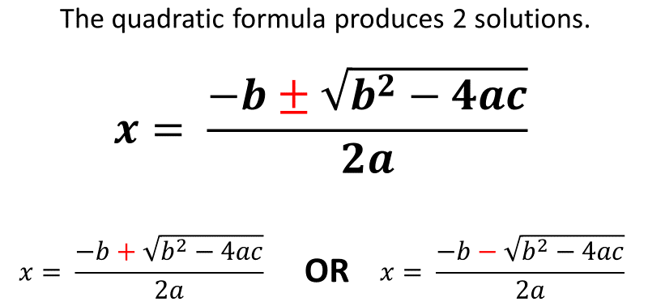
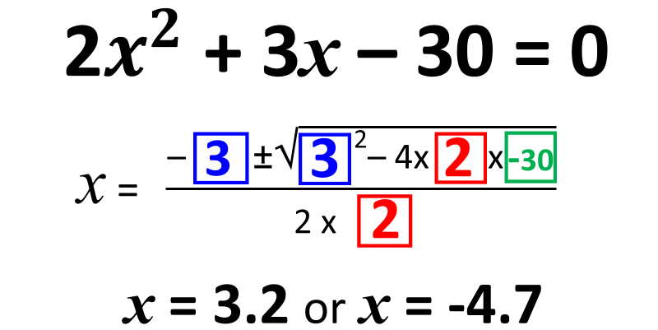
Solving Quadratics - Formula
 | The quadratic formula is not given on the formula sheet so you will need to memorise it.
 | Identify a, b and c. a = 2 b = 3 and c = -30 Morden calculators have a quadratic formula function. All you need to do is enter the values of a, b and c.

Slide 4
Quadratic Formula - Using a Calculator

Slide 5
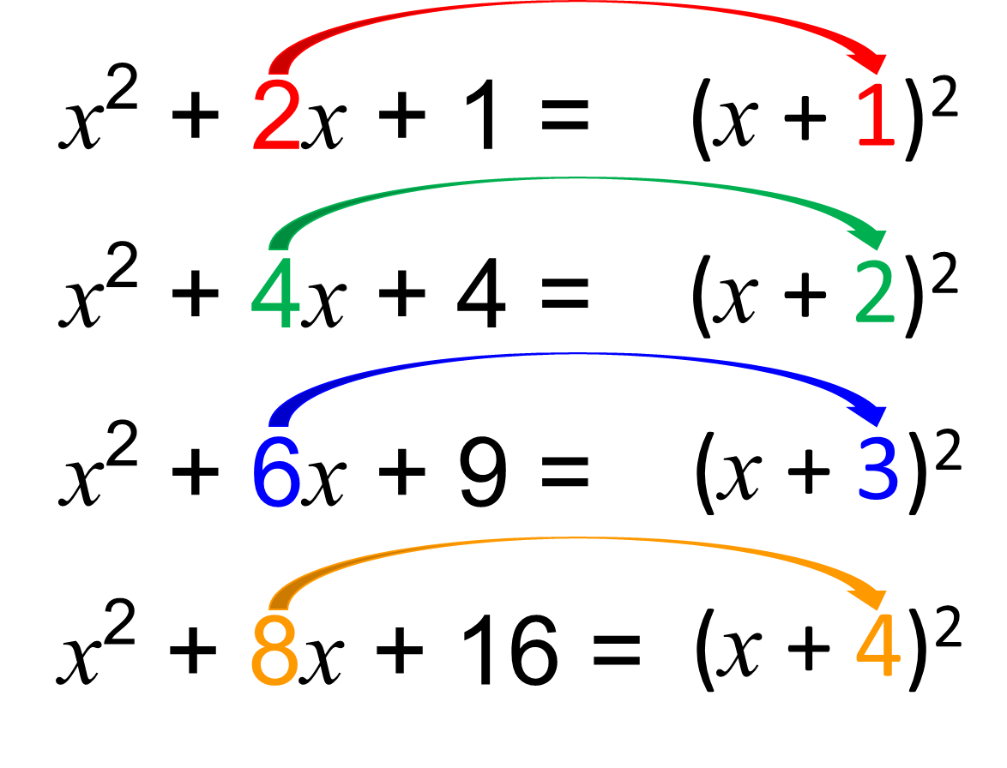
Completing the Square
 | Completing the Square formula.
 | This shows why the b value is halved.
 | (x + $\frac{6}{2}$) – ${(\frac{6}{2})}^{2}$
 | (x + $\frac{6}{2}$) – ${(\frac{6}{2})}^{2}$ + 3

Slide 6
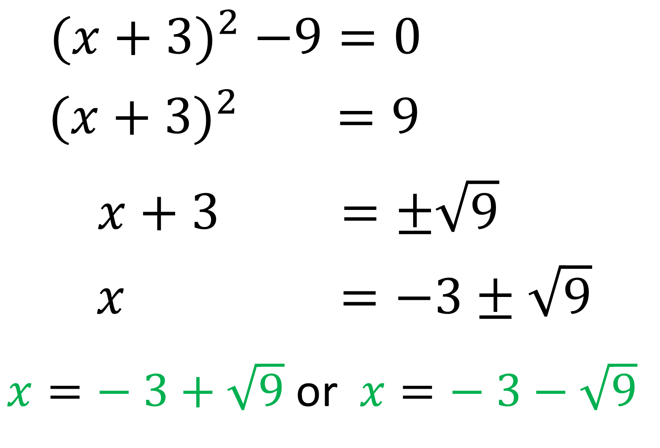
Solving Quadratics – Completing the Square
 | Step 1: Complete the Square Step 2: Make x the subject of the formula Step 3: You may get asked to give you answer to a decimal place or in surd form.

Slide 7
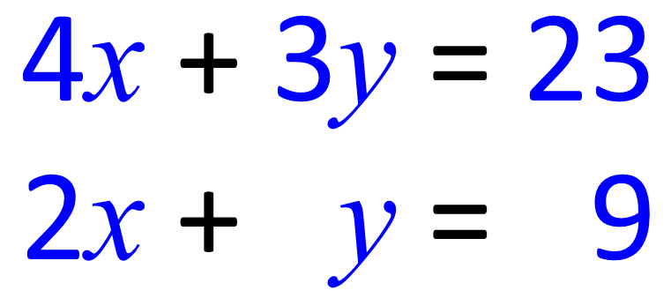
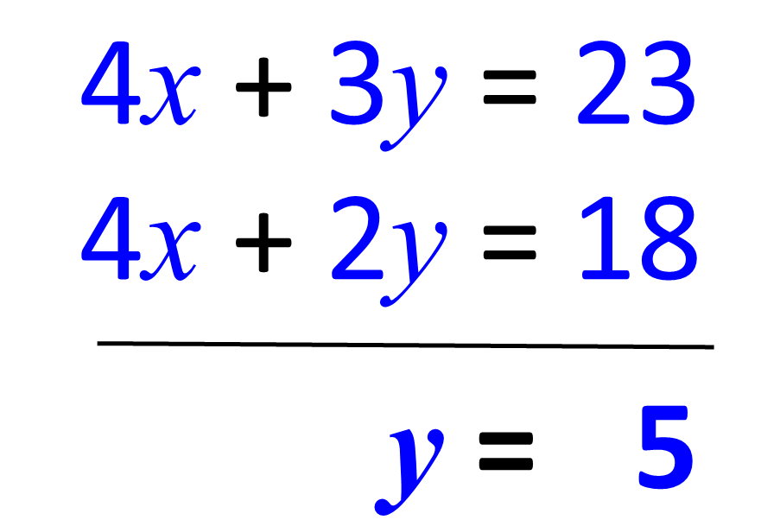
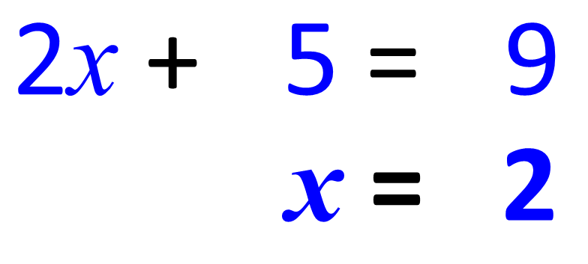
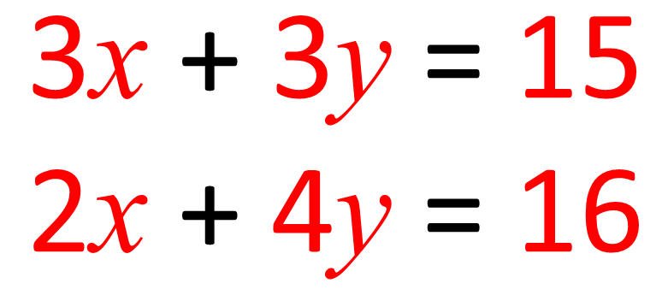
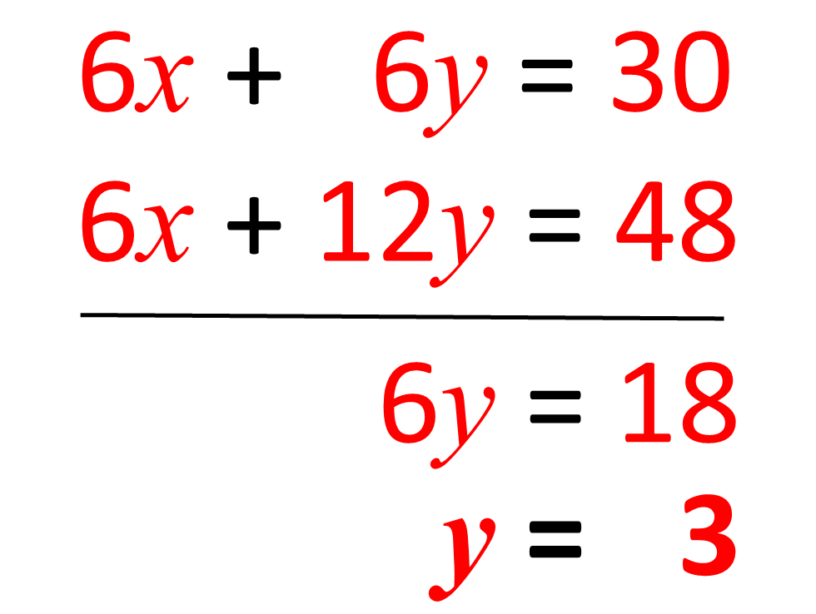
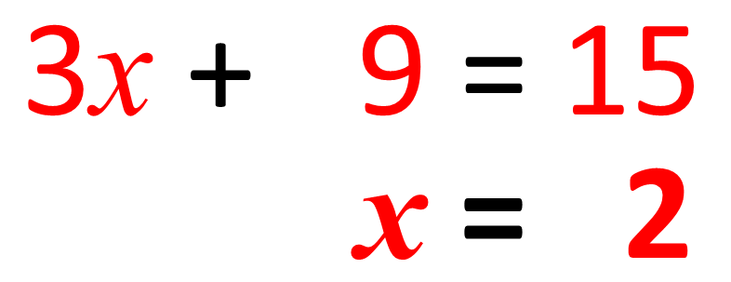
Simultaneous Equations - Elimination
 | Step 1: Subtract the two equations Step 2: Substitute the x = 5 into one of the equations and solve
 | Step 1: Multiply the bottom equation by 2 Step 2: Subtract the two equations Step 3: Substitute the y = 5 into one of the equations and solve
 | Step 1: Multiply the top equation by 2 and multiply the bottom equation by 2 Step 2: Subtract the two equations Step 3: Substitute the y = 3 into one of the equations and solve

Slide 8
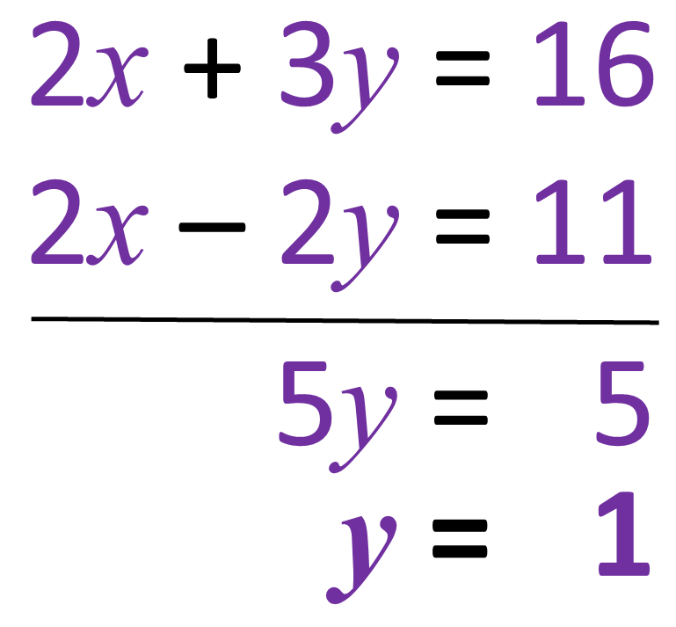
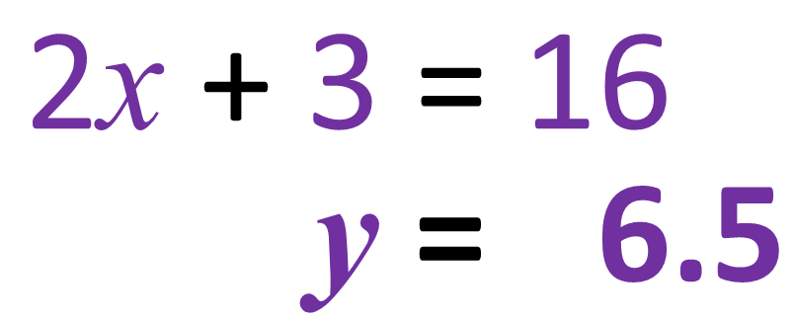
Simultaneous Equations – Elimination Harder
 | Step 1: Subtract the equations 3y – –2y = 5y
 | Step 2: Solve for y 5y = 5 y = 1
 | Step 3: Substitute y = 1 into one of the equations 2x + 3 = 16 x = 6.5

Slide 9
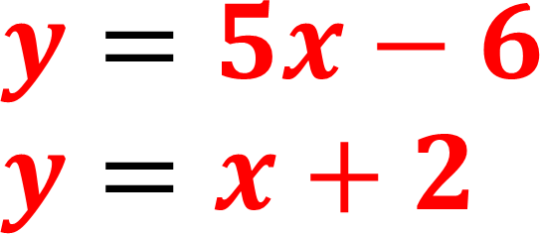
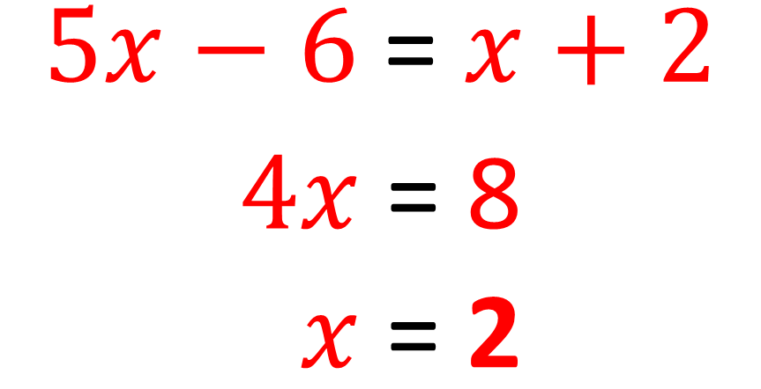
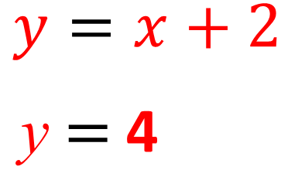
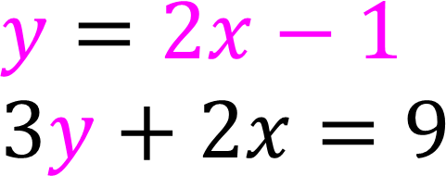
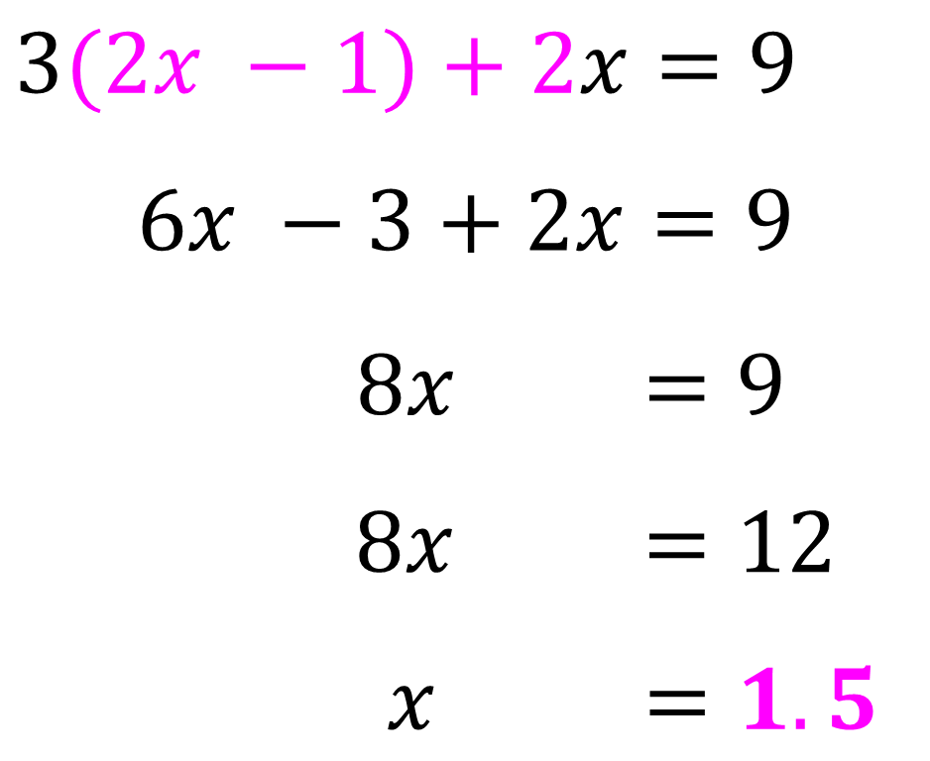
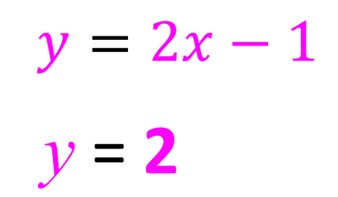
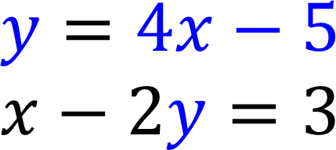
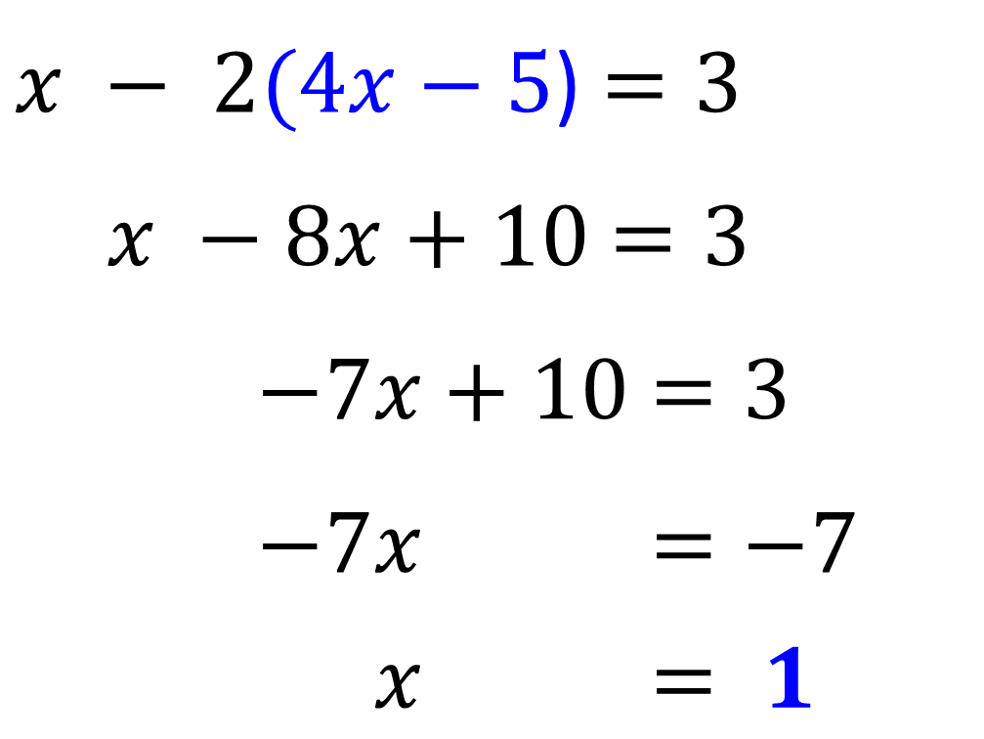
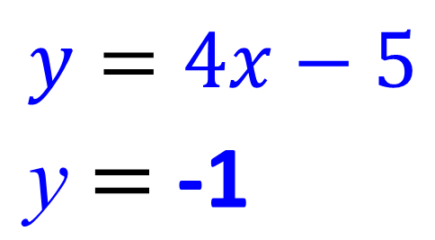
Simultaneous Equations - Substitution
 | Step 1: Substitute y with x +2 Step 2: Solve for x Step 3: Substitute x into an equation to find y
 | Step 1: Substitute y with 2x – 1 Step 2: Solve for x Step 3: Substitute x into an equation to find y
 | Step 1: Substitute y with 2x – 5 Step 2: Solve for x Step 3: Substitute x into an equation to find y

Slide 10
Simultaneous Equations – Linear + Quadratic
y = x² – 2 y = x x² – 2 = x x² – x – 2 = 0 (x + 1)(x – 2) = 0 x = -1 and x = 2 y = -1 and y = 2 | Quadratic Equation Linear Equation Step 1: Substitute y with x² – 2 Step 2: Rearrange to make the equation equal to zero Step 3: Solve the quadratic (in this case by factorising) Step 4: Substitute the x values back into the linear equation to find values of y

Slide 11
Simultaneous Equations – Linear + Quadratic (Harder)
y = x + 1 x² + y² = 13 x² + (x + 1)² = 13 2x² + 2x − 12 = 0 (2x − 4)(x + 3) = 0 x = 2 or x = −3 y = 3 or y = −2 | Quadratic Equation Linear Equation Step 1: Substitute with y Step 2: Rearrange to make the equation equal to zero Step 3: Solve the quadratic (in this case by factorising) Step 4: Substitute the x values back into the linear equation to find values of y

Slide 12
Inequalities – Number Lines
 | Hollow circle means not including that number
 | Solid circle means including that number
3 < x ≤ 8 What integers could x be? 4, 5, 6, 7, 8 | Integers are whole numbers

Slide 13
Inequalities – Solving Equations
2x + 1 ≥ 7 2x + 1 ≥ 6 2x + 1 ≥ 3 | Solve like a normal equal but write the inequality instead of an equals sign Number line answer:
9 ≥ 2x + 1 8 ≥ 2x + 1 4 ≥ 2x + 1 | OR 2x + 1 ≤ 9 OR 2x + 1 ≤ 8 OR x + 1 ≤ 4
4 – 3x ≥ 10 4 – 3x ≥ 16 4 – 3x ≤ 12 | Step 1: Subtract 4 Step 2: Divide by –3 (because you are dividing by a negative you need to change the direction of the inequality)

Slide 14
Inequalities – Double Inequalities
–4 $<2x≤4$ What integers could x be? –2 $<x≤2$ therefore -1, 0, 1, 2 | Divide both sides by 2
$$5<2x−1≤13$$ $$6<2x−1≤14$$ $$3<2x−1≤17$$ | Solve both sides of the inequality at the same time Step 1: Add 1 Step 2: Divide by 2
$$7<3x+4≤13$$ $$3<3x+4≤19$$ $$1<3x+4≤23$$ | Step 1: Subtract 4 Step 2: Divide by 3

Slide 15
Set Notation
A set is a collection of numbers. A = {1, 2, 4, 5, 8} | Set A contains the numbers 1, 2, 4, 5 and 8.
{x: x > 2} | The set of all x values contains numbers greater than 2
2x + 1 ≥ 7 2x + 1 ≥ 6 2x + 1 ≥ 3 {x: x ≥ 3} | If asked to solve the inequality then give the answer x ≥ 3 If asked to give your answer using set notation then given {x: x ≥ 3}

