Slide 1
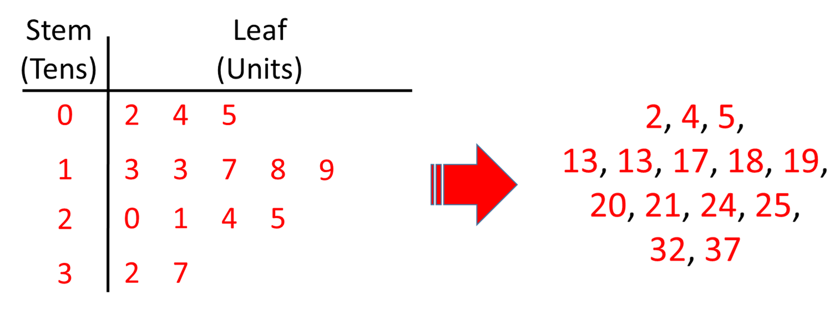
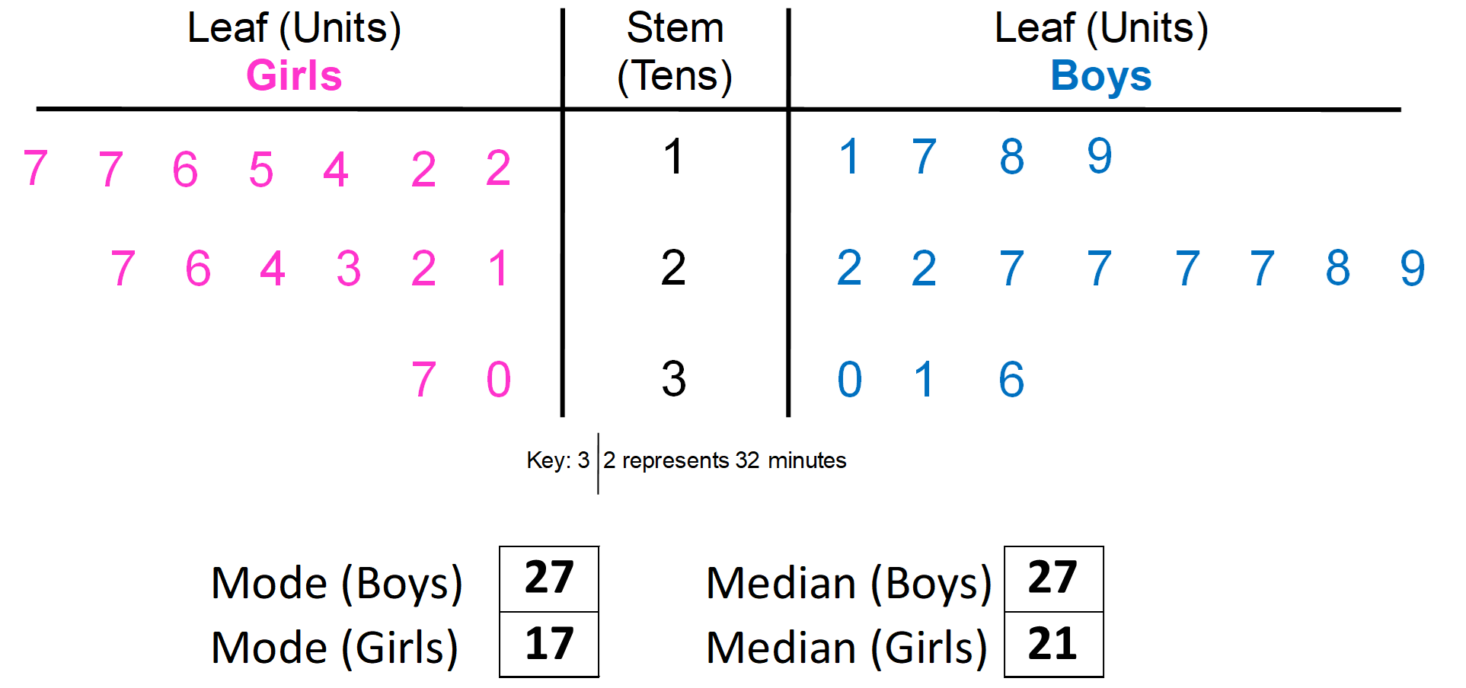
Stem and Leaf Diagram
A stem-and-leaf diagram can be used to display data items in order. | Good for finding averages.
 | Look to find the value of the stem and the value of the leaf.
 | Make sure when drawing a stem and leaf diagram you give a key.

Slide 2
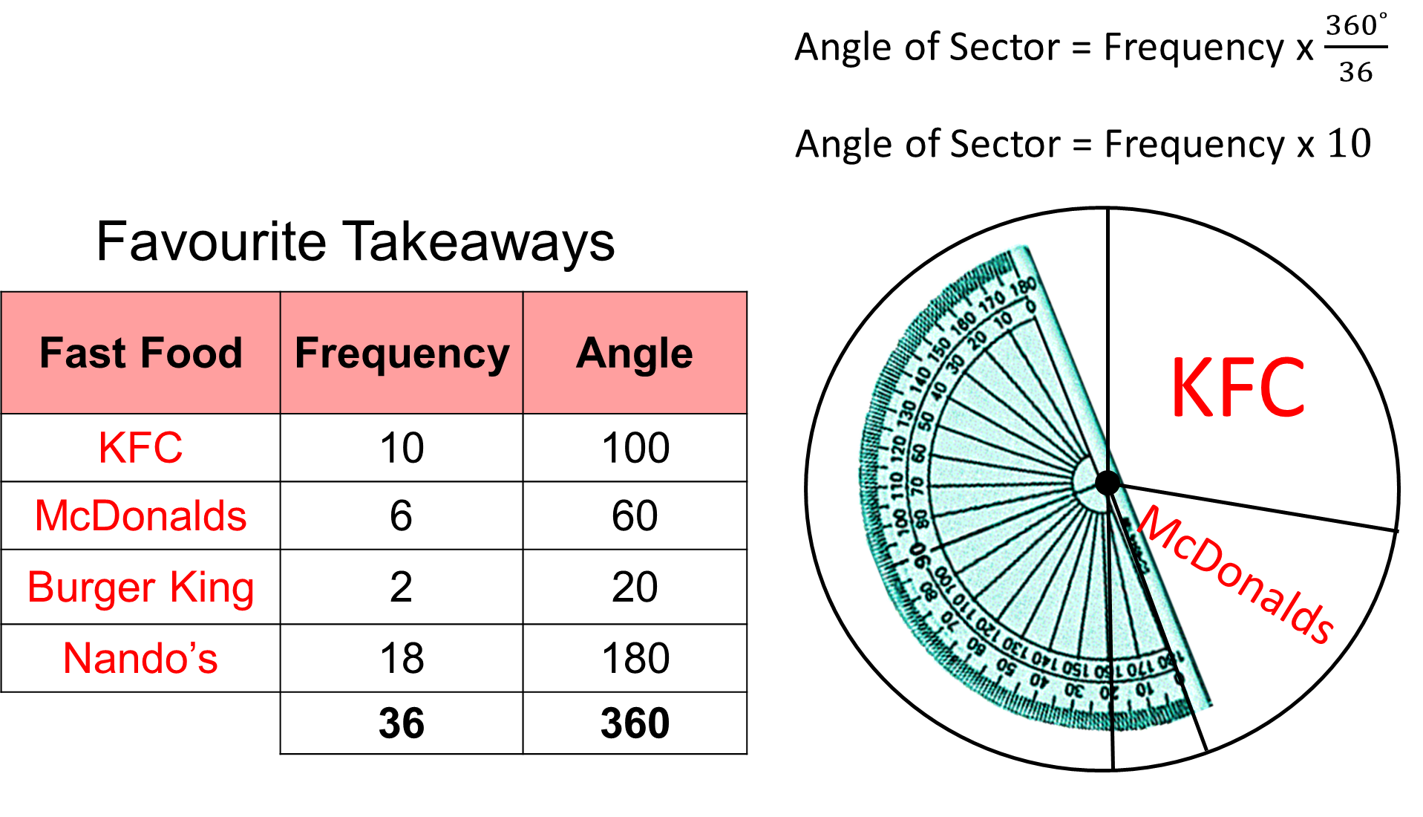
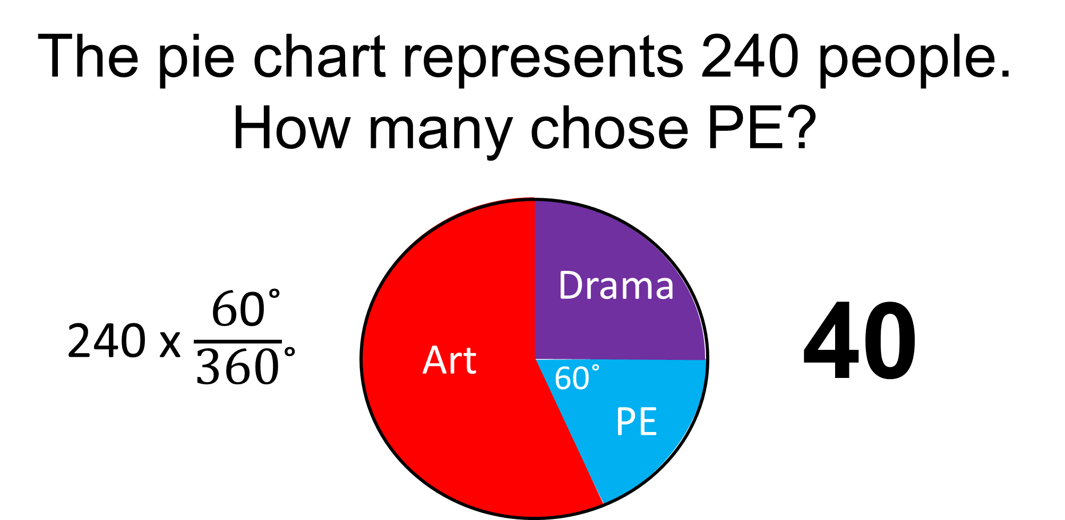
Pie Charts
Drawing | Angle of a Sector = Frequency x $\frac{360˚}{Total Frequency}$
Reading | Frequency = Total Frequency x $\frac{Angle of Sector}{360˚}$

Slide 3
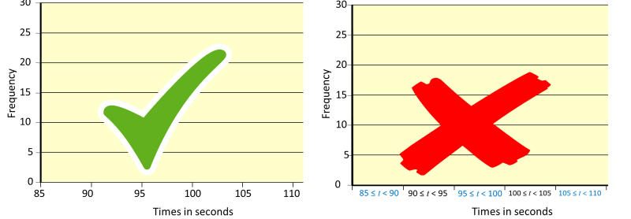
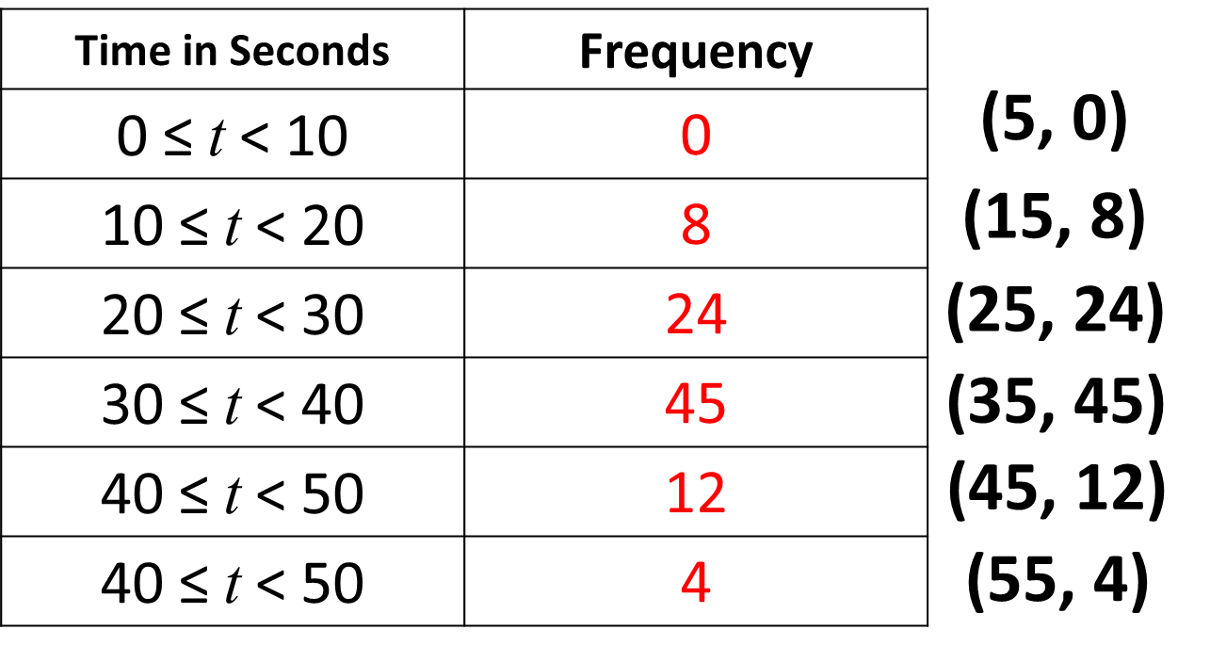
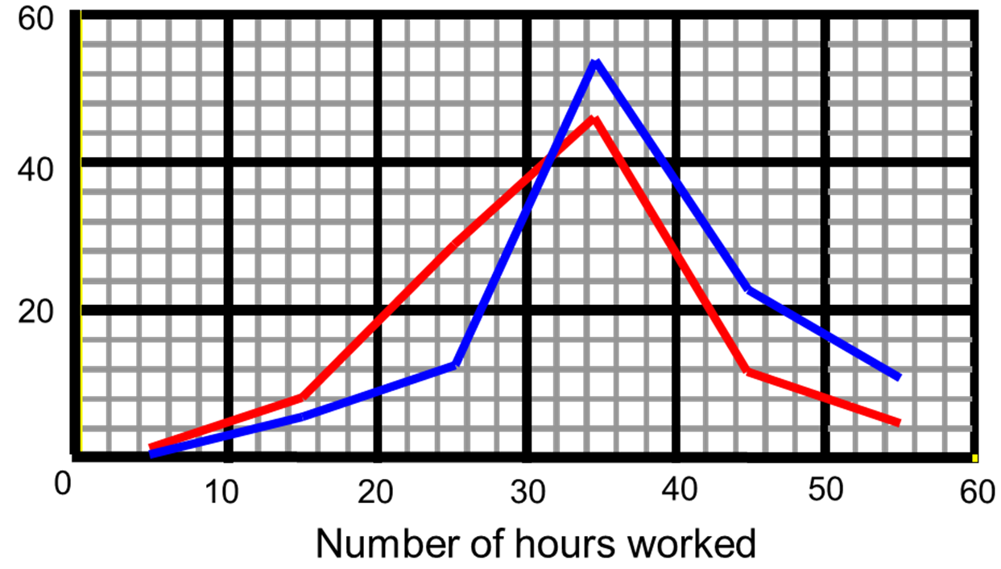
Frequency Polygons
A frequency polygons is a good way for presenting grouped data. | You can learn the trend of the data
Using the correct scale. | You should use a continuous scale on the x axis.
 | Plot on the x axis using the mid-point of the group interval

Slide 4
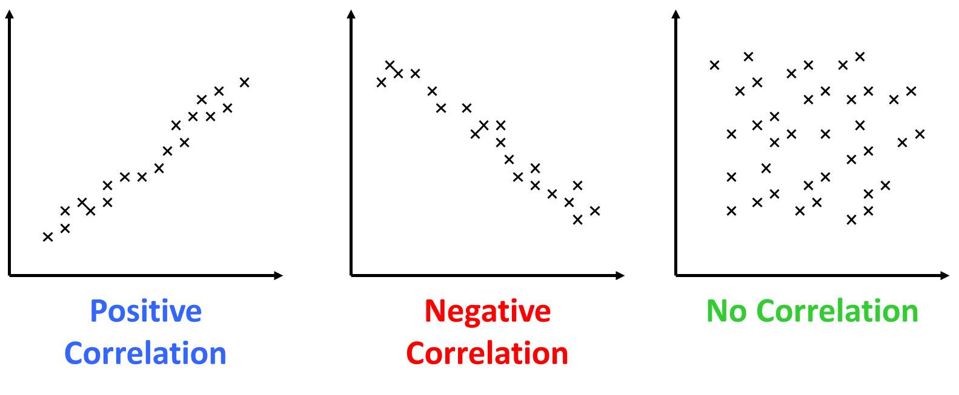
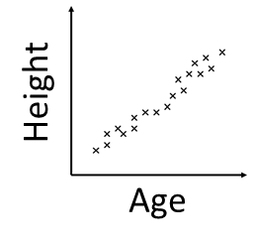
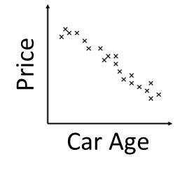
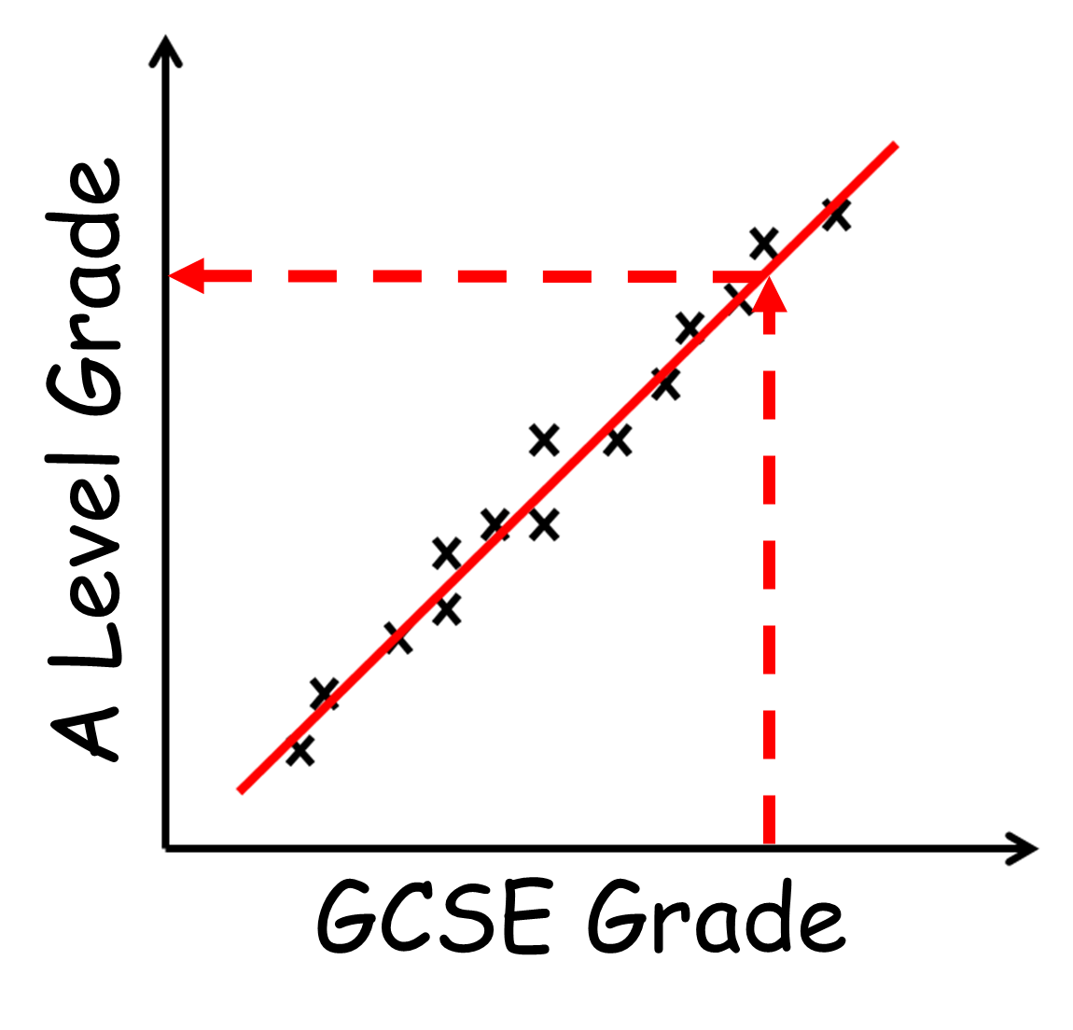
Scatter Graphs
Describe the Correlation | Positive correlation - as one value increases the other increases Negative correlation – as one value increase the other decreases No correlation – no relationship between the data
Describe the Relationship | As the children ages increases their heights increase As the car gets older the price decreases
Line of Best Fit | Line of best should pass through the middle of the points. The line of best fit does not have to go (0,0)

Slide 5
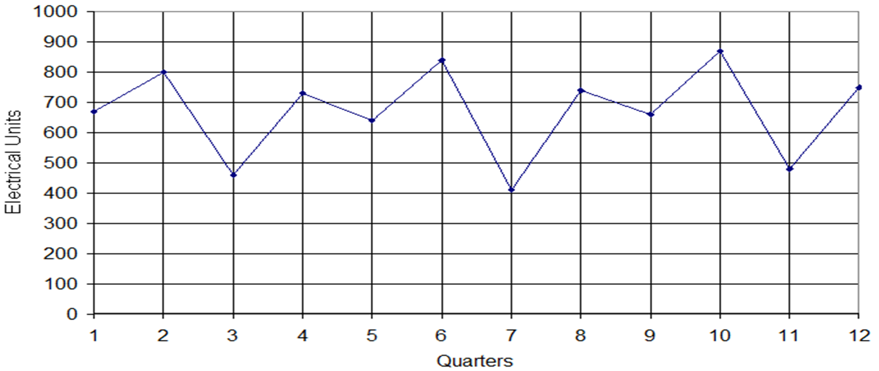
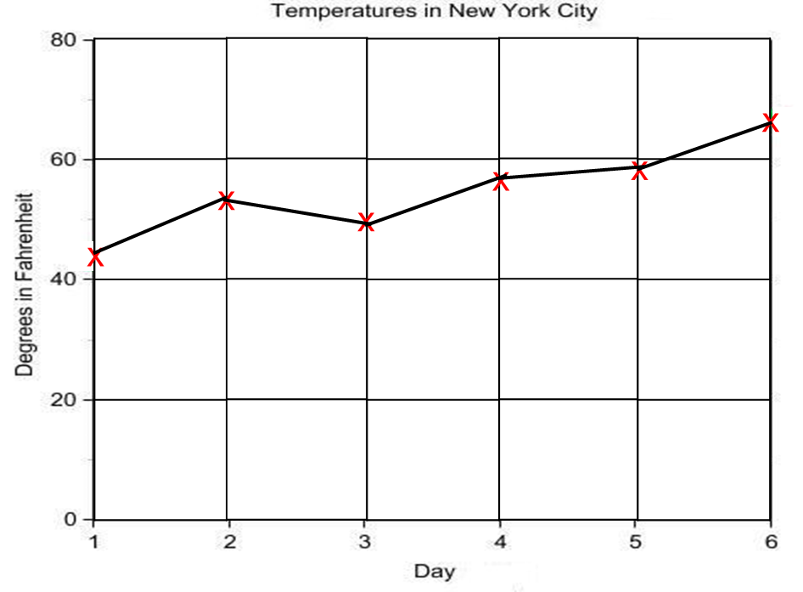
Time Series Graphs
Line graphs are good for describing trends | Trends are the general pattern the data follows.
The trend of electrical units has pretty much been constant. | The trend is the overall pattern. You don’t need to describe every increase and decrease.
The trend of the temperature has increased over time. | You basic options to describe trends are increase, decrease or stay constant.

Slide 6
Average – Which Average
Mode 1, 2, 3, 3, 3, 4, 276 | Pro: Not effective by extreme values Con: Can have more than one mode
Median 1, 2, 3, 3, 3, 4, 276 | Pro: Not effective by extreme values Con: Value of other data not taken into account
Mean 1 + 2 + 3 + 3 + 3 + 4 + 5 = 21 1 + 2 + 3 + 3 + 3 + 4 + 280 = 296 | Pro: Includes all Values Con: Is effective by extreme values
Range 2, 2, 2, 2, 2, 2, 130= Range = 128 (inconsistent) 2, 2, 2, 2, 2, 2, 2 Range = 0 (very consistent) | Pro: Shows how consistent the data maybe Cons: Can not tell how well the data performed

Slide 7
Averages - Frequency Table
 | Mode The highest frequency of goals is 3
 | Median Total pieces of data is 20 (total frequency). So the median will be found between the 10th and 11th piece of data Adding up the frequency 3 + 3 + 5 show that the 10th value is 2 and the 11th value is 2……so the median is 2
 | Mean $$\frac{Total Frequency}{Total Number of Goals}= \frac{44}{20}=2.2$$ Watch out of the common mistake of 0 x 3 = 3
If you converted the data in the table into a list it would look like this: 0,0,0, 1,1,1, 2,2,2,2,2, 3,3,3,3,3,3, 4,4, 5 | Range Biggest amount of goals – Smallest amount of goals 5 – 0 = 5 Common mistake: Biggest frequency – Small Frequency 6 – 1 = 5
Goals | Frequency
0 | 3 | 0 x 3 = | 0
1 | 3 | 1 x 3 = | 3
2 | 5 | 2 x 5 = | 10
3 | 6 | 3 x 6 = | 18
4 | 2 | 4 x 2 = | 8
5 | 1 | 5 x 1 = | 5
 | 20 |  | 44

Slide 8
Averages – Group Frequency Mode
 | The biggest frequency value will tell you the mode.
Modal Group = 20 ≤ d < 30 | Modal Group means you don’t need to give an individual value.
Distance (d) | Frequency
0 ≤ d < 10 | 0
10 ≤ d < 20 | 2
20 ≤ d < 30 | 4
30 ≤ d < 40 | 3
40 ≤ d < 50 | 1

Slide 9
Averages – Group Frequency Mean
 | You will need to get the total of the data. In this case it means getting the total distance. 0 x 0 = 0 15 x 2 = 30 25 x 4 = 100 35 x 3 = 105 45 x 1 = 45 Total = 0 + 30 + 100 + 105 + 45 = 280
Mean = $\frac{280}{10}$ = 28 | Mean = $\frac{Total of Data}{Total Frequency}$
Distance (d) | Frequency
0 ≤ d < 10 | 0
10 ≤ d < 20 | 2
20 ≤ d < 30 | 4
30 ≤ d < 40 | 3
40 ≤ d < 50 | 1
15 + 15
25 + 25 + 25 + 25
35 + 35 + 35
45

Slide 10
Averages – Group Frequency Median
 | The total pieces of data is equal to the total frequency. In this case there are 10 pieces of data. Therefore the median will be between the 5th and 6th
 | Median Group is 20 ≤ d < 30

Slide 11
Two Way Tables
How to Create a Two Way Table. - Read through all of the information first. - Pick out the different categories - Set out your table. - Fill in what you know | Two Way tables have data for rows and columns.
 | The last row and the column are the totals. The bottom right cell is the total number of people in the survey.
 | 90 people were asked whether they preferred Soaps, Drama or Crime shows. 12 men said they liked Dramas 33 people in total said they liked Soaps, and 27 of these were women. 25 people in total liked Dramas best. Only 10 women liked Crime shows.

Slide 12
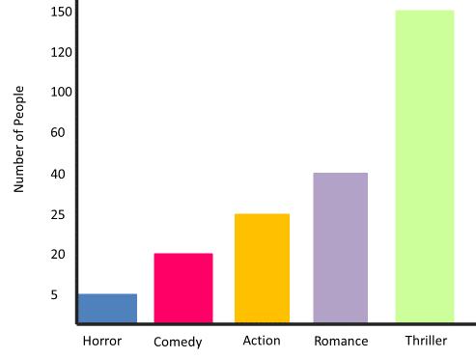
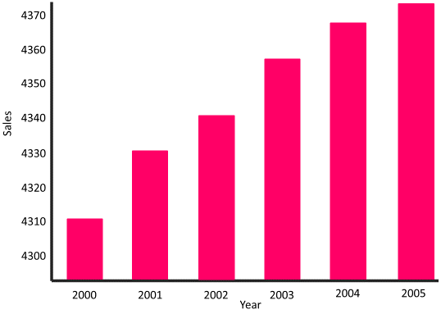
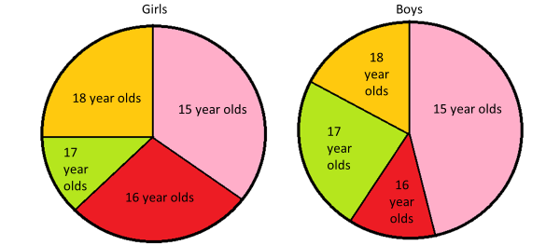
Misleading Graphs
 | Watch out for misleading scales. Look for: - Gap between numbers are different - Starting number of the scale - The range of the scale - No Scale
 | Be carful when comparing pie charts. It is important to know how many people were in the survey.

