Slide 1
Diagnostic Assessment
Delta 1
Unit 1
Two Way Table
Bar Charts
Averages
Line Graphs
Pie Charts
Scatter Graphs

Slide 2
Question 1 – Two Way Tables
The two-way table shows
what food and/or drink customers bought from a stall.
How many people bought only one item?

Slide 3
Answer 1 – Two Way Tables
The two-way table shows
what food and/or drink customers bought from a stall.
How many people bought only one item?
CORRECT ANSWER | CORRECT EXPLANATION
30 | We have 12 + 8 = 20 people who bought just food and 4 + 6 = 10 people who just bought drinks. Adding them together gives 30.
COMMON MISTAKES | WHAT MIGHT BE YOUR MISTAKE
20 | The student has found the number of people who just ordered food.
0 | The student has found the number of people who ordered nothing.
10 | The student has found the number of people who just ordered drinks.

Slide 4
Question 2 – Two Way Tables
What is the value missing number ‘b’ in the table?

Slide 5
Answer 2 – Two Way Tables
What is the value missing number ‘b’ in the table?
CORRECT ANSWER | CORRECT EXPLANATION
8 | If the total is 39, the number of people who bought Coke is 39 - 26 = 13. So the number of people who bought Coke and burgers is 13 - 5 = 8.
COMMON MISTAKES | WHAT MIGHT BE YOUR MISTAKE
Not enough information | The student has not recognised that we can use the other values in the table.
10 | The student may have thought that a and b are equal.
12 | The student has found a, not b.

Slide 6
Question 3 – Bar Charts
How many more cars pass at 15:00 than at 13:00?

Slide 7
Answer 3 – Bar Charts
How many more
cars pass at
15:00 than at 13:00?
CORRECT ANSWER | CORRECT EXPLANATION
3 | 15 cars passed at 15:00 and 12 cars pass at 13:00. Then we have 15 - 12 = 3.
COMMON MISTAKES | WHAT MIGHT BE YOUR MISTAKE
4 | The student may have identified the 15:00 bar as 16.
10 | The student may have read the 11:00 bar.
2 | The student may have compared 11:00 and 13:00.

Slide 8
Question 4 – Bar Charts
How many pets do the girls in the class have?

Slide 9
Answer 4 – Bar Charts
How many pets do the girls in the class have?
CORRECT ANSWER | CORRECT EXPLANATION
7 | The girls have 2 hamsters, 3 dogs and 2 cats. Adding them together gives 7.
COMMON MISTAKES | WHAT MIGHT BE YOUR MISTAKE
19 | The student has given the total number of pets across boys and girls.
12 | The student has given the number of pets the boys have.
Cannot tell | The student may be unfamiliar with reading twin bar charts.

Slide 10
Question 5 – Averages from a List
The median of these four numbers is 5.
Find the value of the missing number.

Slide 11
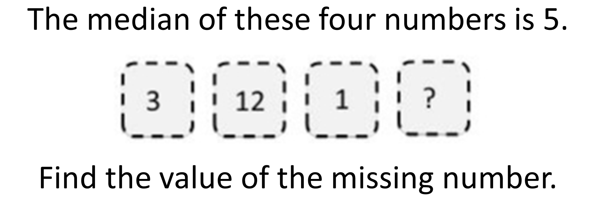
Answer 5 – Averages from a List
CORRECT ANSWER | CORRECT EXPLANATION
7 | The median will be the mean of the missing number and 3. The mean of 7 and 3 is 7 + 3 = 10, 10/2 = 5.
COMMON MISTAKES | WHAT MIGHT BE YOUR MISTAKE
4 | The student has worked out the missing number for the mean to be 5
16 | The student has added the numbers together.
6.5 | The student has not put the numbers in size order first, and has simply worked out the mean of 1 and 12.

Slide 12
Question 6 – Averages from a List

Slide 13
Answer 6 – Averages from a List
CORRECT ANSWER | CORRECT EXPLANATION
Green | If we order the stacks by height, the median stack is the middle one. This will be the green stack.
COMMON MISTAKES | WHAT MIGHT BE YOUR MISTAKE
Red | The student has not ordered the stacks correctly.
Blue | The student has picked the stack currently in the middle.
Purple | The student has not ordered the stacks correctly.

Slide 14
Question 7 – Choosing an Average

Slide 15
Answer 7 – Choosing an Average
CORRECT ANSWER | CORRECT EXPLANATION
Mean | The mean is dependent on the sum of all of the values, so large or small values can change the answer easily.
COMMON MISTAKES | WHAT MIGHT BE YOUR MISTAKE
Median | The student has not realised the median is only effected by how many pieces of data and not the values of them.
Mode | The student has not realized that is looking for multiples of the same value.
Range | The range is effect by extreme values but it is not distorted.

Slide 16
Question 8 – Averages from Frequency Tables
What is the mean shoe size?

Slide 17
Answer 8 – Averages from Frequency Tables
What is the mean shoe size?
CORRECT ANSWER | CORRECT EXPLANATION
3.77 | The total frequency is 50, so we require the 25th data point. This occurs in the 15 - 19 test score interval.
COMMON MISTAKES | WHAT MIGHT BE YOUR MISTAKE
5.65 | The student has given the median frequency.
1.50 | The student has given the middle test score interval.
22.6 | The student has given the frequency of the correct interval.

Slide 18
Question 9 – Averages from Frequency Tables
What is the median number of siblings?

Slide 19
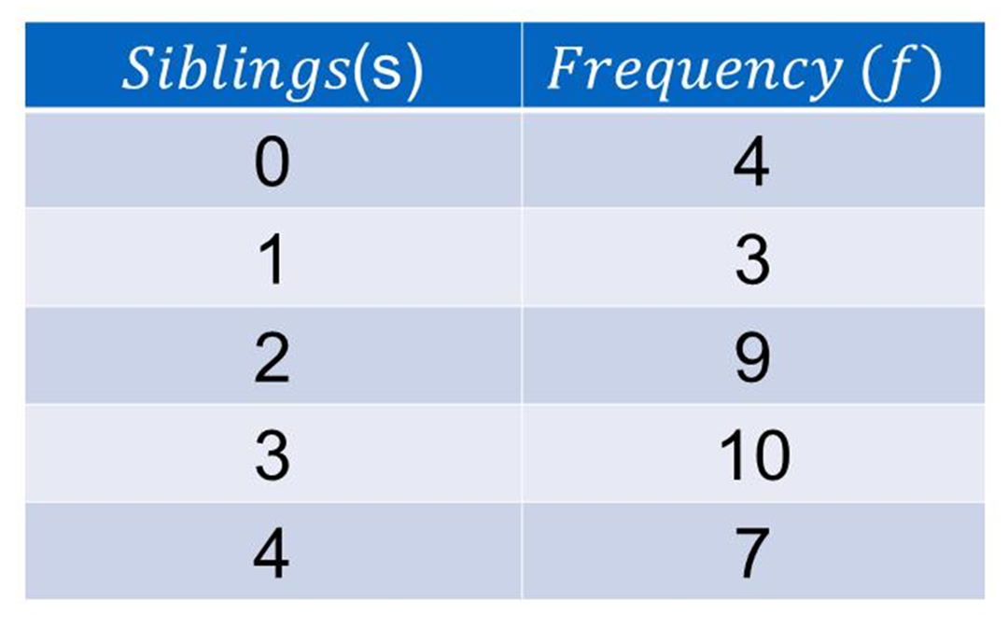
Answer 9 – Averages from Frequency Tables
What is the median number of siblings?
CORRECT ANSWER | CORRECT EXPLANATION
3 | The total frequency is 33, so the median is the 16th data point. This can be found in the 3 Siblings class.
COMMON MISTAKES | WHAT MIGHT BE YOUR MISTAKE
4 | The student has found the median of the frequencies.
2 | The student has found the median of the siblings column.
10 | The student has found the frequency, not the number of siblings.

Slide 20
Question 10 – Line Graphs
How much more water was consumed in the afternoon compared to the morning?

Slide 21
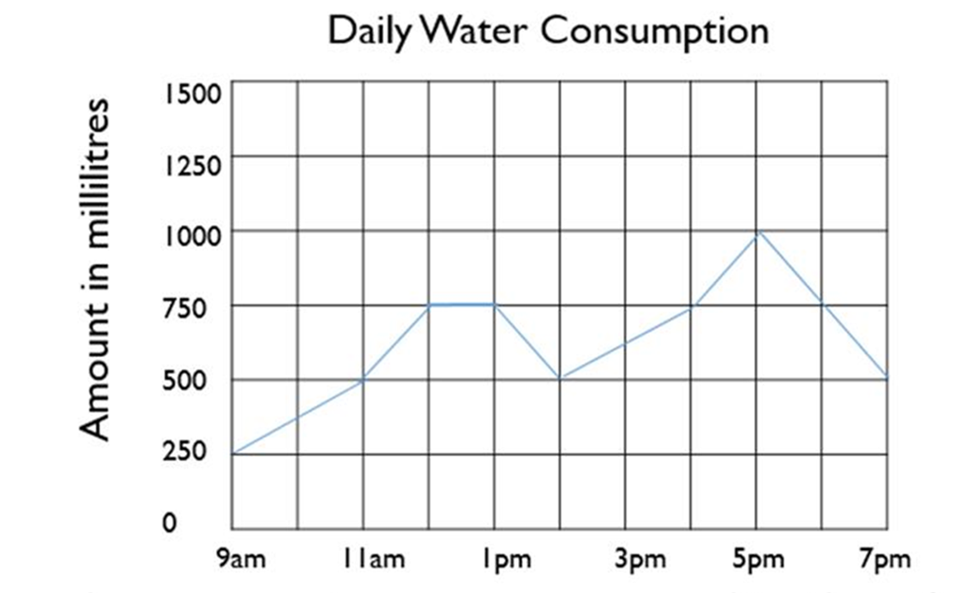
Answer 10 – Line Graphs
How much more water was consumed in the afternoon compared to the morning?
CORRECT ANSWER | CORRECT EXPLANATION
3000 ml | The afternoon begins at 1pm, so we have 750 + 500 + 625 + 750 + 1000 + 750 + 500 = 4875 ml, compared to 250 + 375 + 500 + 750 = 1875 in the morning. Subtracting the two gives 3000 ml.
COMMON MISTAKES | WHAT MIGHT BE YOUR MISTAKE
6750 ml | The student has added the two values, rather than finding the difference.
4875 ml | The student has found the amount of water consumed in the afternoon.
250 ml | The student may have found the difference between the largest value in the morning and the afternoon.

Slide 22
Question 11 – Line Graphs
How far away from home was Rachel at 12:15?

Slide 23
Answer 11 – Line Graphs
How far away from home was Rachel at 12:15?
CORRECT ANSWER | CORRECT EXPLANATION
7500 m | The line between 12:00 and 12:30 is horizontal, so we know that she was 7.5 km away from home. This is 7500m.
COMMON MISTAKES | WHAT MIGHT BE YOUR MISTAKE
0 m | The student may have misunderstood the significance of the flat line.
7.5 m | The student may have ignored the units on the axis.
750 m | The student may believe that 100m = 1km.

Slide 24
Question 12 – Pie Charts
Find the size of the missing Angle (F).

Slide 25
Answer 12 – Pie Charts
Find the size of the missing Angle (F).
CORRECT ANSWER | CORRECT EXPLANATION
135˚ | There are 360 degrees in a circle, so subtracting both 180 and 45 gives the answer.
COMMON MISTAKES | WHAT MIGHT BE YOUR MISTAKE
225˚ | The student has added 45, rather than subtracting.
216˚ | The student has divided by 20, rather than 16 + 4 + 12 = 32.
11.25$˚$ | The student has found the number of degrees for frequency 1. They need to multiply this by 12.

Slide 26
Question 13 – Pie Charts

Slide 27
Answer 13 – Pie Charts
CORRECT ANSWER | CORRECT EXPLANATION
More blue, by 55 | The proportion of diseased blue sheep is 270/360 = 3/4, so we have 3 × 120/4 = 90 blue sheep. Then there are 140/360 × 90 = 7/18 × 90 = 35 diseased yellow sheep.
COMMON MISTAKES | WHAT MIGHT BE YOUR MISTAKE
More blue, by 30 | The student has just subtracted the numbers in the question i.e. 120 - 90.
More blue, by 35 | The student may have used the wrong portions of the pie chart.
More yellow, by 25 | The student may have used the wrong portions of the pie chart.

Slide 28
Question 14 – Scatter graphs

Slide 29
Answer 14 – Scatter Graphs
CORRECT ANSWER | CORRECT EXPLANATION
114 | Find the value of 10 in the general knowledge test. Move across in a straight line that runs parallel to the 𝑥 axis until you get to the line of best fit. Drop down at a right angle to the 𝑥 axis and read off the IQ score.
COMMON MISTAKES | WHAT MIGHT BE YOUR MISTAKE
110 | The student has added 10 to the first value of 100 on the 𝑥 axis.
111 | The student has found the 10th point from the right
121 | The student has found the 10th point from the left

Slide 30
Question 15 – Scatter graphs
Which line is the line of best fit?

Slide 31
Answer 15 – Scatter Graphs
Which line is the line of best fit?
CORRECT ANSWER | CORRECT EXPLANATION
Red | The line of best fit has to follow the pattern of the points as best it can, with approximately half being on top of the line and half underneath. It may not actually end up touching any of the points on the grid. It does not have to pass through (0,0) but sometimes will.
COMMON MISTAKES | WHAT MIGHT BE YOUR MISTAKE
Blue | The student has picked the negative correlation which does not follow the pattern of the points
Green | The student has picked the correlation that runs through the top 3 points.
Purple | The student has assumed the line of best fit needs to run through the origin.

