Slide 1
FM: Advance Trigonometry

Slide 2
Can you write down
the cosine rule for calculating
a side and an angle?
$$a^{2}=b^{2}+c^{2}−2bc\cos{A}$$
$\cos{A}$ = $\frac{a^{2} − b^{2} − c^{2}}{−2bc}$

Slide 3
Can you write down
the sine rule for calculating
a side and an angle?
$\frac{a}{Sin A}=\frac{b}{Sin B}$ $=\frac{c}{sin C}$
$\frac{Sin A}{a}=\frac{Sin B}{b}$ $=\frac{Sin C}{c}$

Slide 4
Cosine Rule:
$$a^{2}=b^{2}+c^{2}−2bc\cos{A}$$
You need two sides either side of an angle.
$$b$$
$$15$$
$$A$$
$$115°$$
$$a$$
$$c$$
$$x$$
$$12$$

Slide 5
Cosine Rule:
$$a^{2}=b^{2}+c^{2}−2bc\cos{A}$$
$$b$$
$$15$$
$$A$$
$$115°$$
$$a$$
$$c$$
$$x$$
$$12$$
$$x^{2}={15}^{2}+{12}^{2}−\left(2×15×12×\cos{115}\right) \\ x^{2}=521.14257… \\ x=22.83$$

Slide 6
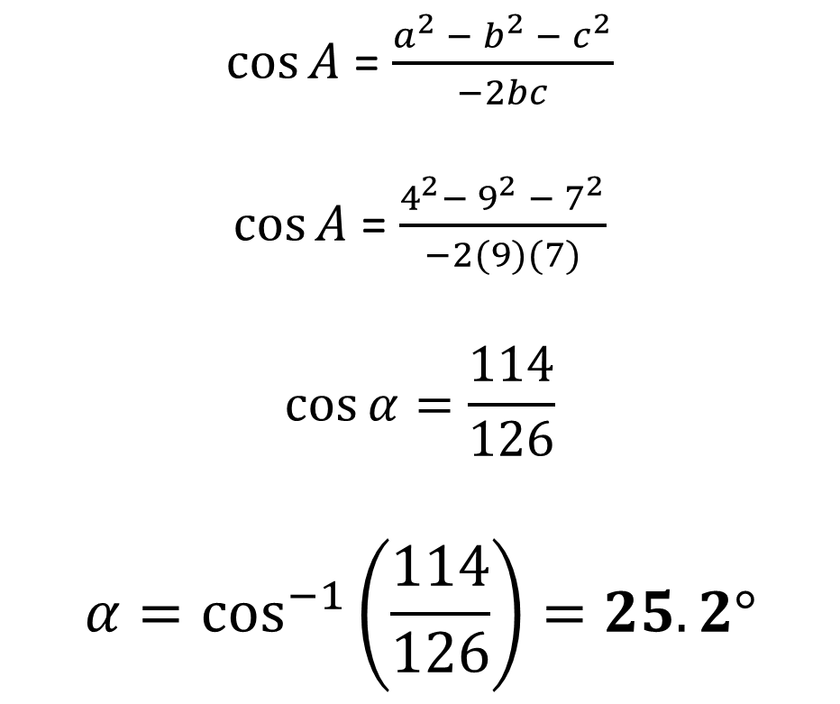
$$a^{2}=b^{2}+c^{2}−2bc\cos{A}$$
$$7$$
$\cos{A}$ = $\frac{a^{2} − b^{2} − c^{2}}{−2bc}$
$\cos{A}$ = $\frac{4^{2}−{ 9}^{2} − 7^{2}}{−2(9)(7)}$
$$\cos{α}=\frac{114}{126}$$
$$α=\cos^{−1}\left(\frac{114}{126}\right)=25.2°$$
$$α$$
$$4$$
$$9$$

Slide 7
Coastguard station $B$ is 8 km,
on a bearing of $060°$, from coastguard station $A$.
A ship $C$ is 4.8 km on a bearing of $018°$, away from $A$.
Calculate how far $C$ is from $B$.
$$N$$
$$C$$
$$a km$$
$$4.8km$$
$$B$$
$$18°$$
$$60°$$
$$8 km$$
$$a^{2}={4.8}^{2}+8^{2}−\left(2×4.8×8×\cos\left(42°\right)\right) \\ a=5.47 (3sf)$$
$C$ is 5.47 km from coastguard station $B$.
$$A$$

Slide 8
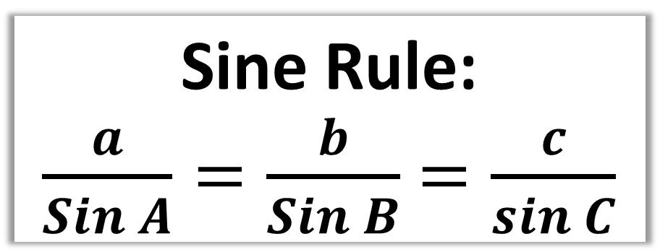
Sine Rule:
$\frac{a}{Sin A}=\frac{b}{Sin B}$ $=\frac{c}{sin C}$
You need two pairs of sides and angles.
$$A$$
$$b$$
8
85°
45°
x
$$a$$
$$B$$

Slide 9
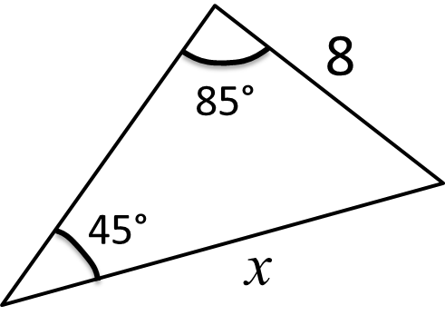
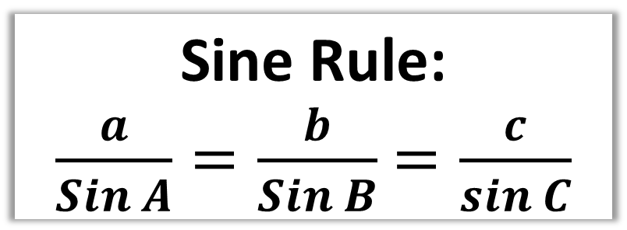
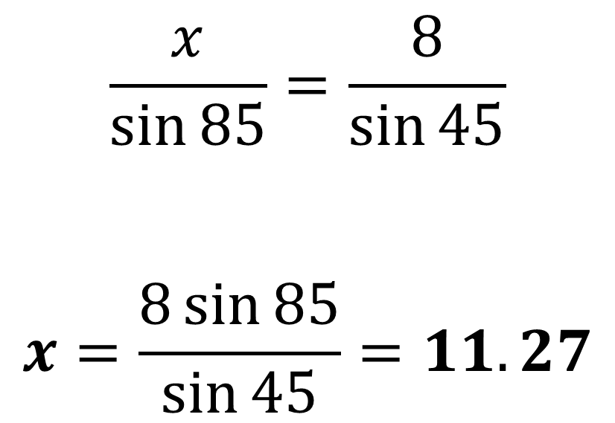
Sine Rule:
$\frac{a}{Sin A}=\frac{b}{Sin B}$ $=\frac{c}{sin C}$
$$\frac{x}{\sin{85}}=\frac{8}{\sin{45}}$$
$$x=\frac{8\sin{85}}{\sin{45}}=11.27$$

Slide 10
Sine Rule:
$\frac{Sin A}{a}=\frac{Sin B}{b}$ $=\frac{Sin C}{c}$
$$\frac{\sin{θ}}{5}=\frac{\sin{85}}{6}$$
$$\sin{θ}=\frac{5\sin{85}}{6}$$
$$θ=\sin^{−1}\left(\frac{5\sin{85}}{6}\right)$$
$$θ=56.11°$$

Slide 11
The ‘Special Case’
$$A$$
Watch out for a special case where the calculator will only give one of two answers.
$$4$$
$$3$$
$$3$$
The clue in the question will be that they are asking for the acute or obtuse angle.
$$44°$$
$$B$$
$$C_{1}$$
$$C_{2}$$
Your calculator will give the acute angle ($C_{2}$).
However it could be the obtuse angle ($C_{1}$) needed.

Slide 12
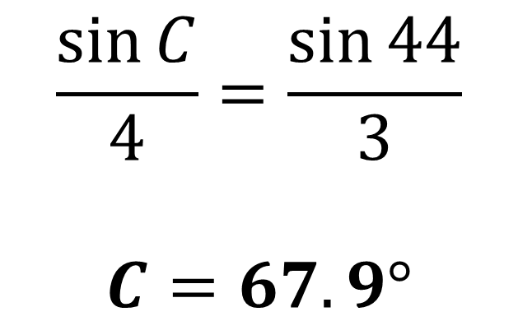
$$A$$
$AB=4$, $AC=3$ and $∠ABC=44°$
What obtuse angle is $∠ACB$?
$$4$$
$$\frac{\sin{C}}{4}=\frac{\sin{44}}{3}$$
$$C=67.9°$$
$$3$$
$$3$$
$$44°$$
$$B$$
$$C_{1}$$
$$C_{2}$$
The obtuse angle needed is
$C=180 − 67.9°$ = 112.1$°$

Slide 13
Area = $\frac{1}{2}a b\sin{C}$
where $C$ is the angle between two sides $a$ and $b$.
3cm
Area = 0.5 x 3 x 7 x sin(59)
= 9.00cm²
59°
7cm

