Slide 1
LO: Volume of Cuboids

Slide 2
What is volume?
The space taken up by a 3D shape.

Slide 3
How is volume measured?
The volume is counted by the number of cubes
that can be fitted inside the shape.

Slide 4
What units are used to measure volume?
cm³, m³, km³ etc.

Slide 5
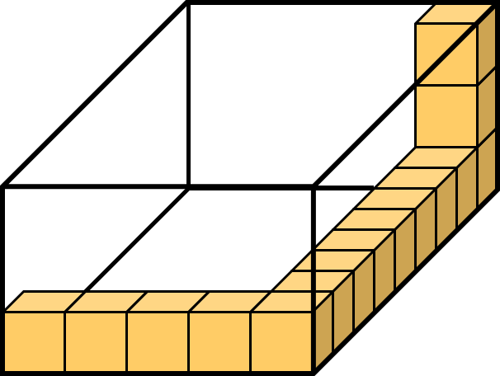
How many cubes can you fit into the box?
136 Cubes

Slide 6
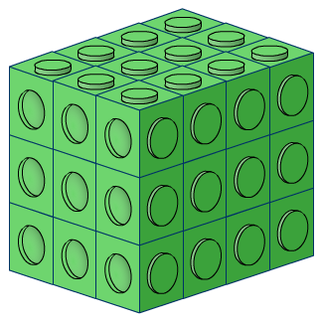
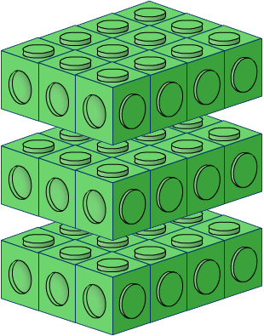
How many cubes?
12 cubes
12 cubes
12 cubes
36 cubes

Slide 7
Find the Volume of the Cuboid.
4m
6m
2m
Volume = 4 x 2 x 6 = 48 m³

Slide 8
Find the Volume of the Cuboid.
5mm
6cm
2mm
Volume = 5 x 2 x 60 = 600 mm³

Slide 9
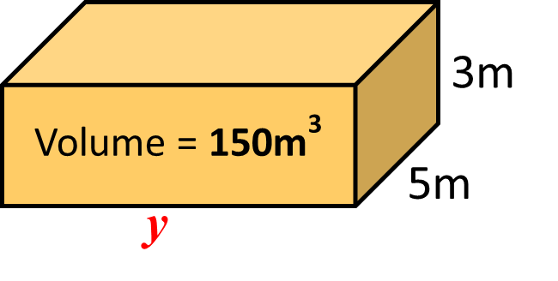
What is the length of the missing side?
y = 150 ÷ 15 = 10m

Slide 10
What is the length of the missing side?
y = 90 ÷ 12 = 7.5m

Slide 11
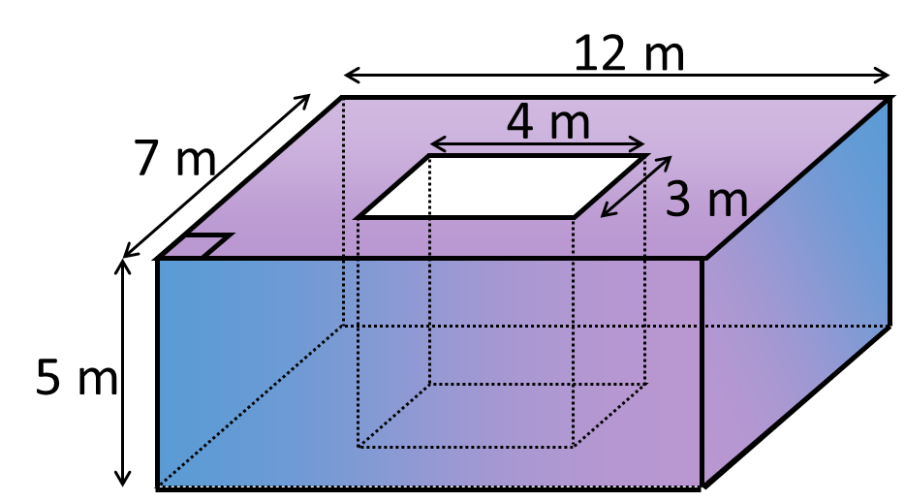
Calculate the volume of the shape.
Volume = 420 – 60 = 360m³

Slide 12
What is the volume of the shape?
Area A
= 10 x 6 x 20 = 1200 cm²
Volume B
= 10 x 3 x 20 = 600 cm²
6cm
3cm
A
13cm
B
20cm
Volume
= 1200 + 600
= 1800 cm³
10cm

