Slide 1
LO: Surface Area of Prisms

Slide 2
Is it a prism?
No

Slide 3
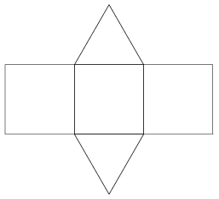
Is it a prism?
No

Slide 4
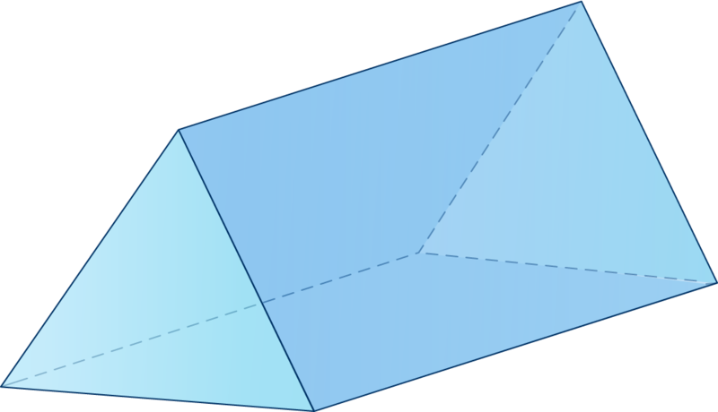
Is it a prism?
Yes

Slide 5
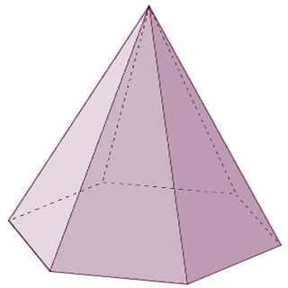
Is it a prism?
No

Slide 6
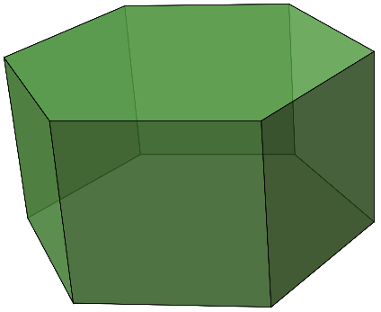
Is it a prism?
Yes

Slide 7
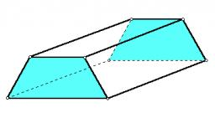
Is it a prism?
Yes

Slide 8
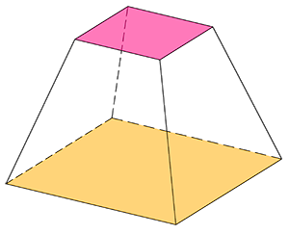
Is it a prism?
No

Slide 9
Is it a prism?
Yes

Slide 10
Discuss in pairs
and come up with a definition for a prism.
Prism is a 3D shape
which has a constant cross section.

Slide 11
What is meant by surface area?
Surface Area is the area
that covers a 3D shape.

Slide 12
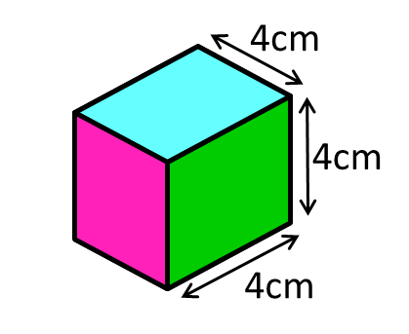
What 2D shapes (and how many)
make up the net of a cube?
6 Squares

Slide 13
What 2D shapes (and how many)
make up the net of a cuboid?
4 Rectangles
2 Squares

Slide 14
5cm
What 2D shapes (and how many)
make up the net of a cuboid?
6 Rectangles

Slide 15
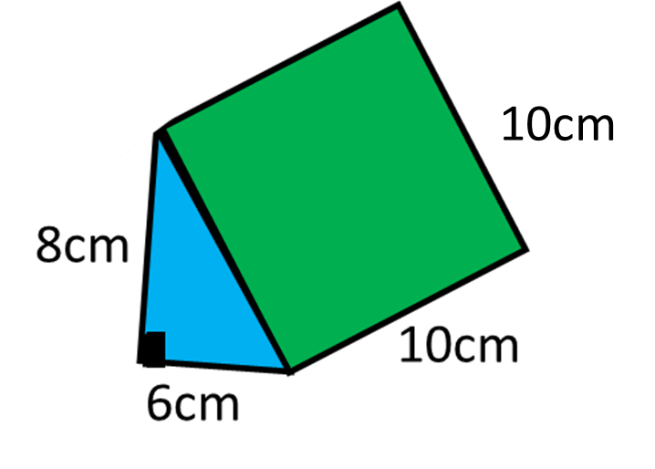
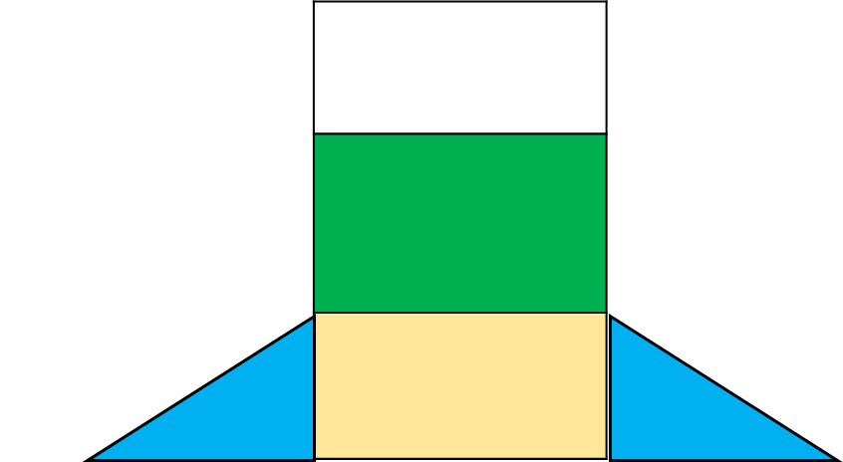
What 2D shapes (and how many)
make up the net of a triangular prism?
2 Triangles
2 Rectangles
1 Square

Slide 16
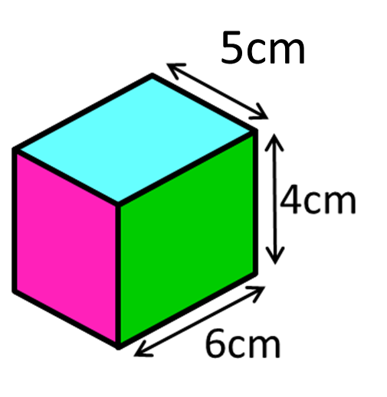
What is the Total Surface Area?
 | 30
 | 24
 | 30
20 | 24 | 20
148 cm²

Slide 17
What is the Total Surface Area?
60
288 cm²
100
80
24
24

