Slide 1
LO: Stem-and-Leaf Diagrams

Slide 2
A stem-and-leaf diagram can be used to display data items in order.
Stem (Tens)
Leaf (Units)
Key:
0
2
4
5
Stem
Leaf
=
14
1
4
1
3
3
7
8
9
2
0
1
4
5
3
2
7

Slide 3
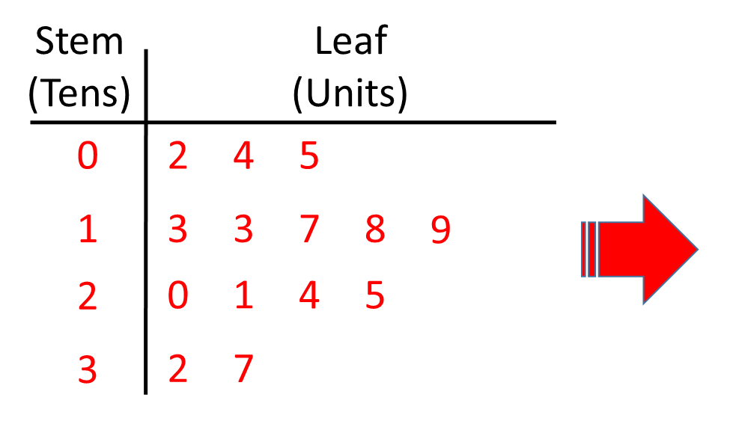

Slide 4
Back to back stem-and-leaf diagram
can be used to compare data.

Slide 5
14
37
35
13
18.5

Slide 6
27
27
17
21

