Slide 1
LO: Solving Simultaneous
Equations Graphically

Slide 2
x + y = 5
2x + y = 6
What x and y value works
for both equation?

Slide 3
1 + 4 = 5
2(1) + 4 = 6
x = 1 and y = 4

Slide 4
Rather than
trial and improvement
can find the answers
from potting the graphs?

Slide 5
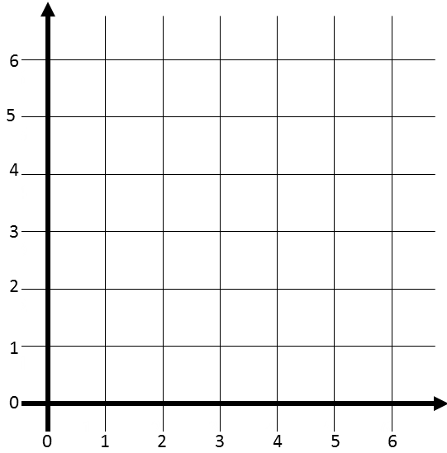
What is an easy way to plot x + y = 5?
5
(0, ?)
(0, 0)
5

Slide 6
What is an easy way to plot 2x + y = 6?
(0, ?)
6
(0, 0)
3

Slide 7
The solutions can be found from the co-ordinate
of intersection.
2x + y = 6
(1, 4)
x + y = 5
x = 1 y = 4

Slide 8
How many points of intersection
can you have with
a quadratic graph and
a linear graph?
0, 1 or 2

Slide 9
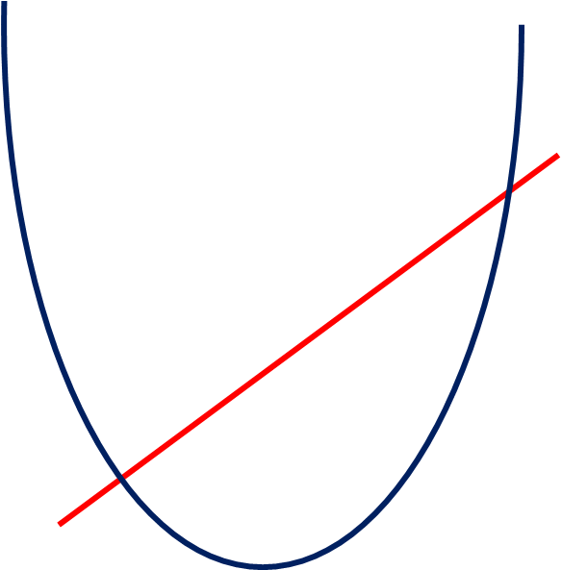
Two points of intersection

Slide 10
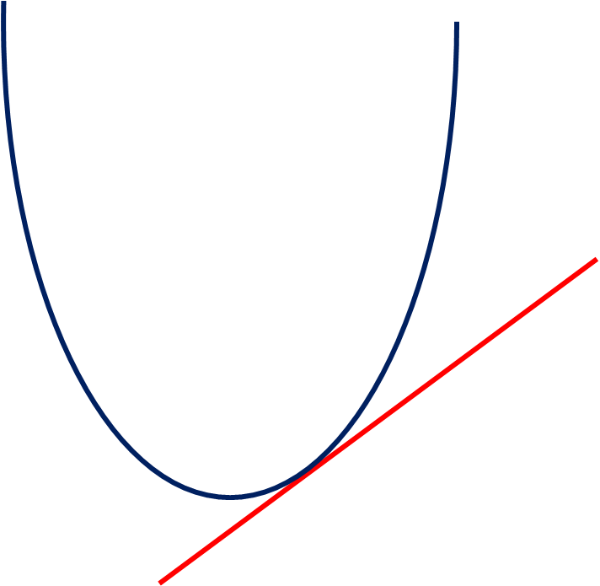
One point of intersection

Slide 11
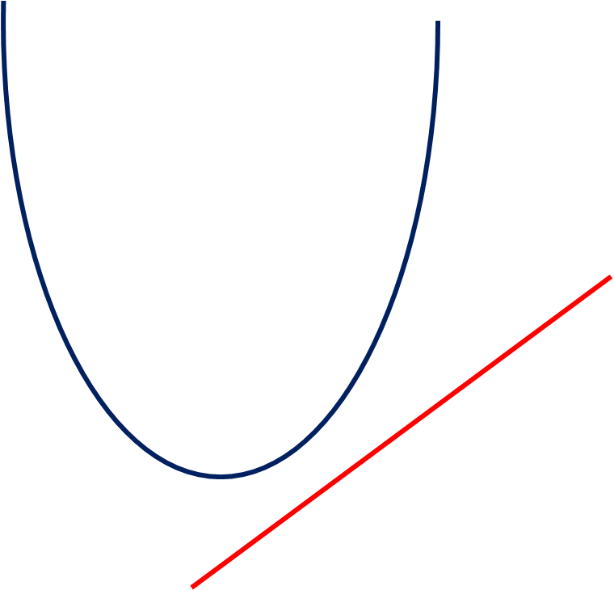
No points
of intersection

Slide 12
What are solution for
y = x² – 2
y = x
x = -1 and y = -1
x = 2 and y = 2

