Slide 1
LO: Sharing Amounts in a Ratio

Slide 2
Mr. Gale and Mr. Almond
go into business together.
Mr. Gale does twice as many hours work
than Mr. Almond!
Should they get paid the same?

Slide 3
What ratio of money
should they get if
Mr Gale does twice as much work?
2:1

Slide 4
If they earn £12 pounds.
How much should they get each?
£8
£4

Slide 5
If they earn £12 pounds.
How much should they get each?
Step 1
Add the ratio
2 + 1 = 3
Step 2
Divide the money
$\frac{12}{3}$ = 4
Step 3
Multiple the ratio
2:1
8:4

Slide 6
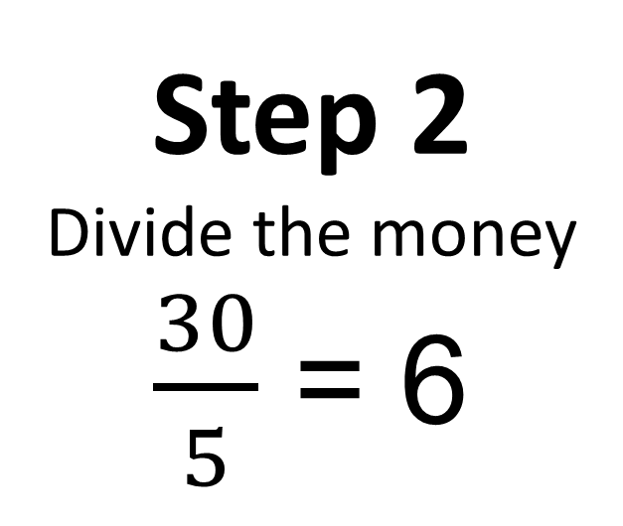
Share £30 in the ratio 2:3
Step 1
Add the ratio
2 + 3 = 5
Step 2
Divide the money
$\frac{30}{5}$ = 6
Step 3
Multiple the ratio
2:3
12:18

