Slide 1
LO: Area
of a Sector

Slide 2
O
A sector is a slice of a circle.

Slide 3
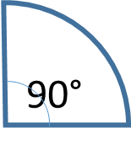
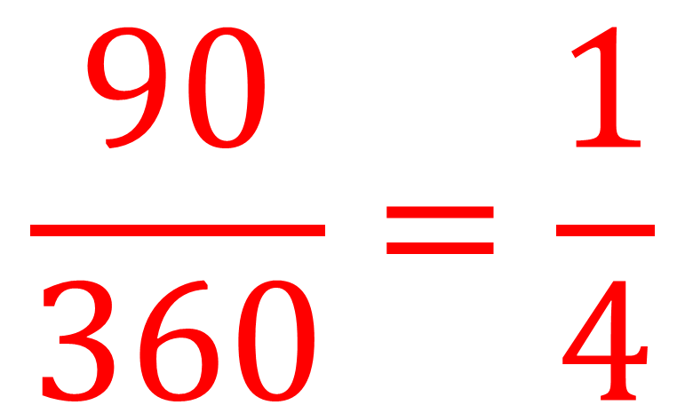
What is the fraction of the circle?
$$\frac{90}{360}=\frac{1}{4}$$

Slide 4
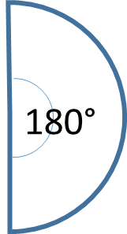
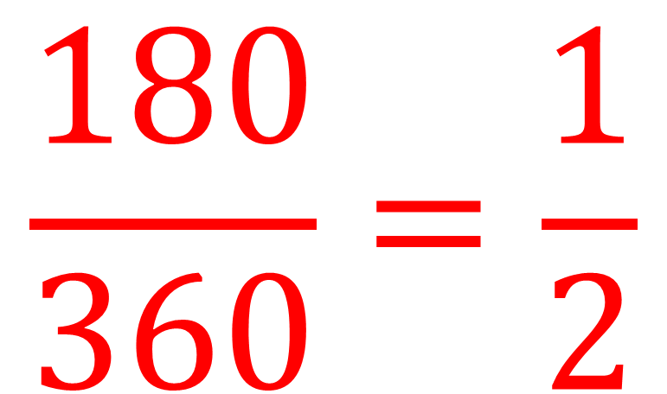
What is the fraction of the circle?
$$\frac{180}{360}=\frac{1}{2}$$

Slide 5
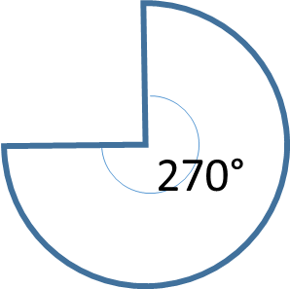
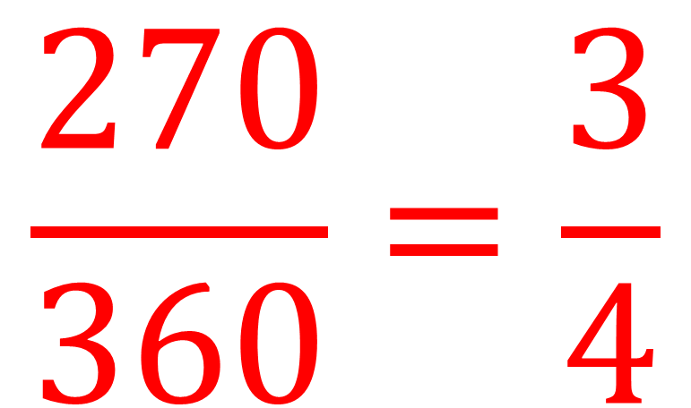
What is the fraction of the circle?
$$\frac{270}{360}=\frac{3}{4}$$

Slide 6
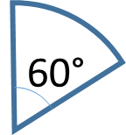
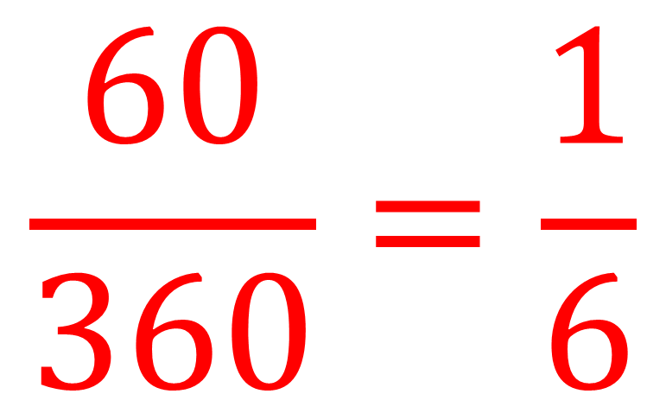
What is the fraction of the circle?
$$\frac{60}{360}=\frac{1}{6}$$

Slide 7
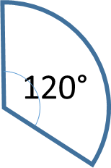
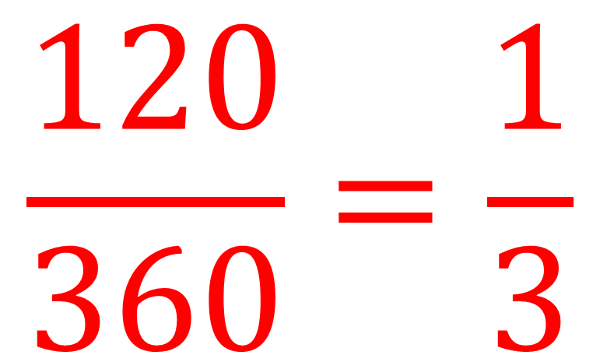
What is the fraction of the circle?
$$\frac{120}{360}=\frac{1}{3}$$

Slide 8
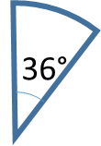
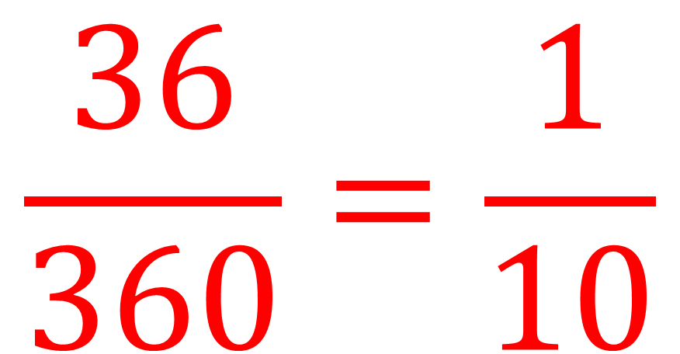
What is the fraction of the circle?
$$\frac{36}{360}=\frac{1}{10}$$

Slide 9
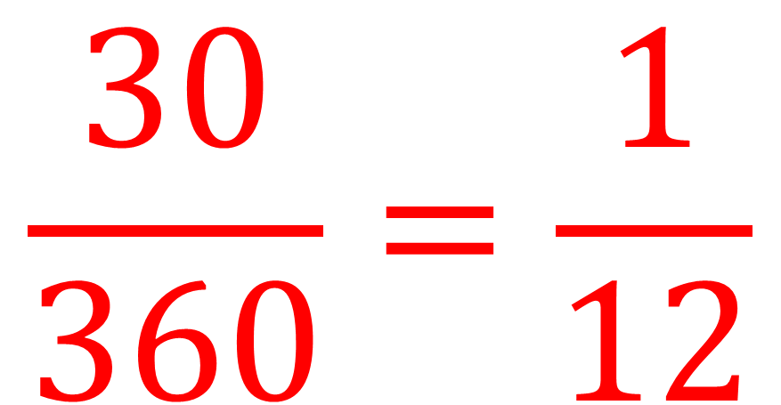
What is the fraction of the circle?
$$\frac{30}{360}=\frac{1}{12}$$

Slide 10
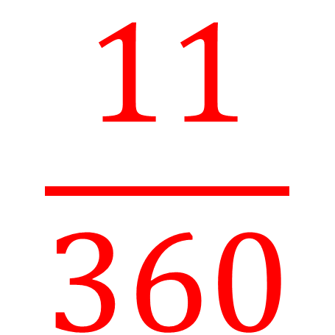
What is the fraction of the circle?
$$\frac{11}{360}$$
11°

Slide 11
Area =
πr²
Full Circle

Slide 12
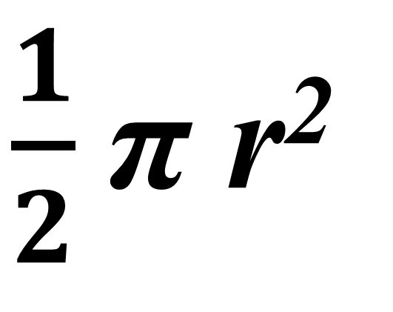
πr²
180°
$\frac{1}{2}$π r²
Area =

Slide 13
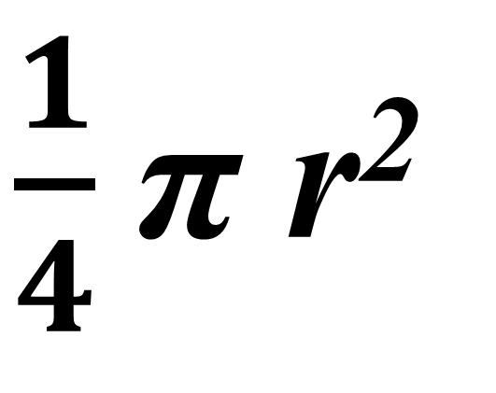
πr²
90°
$\frac{1}{4}$π r²
Area =

Slide 14
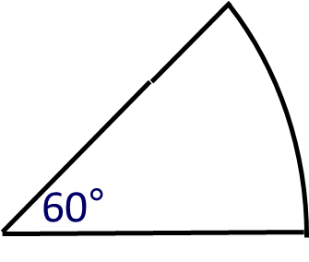
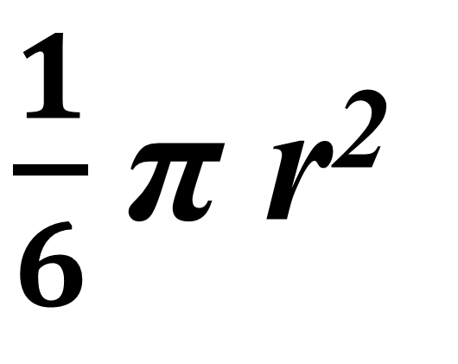
πr²
$\frac{1}{6}$π r²
Area =

Slide 15
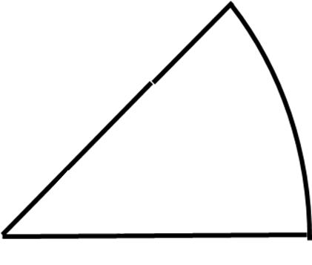
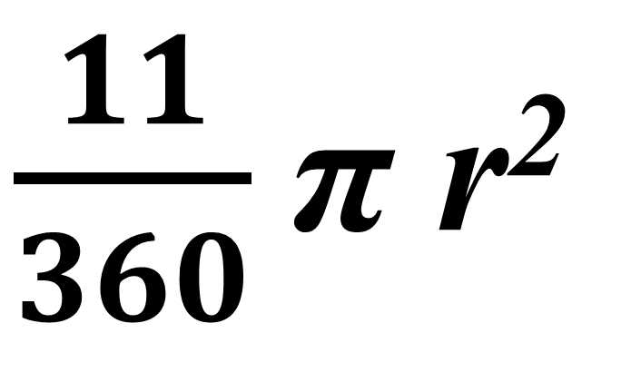
πr²
11˚
$\frac{11}{360}$π r²
Area =

Slide 16
Write a formula for calculating the area of a sector.
r
θ
θ
Area of sector =
× πr²
360

Slide 17
What is the area of the sector?
Give you answer to 1dp
Area = $\frac{\text{60}}{\text{360}}\text{π}$5²
5 cm
Area = 13.1 ${cm}^{2}$

Slide 18
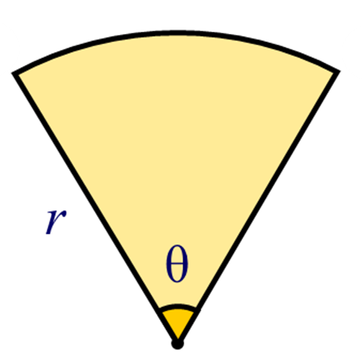
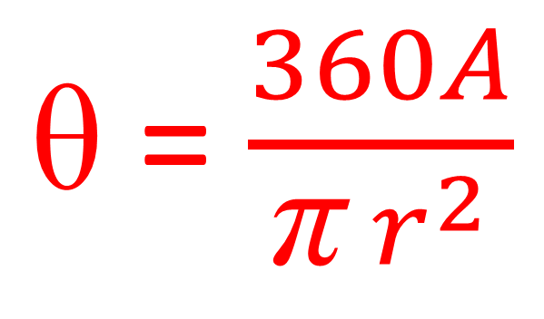
Area = $\frac{\text{θ}}{\text{360}}\text{π}$r²
What is the formula to find
the angle of the sector?
$\text{θ}$ = $\frac{360A}{\text{π}{ r}^{2}}$

Slide 19
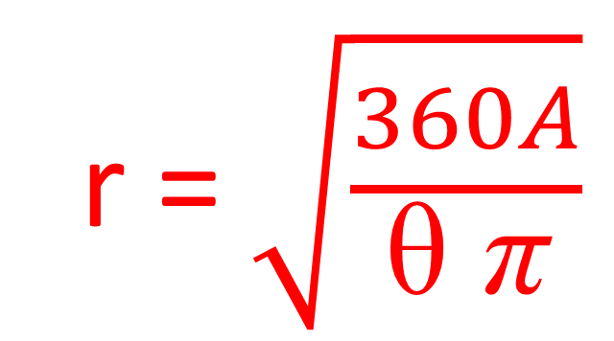
Area = $\frac{\text{θ}}{\text{360}}\text{π}$r²
What is the formula to find
the radius of the sector?
r = $\sqrt{\frac{360A}{\text{θ} \text{π}}}$

Slide 20
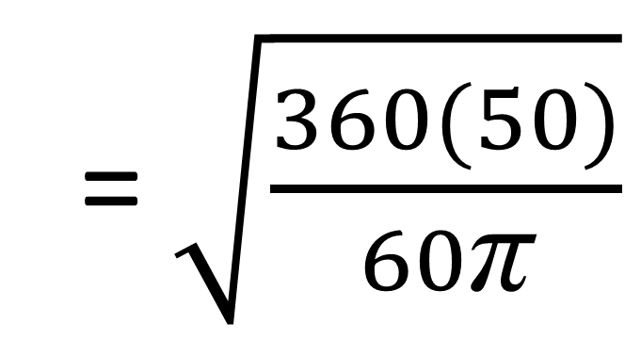
What is the radius of the sector?
Give you answer to 1dp
= $\sqrt{\frac{360(50)}{60\text{π}}}$
r
= 9.8 cm
Area = 50 cm²

Slide 21
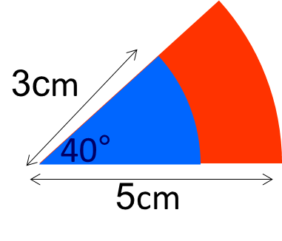
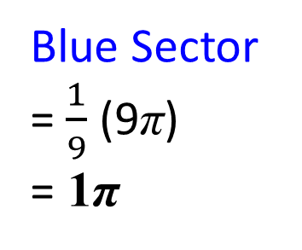
Find the area of the red shaped part of the shape.
Blue Sector
= $\frac{1}{9}$ (9π)
= 1π
Red Sector
= $\frac{1}{9}$ (36π)
= 4π
6cm
Red Shape
= 4π - 1π
= 3π

