Slide 1
LO: Relative
Frequency

Slide 2
What is theoretical
probability?
What is experimental probability?

Slide 3
Theoretical or Experimental
The probability of getting three heads in a row.
Theoretical

Slide 4
Theoretical or Experimental
The probability of it raining tomorrow.
Experimental

Slide 5
Theoretical or Experimental
The probability of
the next car being red.
Experimental

Slide 6
Theoretical or Experimental
The probability of rolling consecutive sixes.
Theoretical

Slide 7
The dice is biased.
What is the probability
of rolling a 5?

Slide 8
Roll the dice and record the
Relative Frequency
of each number.

Slide 9






Number | Frequency | Relative Frequency
1
2
3
4
5
6
12
3
5
7
5
18
$$\frac{12}{50}$$
$$\frac{3}{50}$$
$$\frac{5}{50}$$
$$\frac{7}{50}$$
$$\frac{5}{50}$$
$$\frac{18}{50}$$

Slide 10
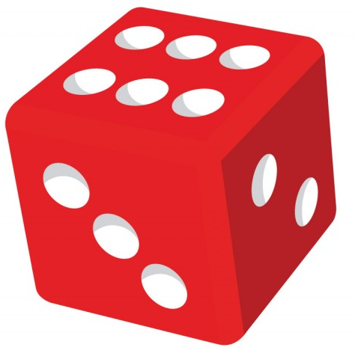
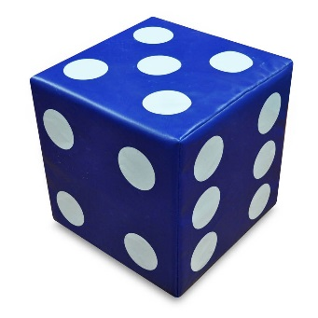
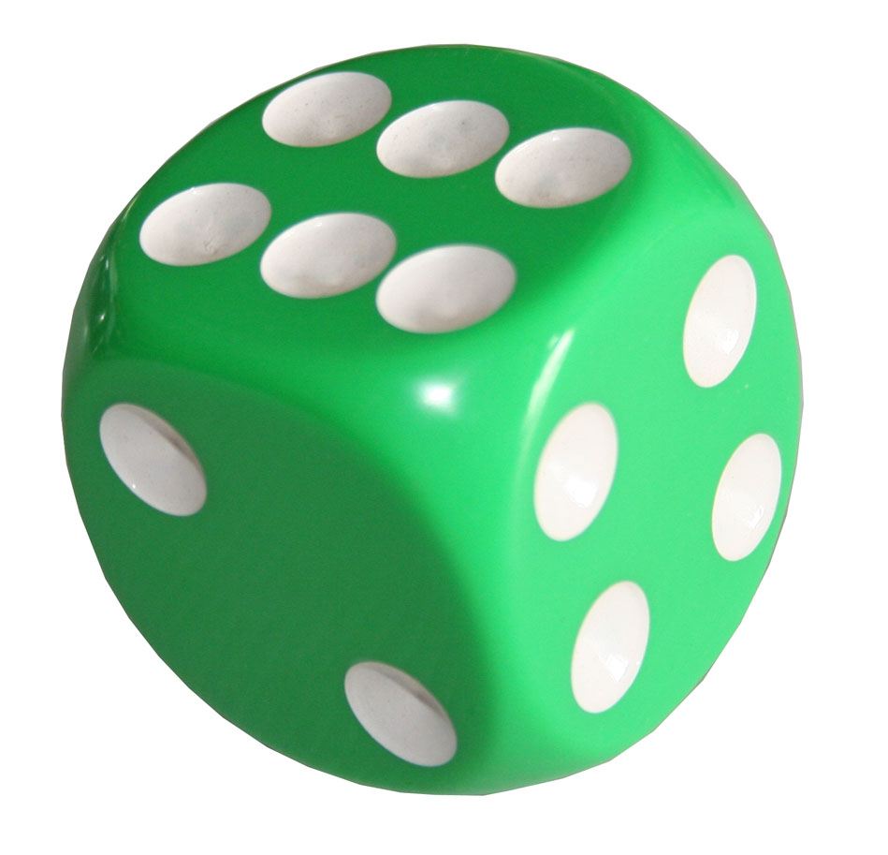
If you roll three different dice 60 times.
What can you say about each dice?
Even
Odd
28
32
Even
Odd
0
60
Even
Odd
20
40

Slide 11
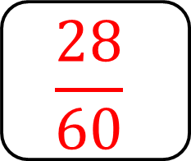
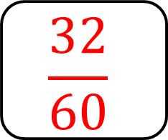
What is the experimental probability
(relative frequency)
for even and odd of the dice?
Even
Odd
Frequency
28
32
$$\frac{28}{60}$$
$$\frac{32}{60}$$
Relative Frequency

Slide 12
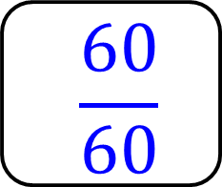
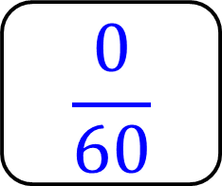
What is the experimental probability
(relative frequency)
for even and odd of the dice?
Even
Odd
Frequency
0
60
$$\frac{0}{60}$$
$$\frac{60}{60}$$
Relative Frequency

Slide 13
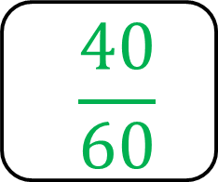
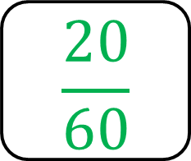
What is the experimental probability
(relative frequency)
for even and odd of the dice?
Even
Odd
Frequency
20
40
$$\frac{20}{60}$$
$$\frac{40}{60}$$
Relative Frequency

Slide 14
Relative Frequency is
a probability from an experiment.

