Slide 1
LO: Reciprocal
Graphs

Slide 2
Can you give an example of a reciprocal equation?

Slide 3
Is this an equation of a reciprocal graph?
y = $\frac{1}{x}$

Slide 4
Is this an equation of a reciprocal graph?
y = $\frac{3}{x}$

Slide 5
Is this an equation of a reciprocal graph?
y = $\frac{3x}{x}$

Slide 6
Is this an equation of a reciprocal graph?
y = $\frac{x}{3}$

Slide 7
Is this an equation of a reciprocal graph?
y = $\frac{3}{x+1}$

Slide 8
Is this an equation of a reciprocal graph?
y = $\frac{x+1}{3}$

Slide 9
Is this an equation of a reciprocal graph?
yx = 1

Slide 10
The equation of a reciprocal graph will be a fraction with the
x value in the denominator.
y = $\frac{3}{x+1}$
y = $\frac{1}{x}$
y = $\frac{−2}{x}$
y = $\frac{1}{x+1}$
y = $\frac{2}{x}$
y = $\frac{1}{x−1}$

Slide 11
Can you sketch a reciprocal graph?

Slide 12
Do the two sections of the graph connect?
No
A reciprocal graph
is made of two sections that never meet.

Slide 13
What is one
divide by zero?
∞

Slide 14
Why do the two sections of the graph not connect?
$$\frac{1}{0}=∞$$

Slide 15
What are the names of the dotted lines?
The lines that split
the two sections are called asymptotes.

Slide 16
Does the graph ever touch the asymptotes?
No

Slide 17
What are the equations of the two asymptotes?
x = -1
y = 0

Slide 18
What are the equations of the two asymptotes?
x = 2
y = 0

Slide 19
What are the equations of the two asymptotes?
x = 2
y = 0

Slide 20
What are the equations of the two asymptotes?
x = 2
y = 1

Slide 21
Plotting the graph of y = $\frac{1}{x}$
x | -3 | -2.5 | -2 | -1.5 | -1 | -0.5 | 0 | 0.5 | 1 | 1.5 | 2 | 2.5 | 3
y |  |  |  |  |  |  | ∞
-0.3
-0.4
-0.5
-0.7
-1
-2
2
1
0.7
0.5
0.4
0.3
Join with a smooth curve.

Slide 22
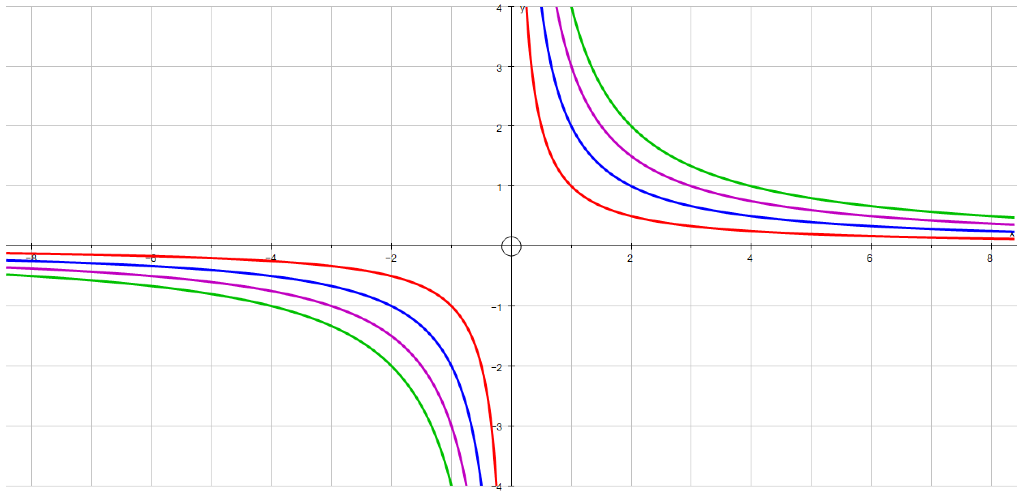
Which equation goes with which graph?
$y= \frac{1}{x}$
$y= \frac{2}{x}$
$y= \frac{3}{x}$
$y= \frac{4}{x}$

Slide 23
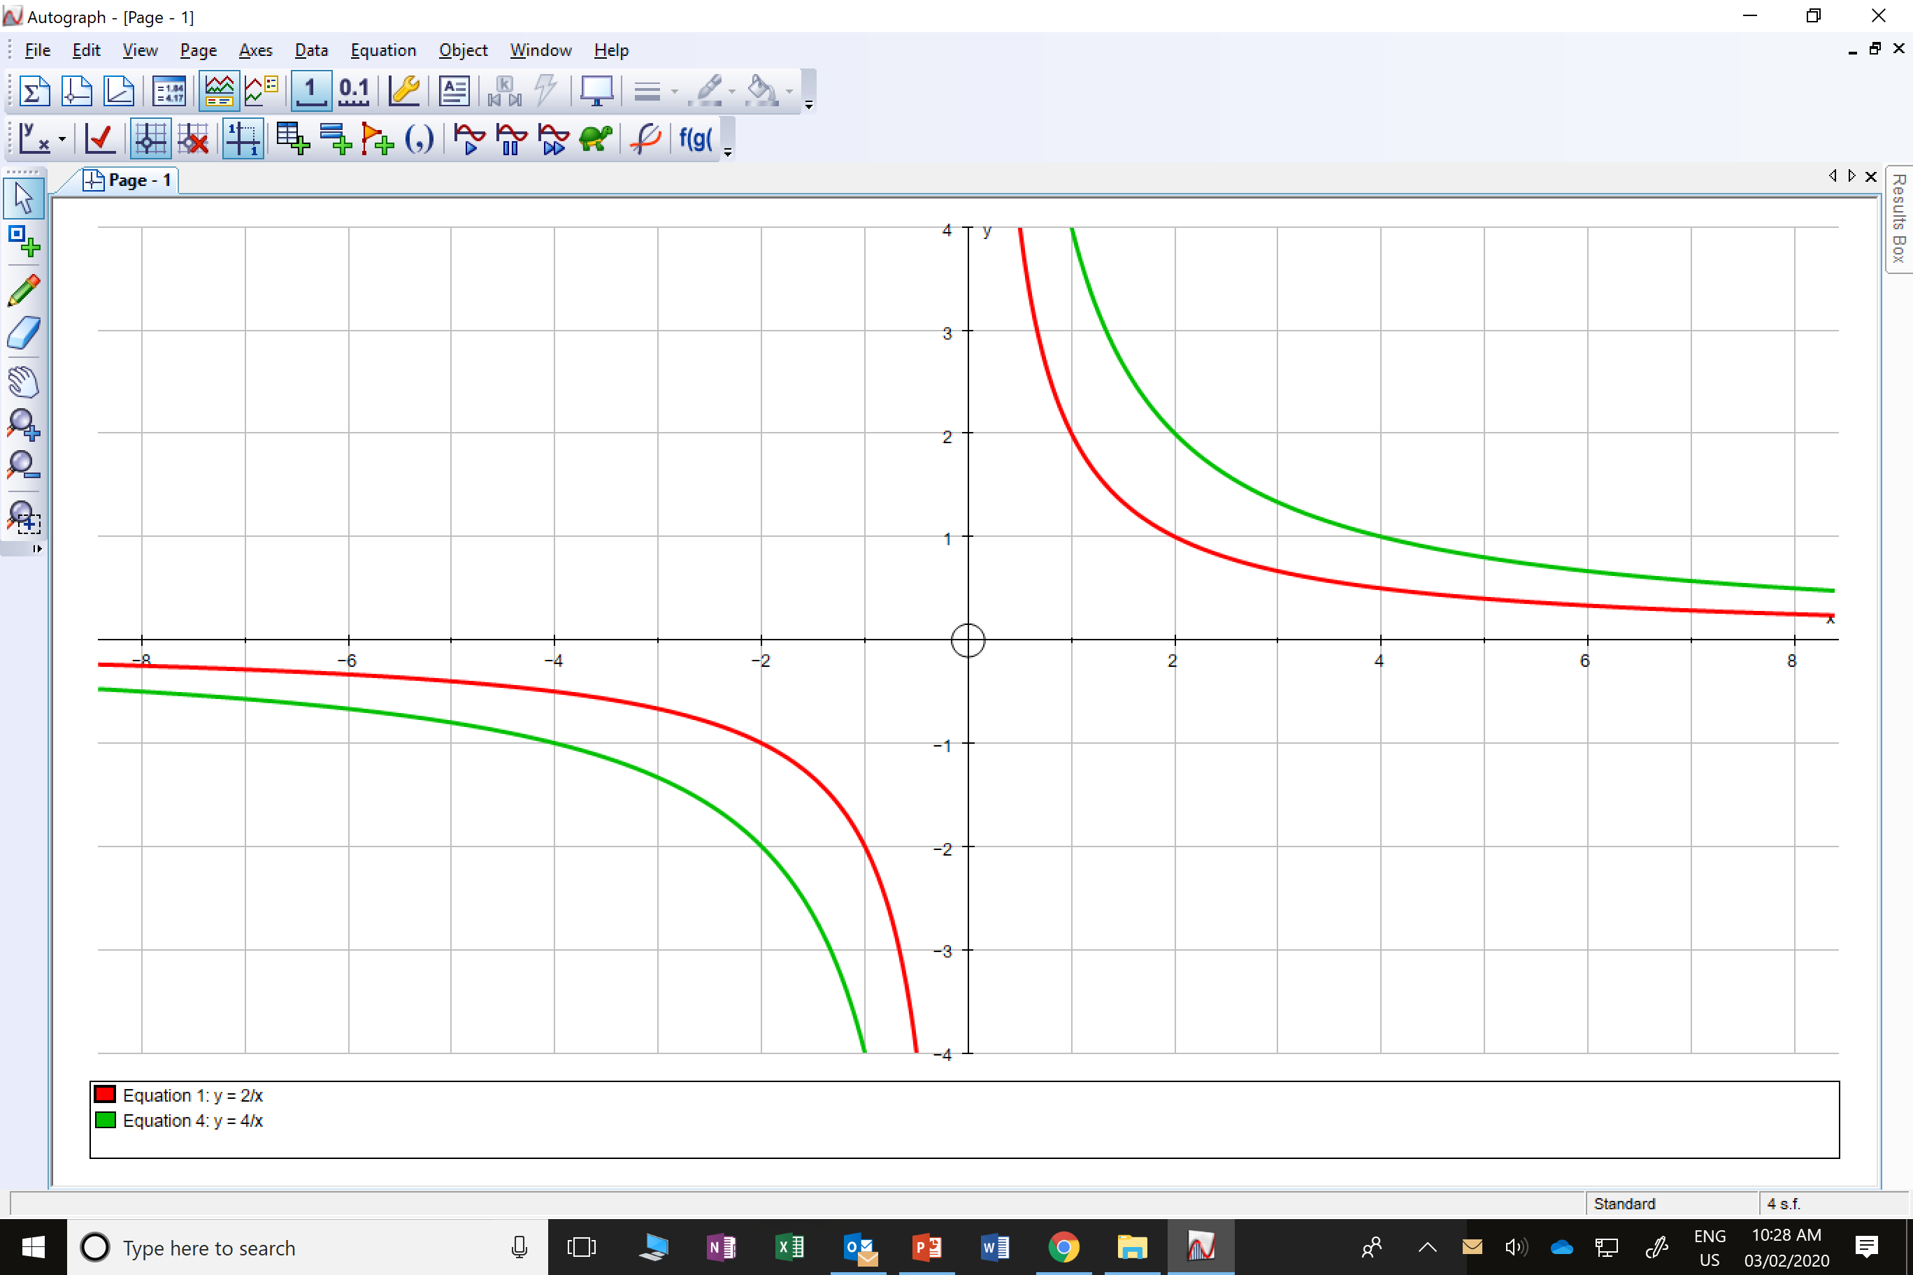
Which equation goes with which graph?
$y= \frac{4}{x}$
$y= \frac{2}{x}$

Slide 24
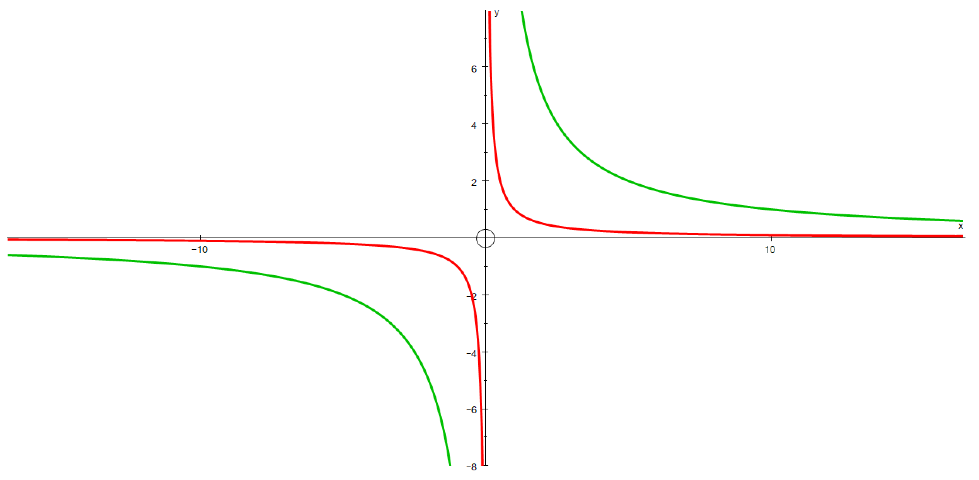
Which equation goes with which graph?
$y= \frac{1}{x}$
$y= \frac{10}{x}$

Slide 25
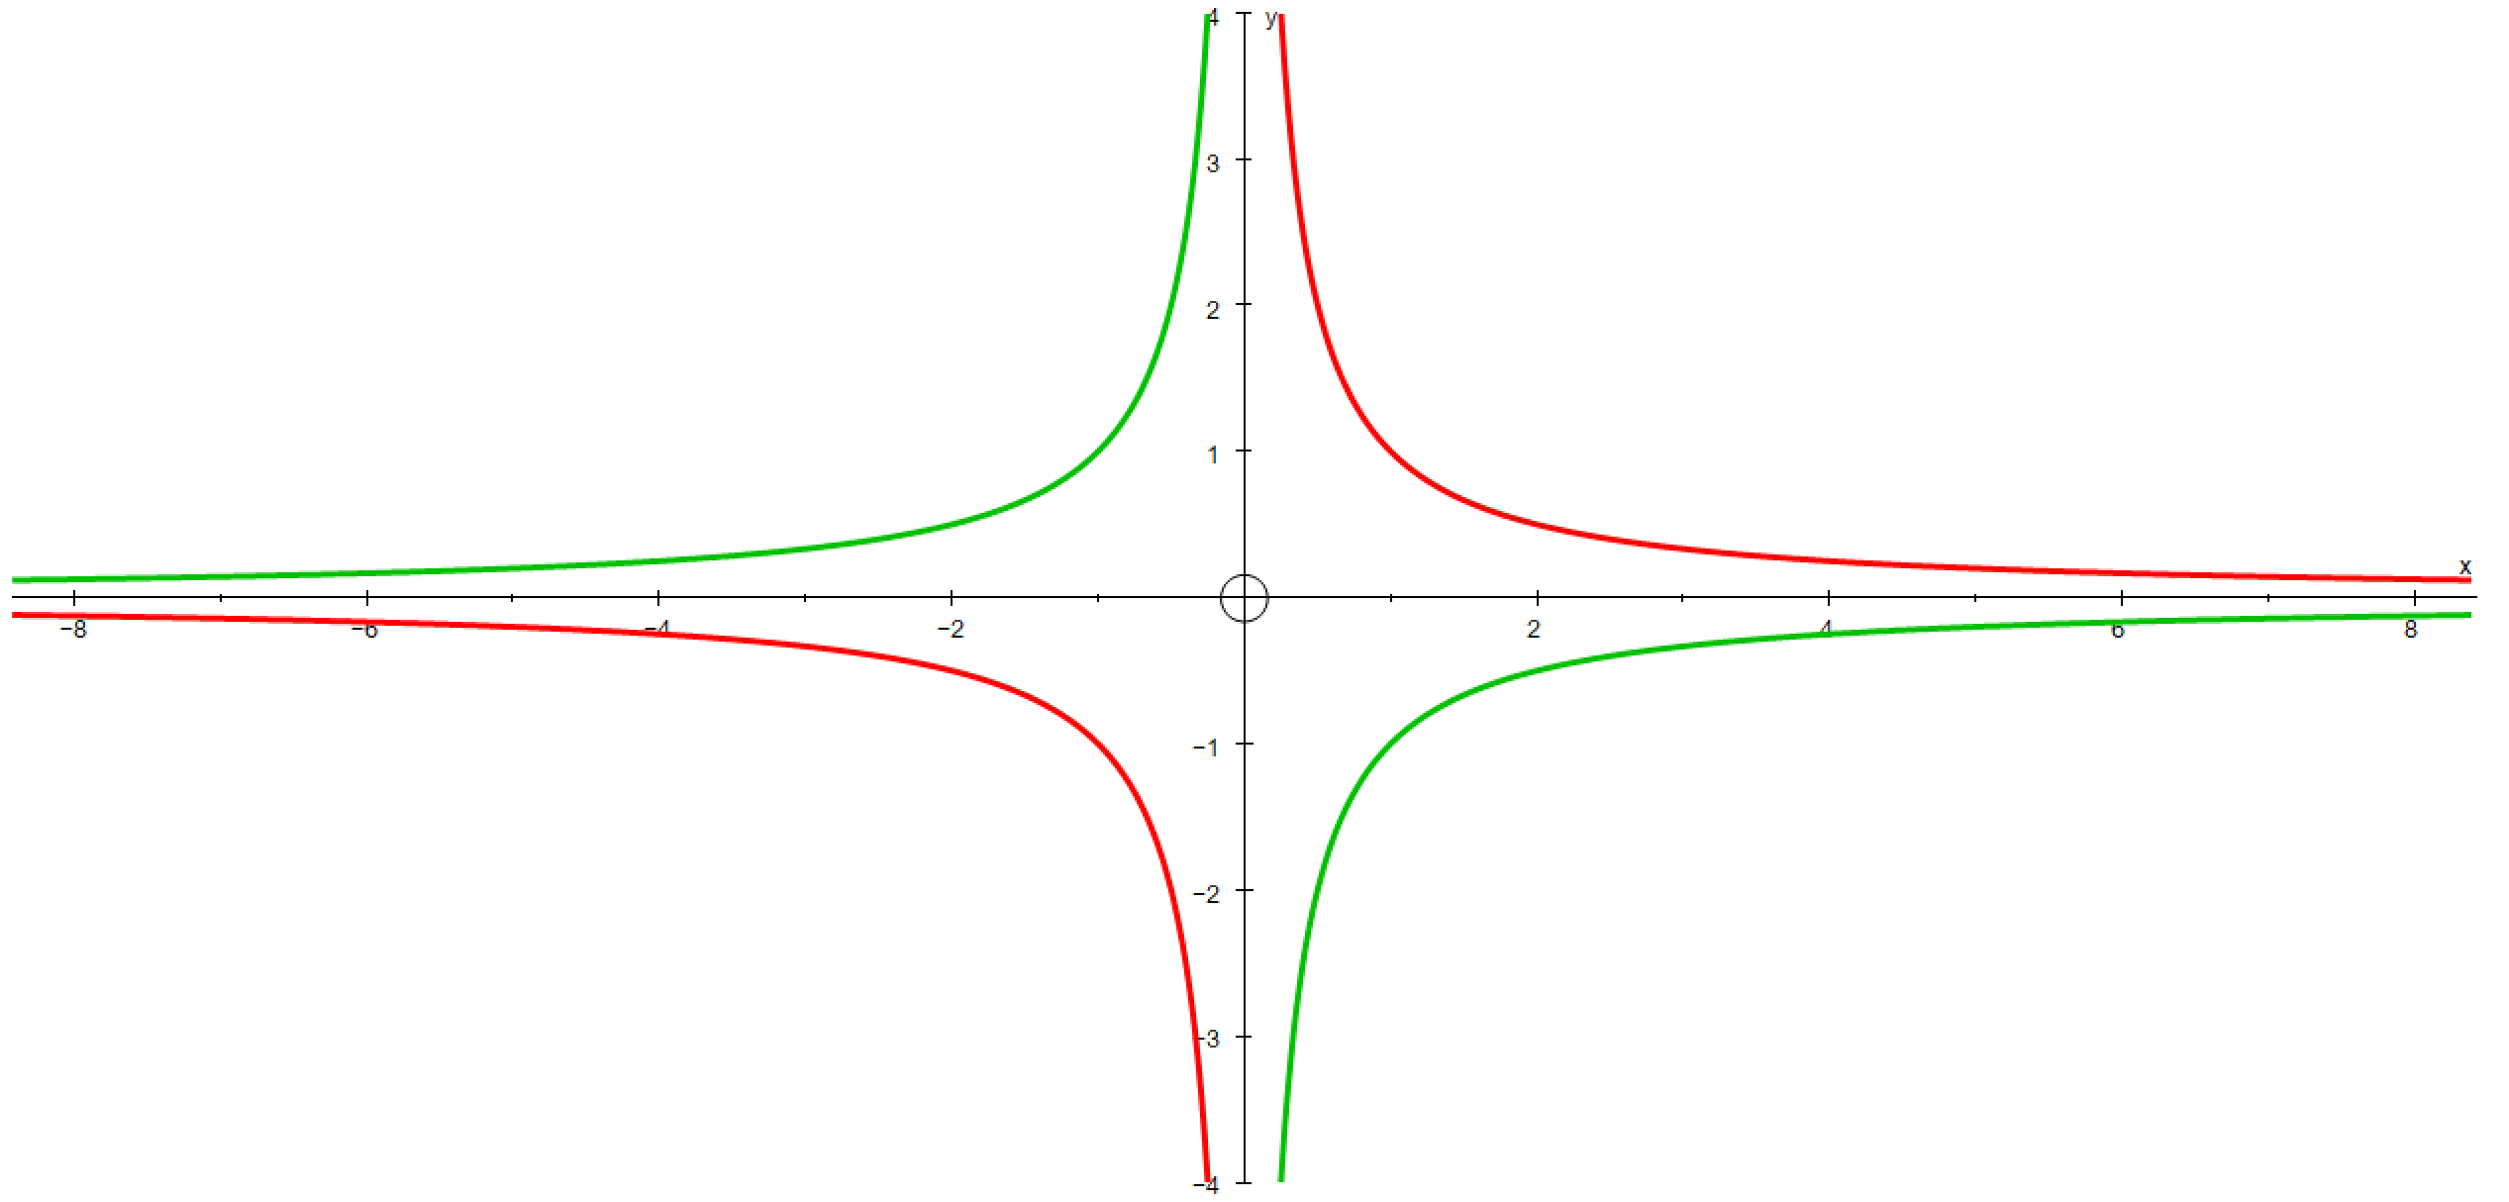
Which equation goes with which graph?
$y= \frac{−1}{x}$
$y= \frac{1}{x}$

Slide 26
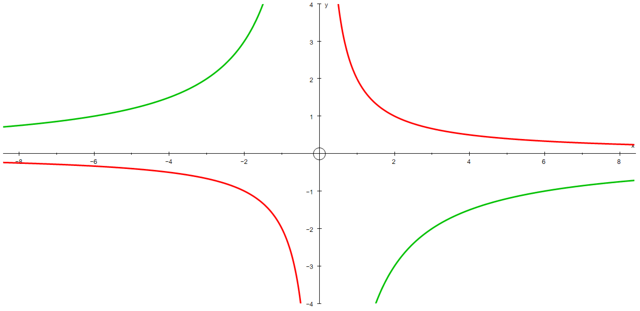
Which equation goes with which graph?
$y= \frac{−6}{x}$
$y= \frac{2}{x}$

