Slide 1
LO: Quadratic Sequences

Slide 2
What is the nth term?
2, 5, 8, 11, 14….
3n – 1

Slide 3
What is the nth term?
7, 9, 11, 13, 15….
2n + 5

Slide 4
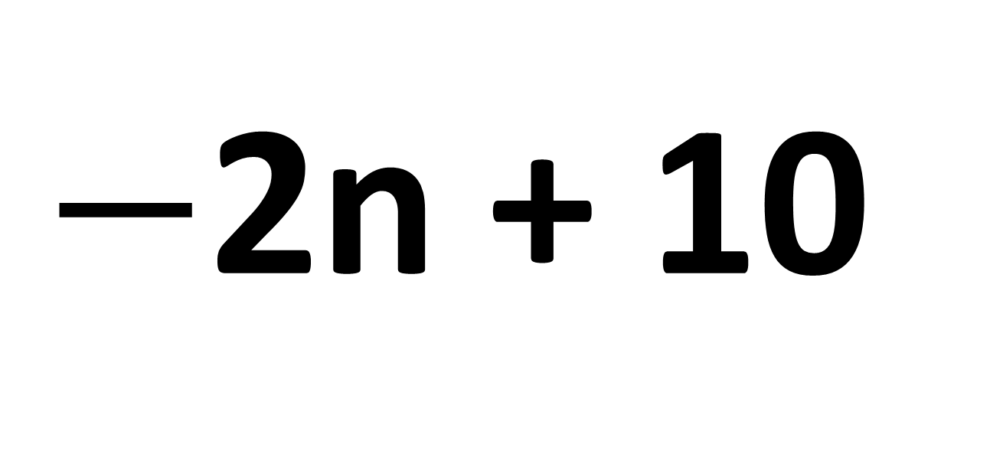
What is the nth term?
8, 6, 4, 2, 0….
$−$2n + 10

Slide 5
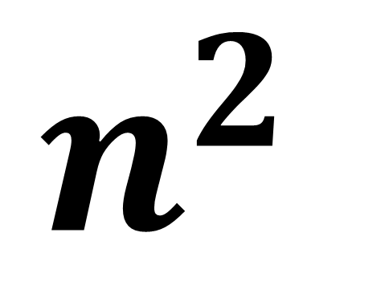
What is the nth term?
1, 4, 9, 16, 25……
$$n^{2}$$

Slide 6
How can you identify that this is a quadratic sequence?
1, 4, 9, 16, 25, 36…….
The second differences are the same

Slide 7
How can you identify that this is not a linear sequence?
1, 4, 9, 16, 25, 36…….
The first differences are not the same

Slide 8
1, 4, 9, 16, 25, 36…….
If the second differences are the same then you have a Quadratic Sequence.

Slide 9
Quadratic Sequence or Linear
3 | 12 | 27 | 48 | 75
Quadratic

Slide 10
Quadratic Sequence or Linear
3 | 6 | 11 | 18 | 27
Quadratic

Slide 11
Quadratic Sequence or Linear
3 | 7 | 11 | 15 | 19
Linear

Slide 12
Quadratic Sequence or Linear
3 | 9 | 19 | 33 | 51
Quadratic

Slide 13
Quadratic Sequence or Linear
5 | 11 | 17 | 23 | 29
Linear

Slide 14
Finding the nth term of a Quadratic Sequence
Step 1: Find the second difference
Step 2: Half the second difference
(this is the value of the $n^{2}$)
Step 3: Compare the new sequence with the old sequence and adjust.

Slide 15
5 |  | 14 |  | 29 |  | 50
Second Difference =
6
Half Second Difference 3n²
1 | 2 | 3 | 4
3n²
3 | 12 | 27 | 48
3n² + 2
5 | 14 | 29 | 50

Slide 16
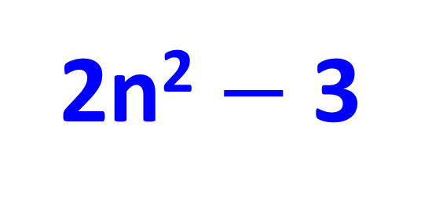
-1 |  | 5 |  | 15 |  | 29
Second Difference =
4
Half Second Difference 2n²
1 | 2 | 3 | 4
2n²
2 | 8 | 18 | 32
2n² $−$ 3
$−$1 | 5 | 15 | 29

Slide 17
6 |  | 9 |  | 14 |  | 21
Second Difference =
2
Half Second Difference 1n²
1 | 2 | 3 | 4
n²
1 | 4 | 9 | 16
n² + 5
6 | 9 | 14 | 21

