Slide 1
LO: Calculating with Algebraic Indices

Slide 2
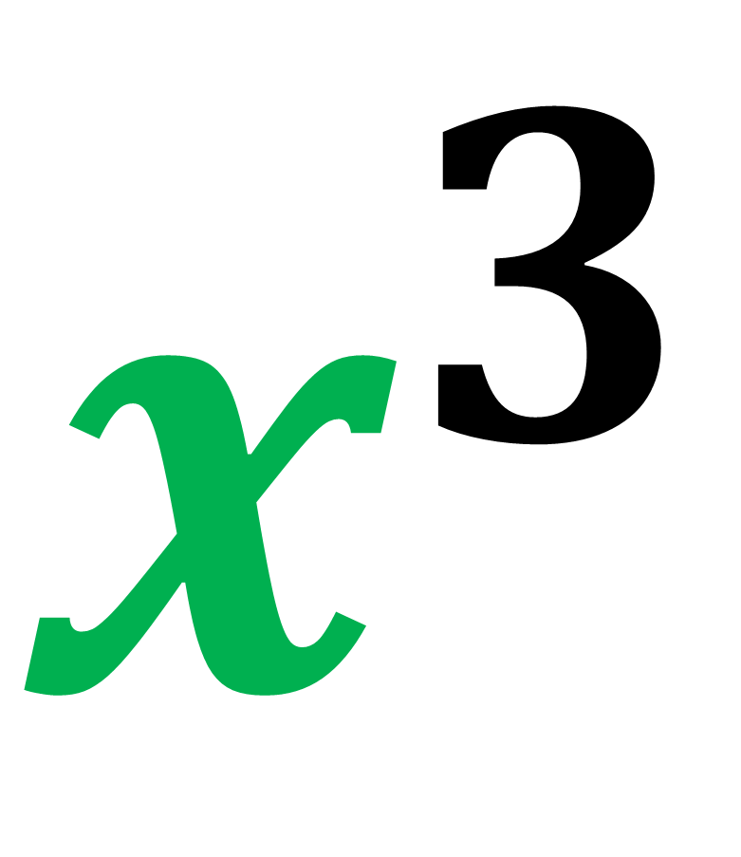
$$x^{3}$$
Base Value
Index
Value

Slide 3
Simplify
x × x × x × x × x =
x⁵

Slide 4
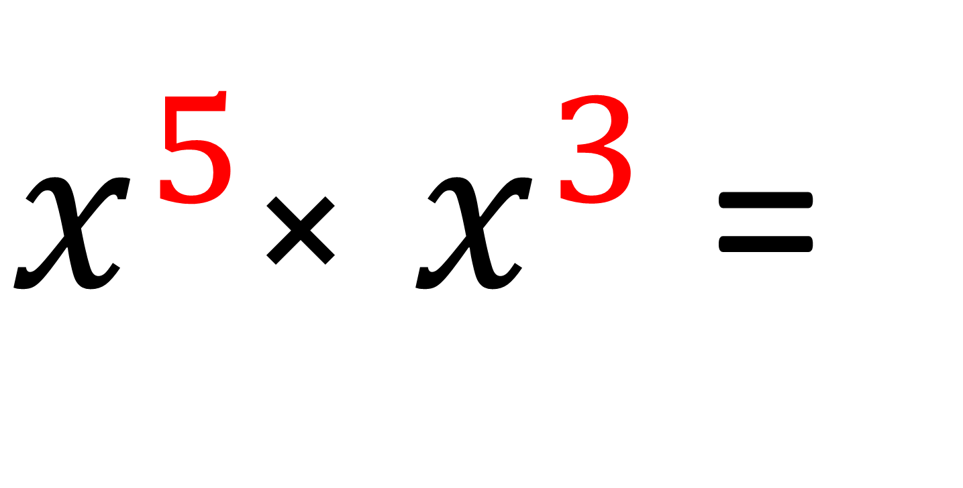
Simplify
$x^{5}$× $x^{3}$ =
x⁸

Slide 5
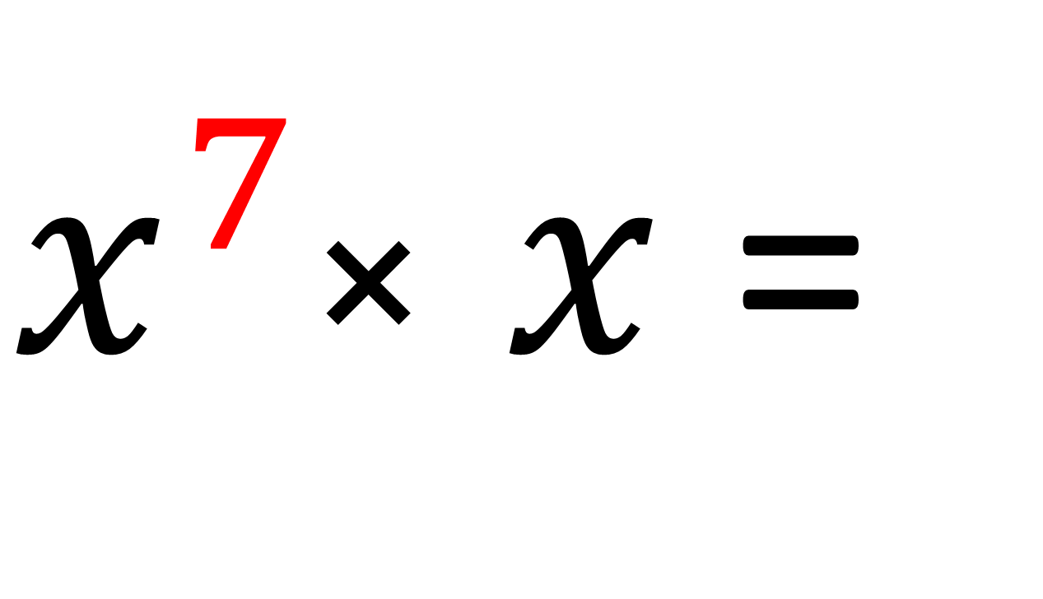
Simplify
$x^{7}$× $x$ =
x⁸

Slide 6
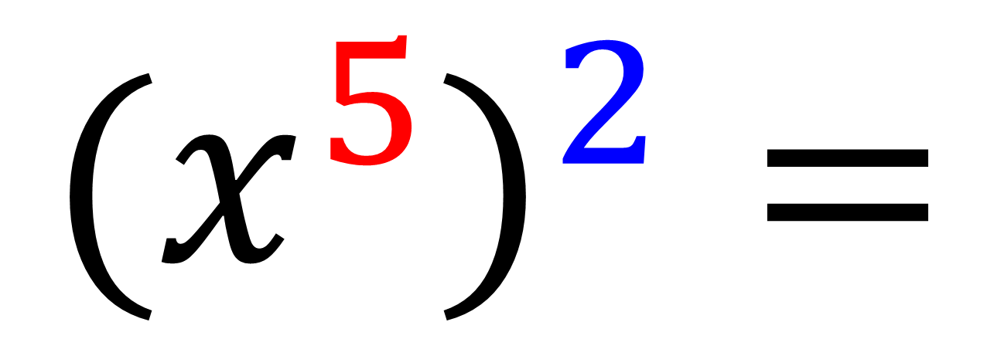
Simplify
$${{(x}^{5})}^{2}=$$
x¹⁰

Slide 7
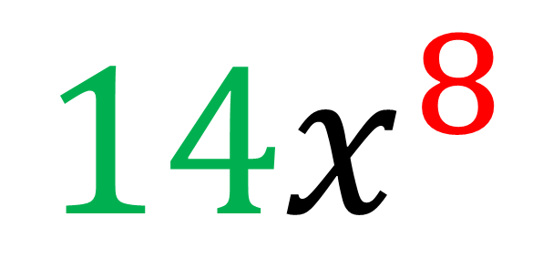
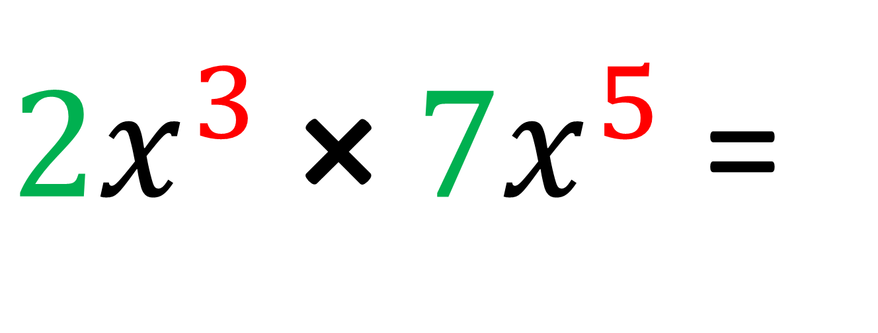
Simplify
$2x^{3} \text{×} 7x^{5}$ =
$$14x^{8}$$

Slide 8
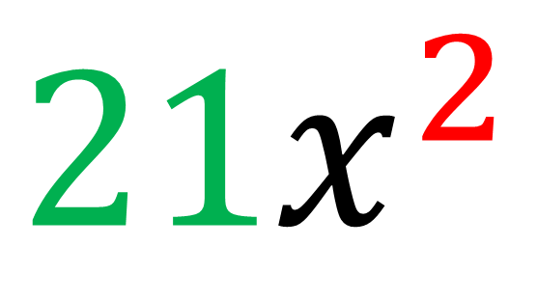
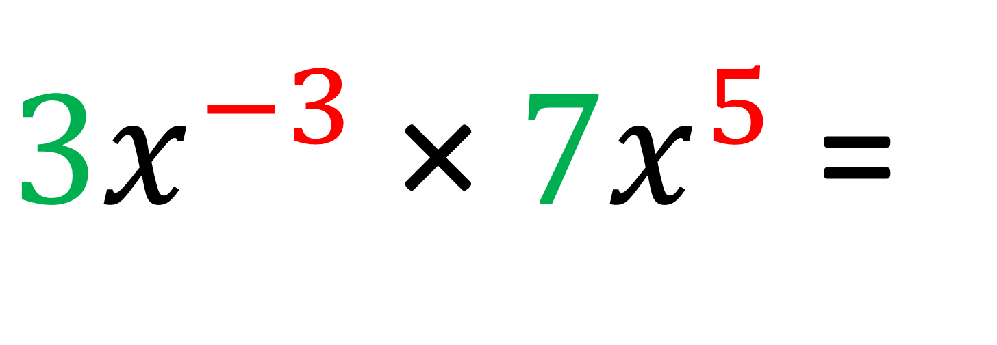
Simplify
$3x^{−3} \text{×} 7x^{5}$ =
$$21x^{2}$$

Slide 9
Simplify
4x¹⁰
$${{(2x}^{5})}^{2}=$$

Slide 10
Simplify
8x¹⁵
$${{(2x}^{5})}^{3}=$$

Slide 11
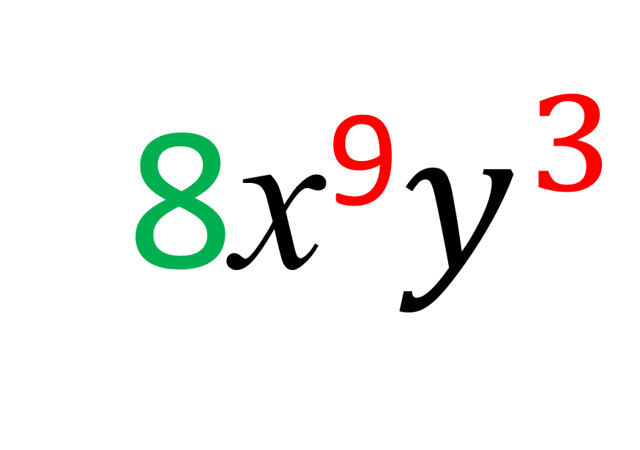
Simplify
8x⁹$y^{3}$
$${{(2x}^{3}y)}^{3}=$$

Slide 12
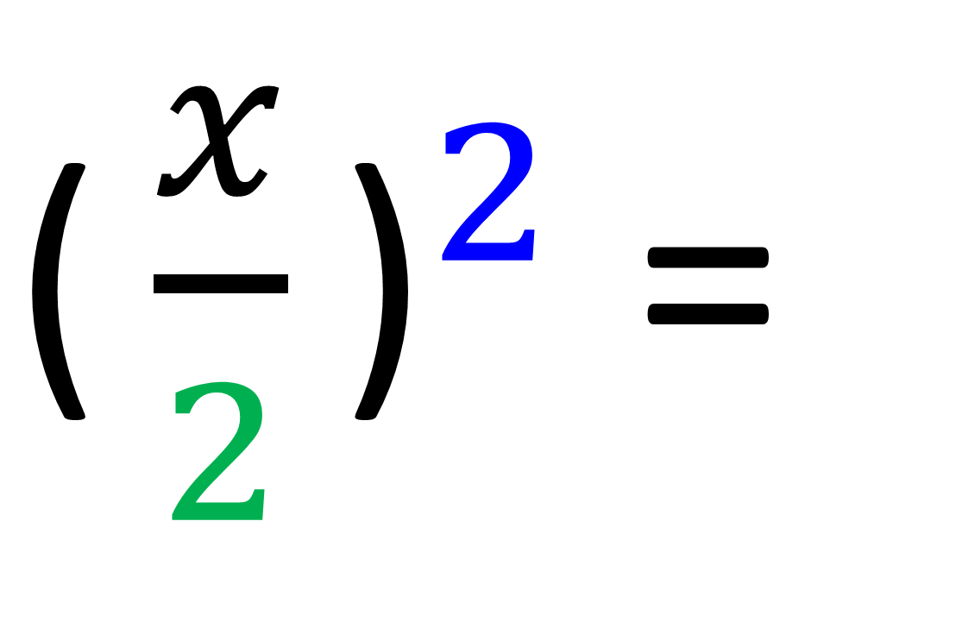
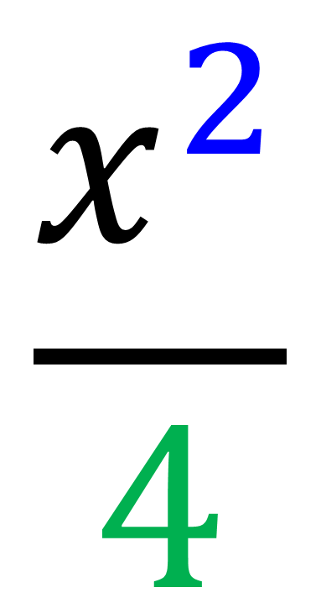
Simplify
$$\frac{x^{2}}{4}$$
${\text{(}\frac{x}{2}\text{)}}^{2}$ =

Slide 13
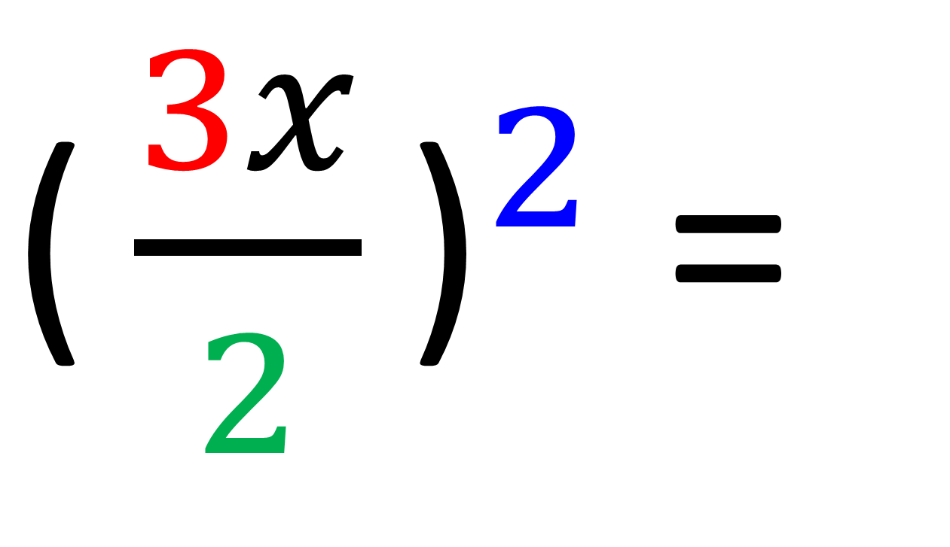
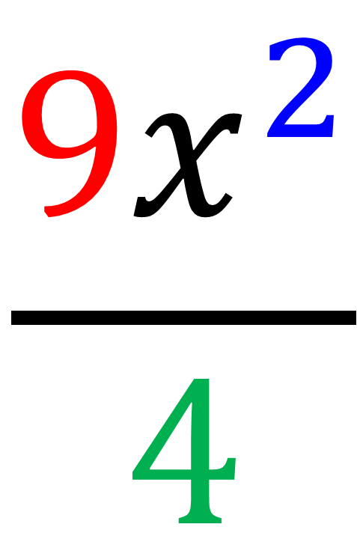
Simplify
$$\frac{{9x}^{2}}{4}$$
${\text{(}\frac{3x}{2}\text{)}}^{2}$ =

Slide 14
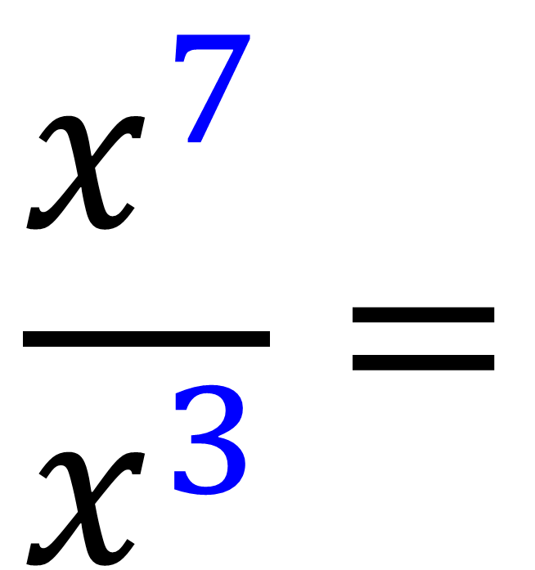
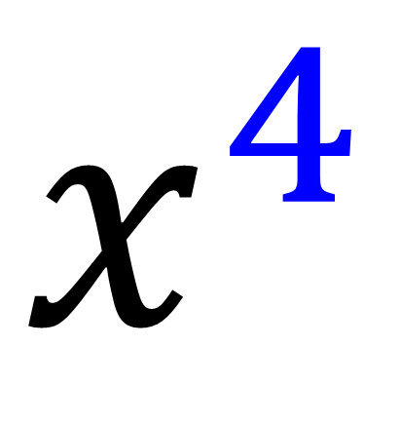
Simplify
$$\frac{x^{7}}{x^{3}}=$$
$$x^{4}$$

Slide 15
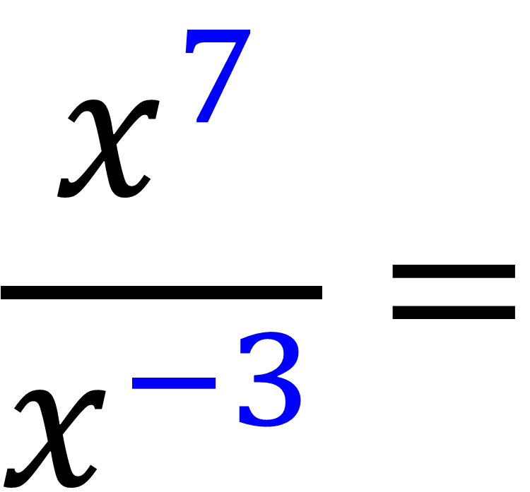
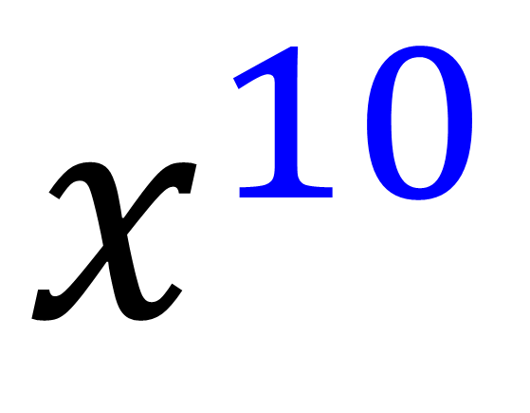
Simplify
$$\frac{x^{7}}{x^{−3}}=$$
$$x^{10}$$

Slide 16
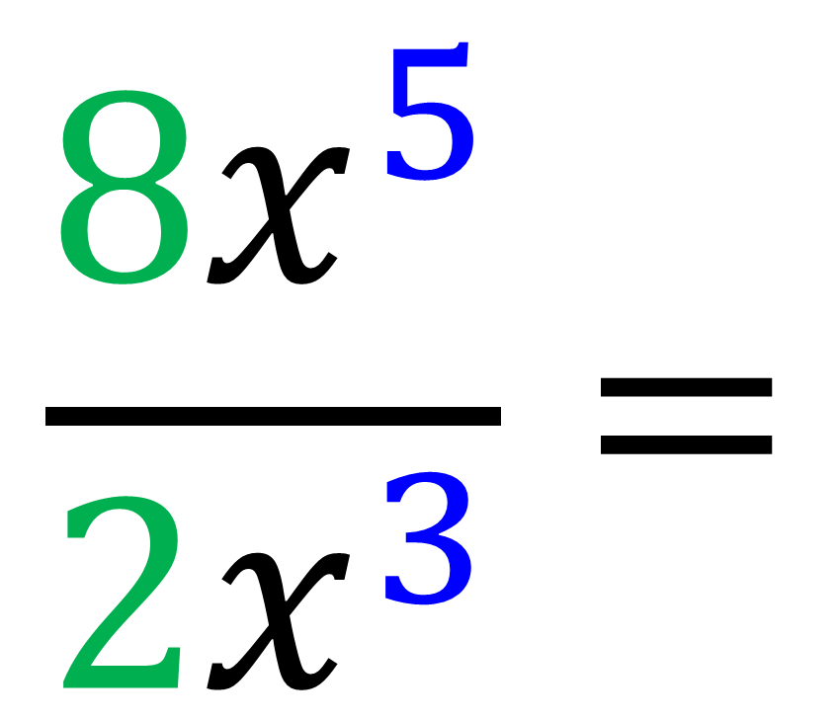
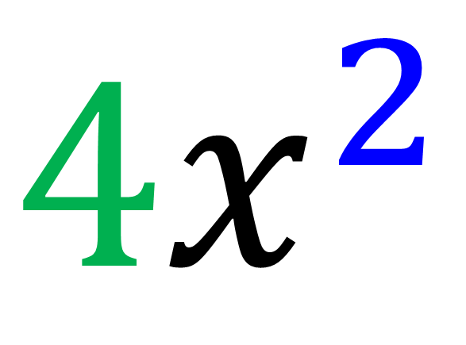
Simplify
$$\frac{{8x}^{5}}{{2x}^{3}}=$$
$${4x}^{2}$$

Slide 17
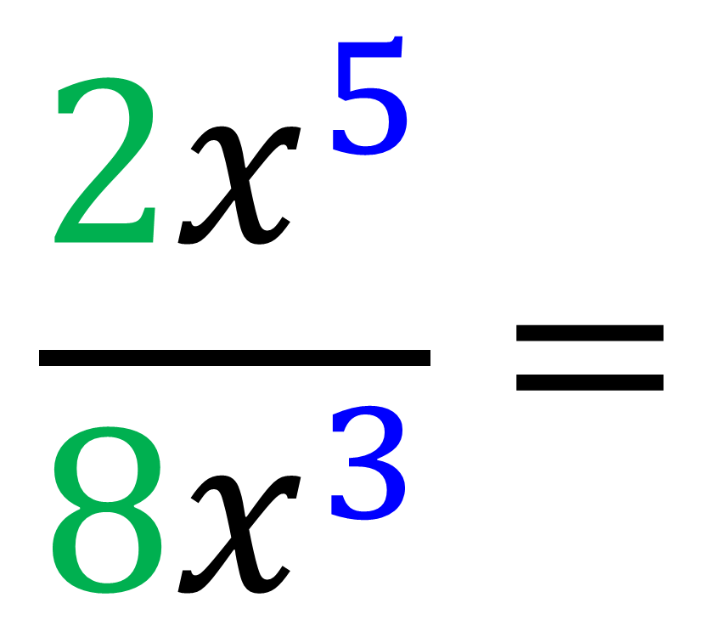
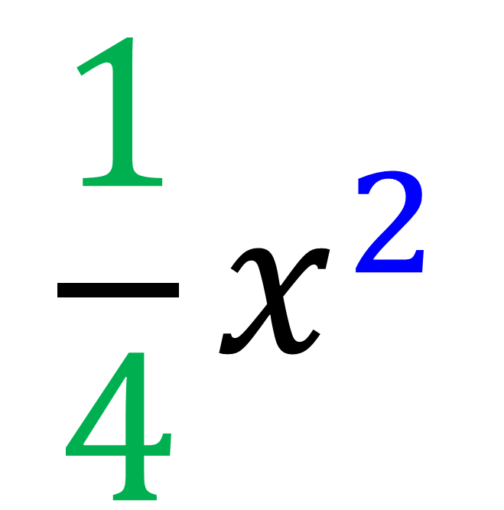
Simplify
$$\frac{{2x}^{5}}{{8x}^{3}}=$$
$${\frac{1}{4}x}^{2}$$

Slide 18
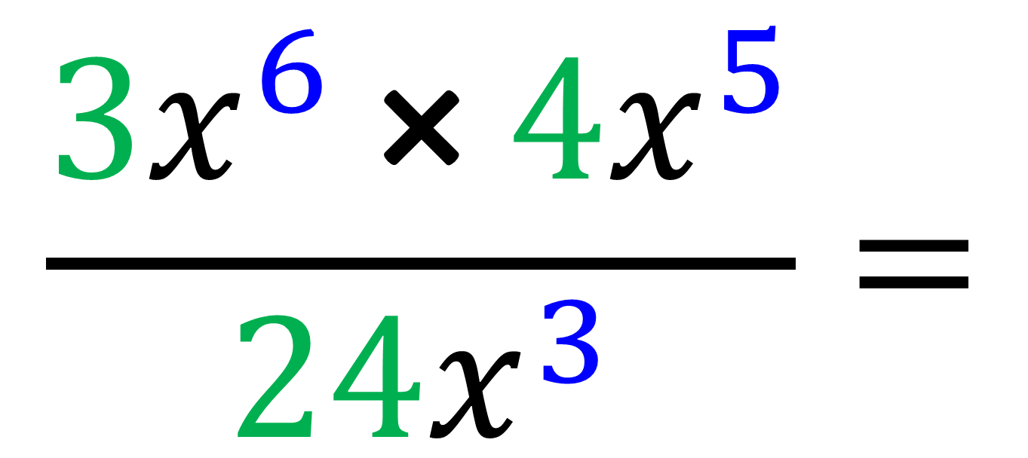
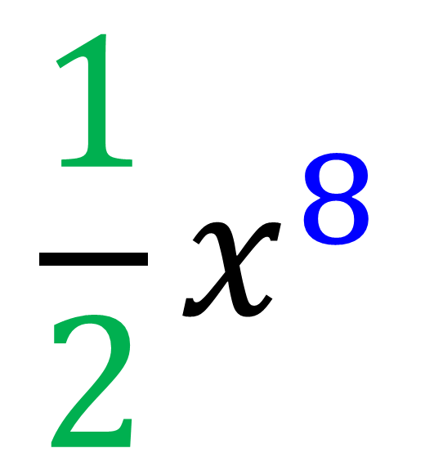
Simplify
$$\frac{3x^{6} \text{×} 4x^{5}}{{24x}^{3}}=$$
$${\frac{1}{2}x}^{8}$$

