Slide 1
LO: Misleading Graphs

Slide 2
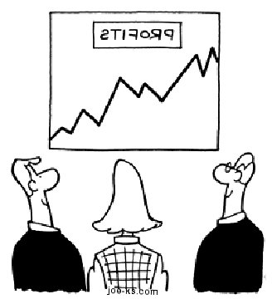
You must be very careful when reading information from a chart as often people and companies will deliberately mislead you.

Slide 3
True or False: Sales are rising rapidly!
4370
4360
4350
Sales
4340
4330
4320
4310
4300
2000
2001
2002
2003
2004
2005
Year
Notes:
The graph is misleading because it suggests that sales have increased significantly over a five year period. In reality they have only increased by 70 units, which is not much given that they are selling thousands.

Slide 4
True or False: There are more 15 year old boys than girls.
Girls
Boys
18 year olds
18 year olds
15 year olds
15 year olds
17 year olds
17 year olds
16 year olds
16 year olds
Notes:
False. We cannot make this conclusion from these graphs because we don’t know the totals. There might be 10 boys in total, making roughly 5 aged 15, but 100 girls, 30 of which are 15. It only tells us the proportion of 15 year olds.

Slide 5
True or False: Twice as many people like Thriller’s than Romance films.
150
120
100
60
Number of People
40
25
20
5
Favourite Films
Horror
Comedy
Action
Romance
Thriller
Notes:
The scale on the vertical axis is not linear, so even though the green bar is twice as big as the purple bar, it does not represent twice as many people.

Slide 6
Kings or West:
Which school had more students in the class?

Slide 7
Company A or Company B:
Which company would you like to invest in?

