Slide 1
LO: Locating and
Relative Bearings

Slide 2
Two other skills you need with bearings.
- Locating a position from two bearings
- Writing bearings being aware of your
starting position

Slide 3
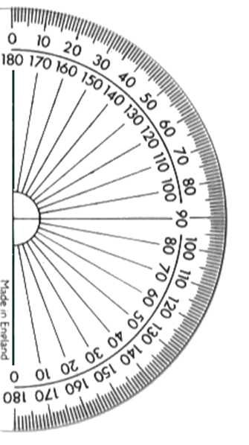
Locating a Position
The bearing of C from A is 115°
The bearing of C from B is 075°
Find location C.
C
Notes:
3

Slide 4
Relative Bearings
It is important to know your starting location and your finishing location.
Town B
Town B
Town A
Town A

Slide 5
Instruction | Starting at | Finishing at
From A to B
From B to A
A from B
B from A
A | B
Town B
B | A
B | A
Town A
A | B

Slide 6
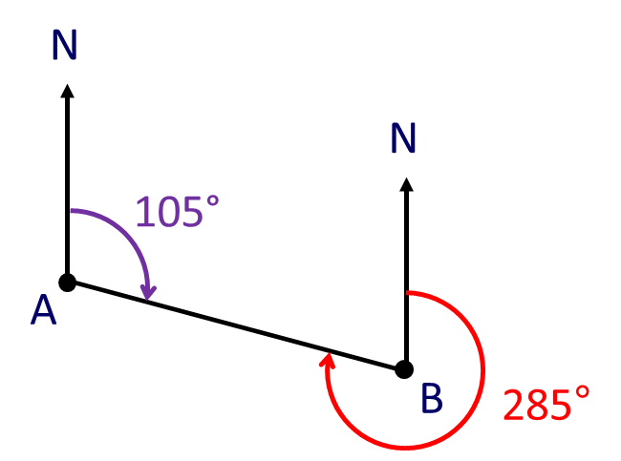
What is the bearing
from A to B?
105°
What is the bearing
to B from A?
105°

Slide 7
What is the bearing
from B to A?
285°
What is the bearing
to A from B?
285°

Slide 8
What is the bearing from B to A?
N
60° co-interior angles add to 180˚
N
120°
360° – 60° = 300°
A
60°
B

