Slide 1
LO: Equations of
Linear Lines

Slide 2
y = mx + c
What does the
m and c represent?

Slide 3
y
5
y = x + c
4
3
2
What is the value of C?
1
x
-5
-4
-3
-2
-1
1
2
3
4
5
-1
-2
y = x + 1
-3
-4
-5

Slide 4
y
5
y = x + c
4
3
2
What is the value of C?
1
x
-5
-4
-3
-2
-1
1
2
3
4
5
-1
-2
y = x – 2
-3
-4
-5

Slide 5
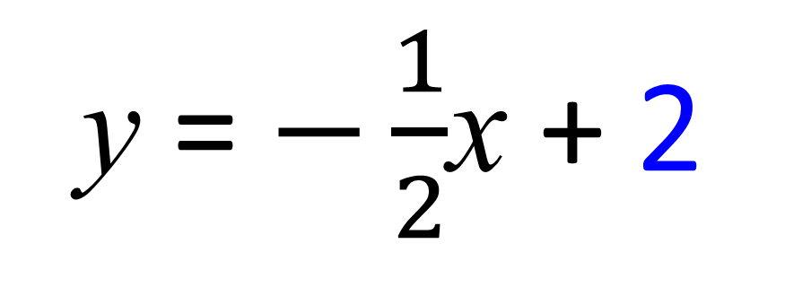
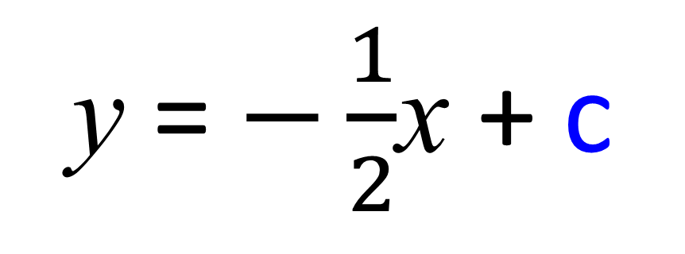
y
y = $−\frac{1}{2}$x + c
5
4
3
2
What is the value of C?
1
x
-5
-4
-3
-2
-1
1
2
3
4
5
-1
-2
y = $−\frac{1}{2}$x + 2
-3
-4
-5

Slide 6
A line has a gradient of 3.
What does that mean?
3
1
3
1
For every 1 you go across
you go 3 up.
3
1

Slide 7
A line has a gradient of 4.
What does that mean?
4
1
4
1
For every 1 you go across
you go 4 up.
4
1

Slide 8
A line has a gradient of -3.
What does that mean?
1
-3
1
-3
For every 1 you go across
you go 3 down.
1
-3

Slide 9
y
5
What is the gradient
of the line?
4
3
2
1
x
-5
-4
-3
-2
-1
1
2
3
4
5
-1
-2
Gradient = 2
-3
-4
-5

Slide 10
y
5
What is the gradient
of the line?
4
3
2
1
x
-5
-4
-3
-2
-1
1
2
3
4
5
-1
Gradient = $−2$
-2
-3
-4
-5

Slide 11
y
5
What is the gradient
of the line?
4
3
2
1
x
-5
-4
-3
-2
-1
1
2
3
4
5
-1
Gradient = $−\frac{1}{2}$
-2
-3
-4
-5

Slide 12
y
5
What is the gradient
of the line?
4
3
2
1
x
-10
-8
-6
-4
-2
2
4
6
8
10
-1
-2
Gradient = 1
-3
-4
-5

Slide 13
Rise
Run
$$\frac{Rise}{Run}$$
Gradient =

Slide 14
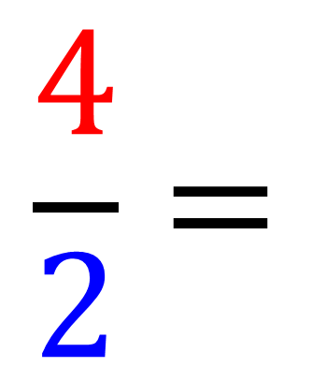
4
2
$$\frac{4}{2}=$$
Gradient =
2

Slide 15
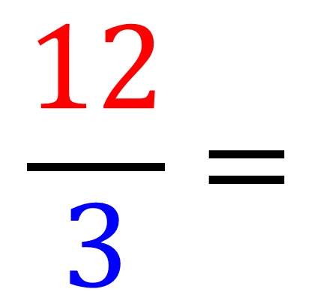
12
3
$$\frac{12}{3}=$$
Gradient =
4

Slide 16
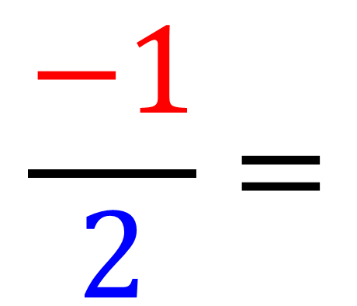
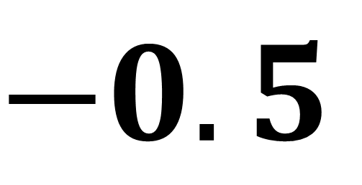
2
-1
$$\frac{−1}{2}=$$
Gradient =
$$−0.5$$

Slide 17
y
5
y = mx + c
4
3
2
What is equation of the line?
1
x
-5
-4
-3
-2
-1
1
2
3
4
5
-1
-2
y = 1x + 3
-3
-4
-5

Slide 18
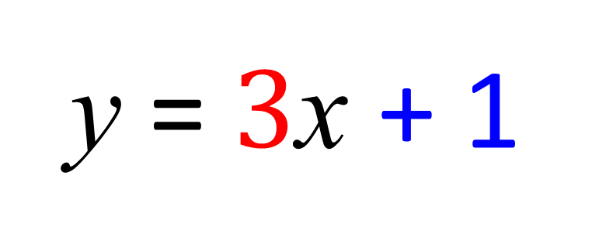
y
5
y = mx + c
4
3
2
What is equation of the line?
1
x
-5
-4
-3
-2
-1
1
2
3
4
5
-1
-2
y = $3$x + 1
-3
-4
-5

Slide 19
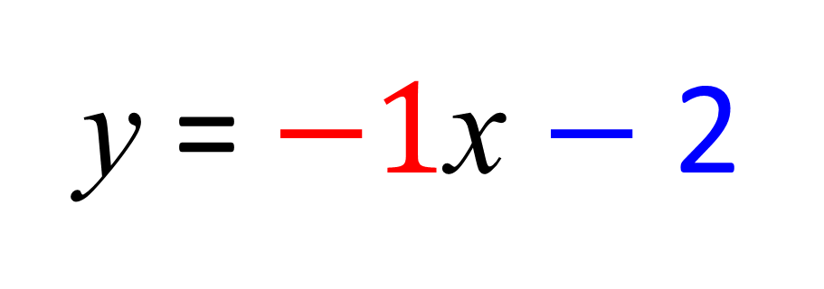
y
5
y = mx + c
4
3
2
What is equation of the line?
1
x
-5
-4
-3
-2
-1
1
2
3
4
5
-1
-2
y = $−1$x $−$ 2
-3
-4
-5

Slide 20
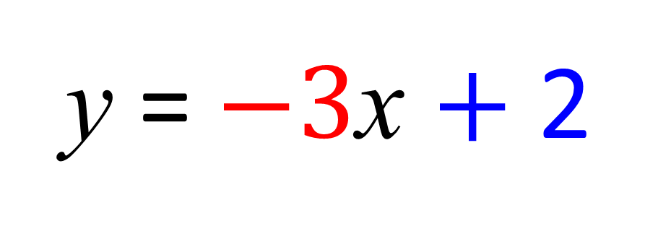
y
5
y = mx + c
4
3
2
What is equation of the line?
1
x
-5
-4
-3
-2
-1
1
2
3
4
5
-1
-2
y = $−3$x $+$ 2
-3
-4
-5

Slide 21
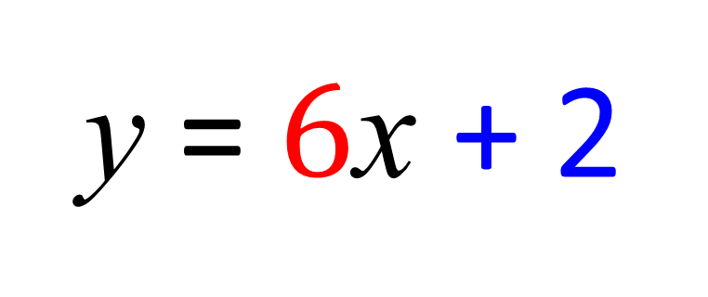
y
10
y = mx + c
8
6
4
2
What is equation of the line?
x
-5
-4
-3
-2
-1
1
2
3
4
5
-2
-4
y = $6$x + 2
-6
-8
-10

