Slide 1
LO: Graphing Inequalities

Slide 2
y
5
x = 2
4
3
2
1
x < 2
–6
–5
–4
–3
–2
–1
0
1
2
3
4
5
6
x
–1
–2
–3
x > 2
–4
–5
Notes:
A common mistake is to think that the line x = 2 will be horizontal because the x-axis is horizontal. Show that the line x = 2 is as shown by asking pupils to tell you the coordinates of any point lying on the line.

Slide 3
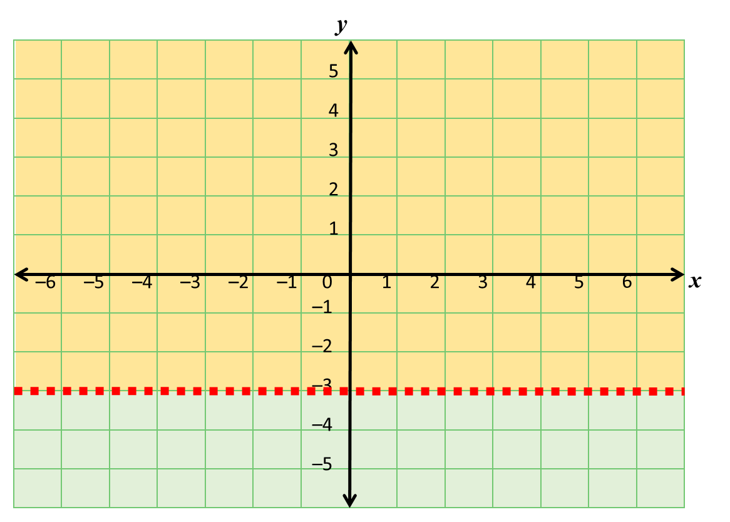
y = -3
y < -3
y > -3
Notes:
A common mistake is to think that the line x = 2 will be horizontal because the x-axis is horizontal. Show that the line x = 2 is as shown by asking pupils to tell you the coordinates of any point lying on the line.

Slide 4
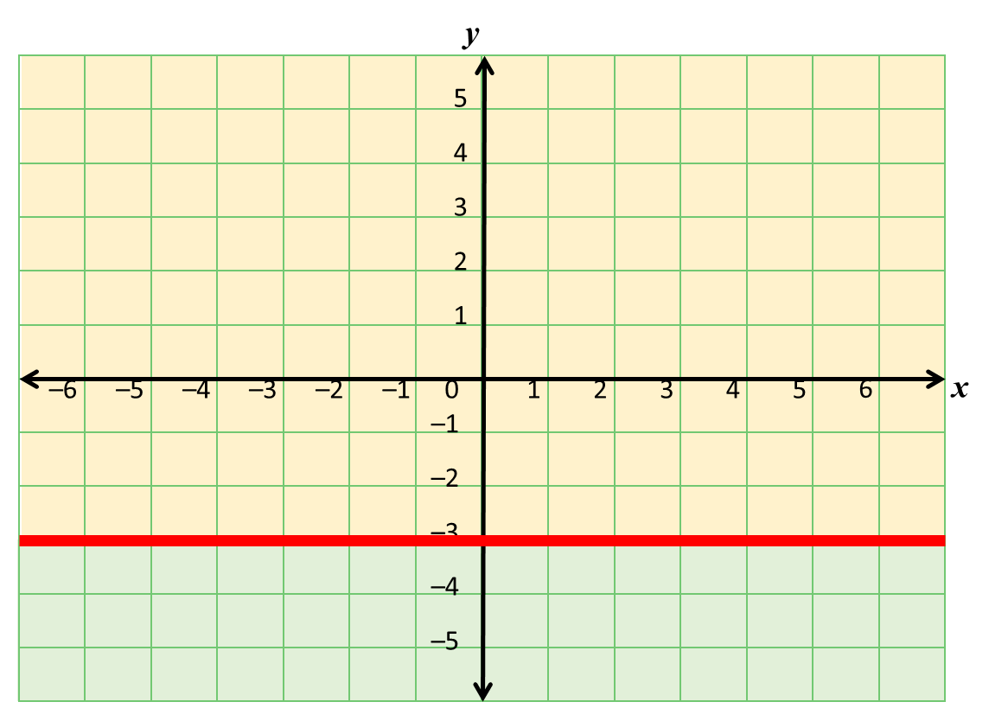
y = -3
y ≤ -3
y ≥ -3
Notes:
A common mistake is to think that the line x = 2 will be horizontal because the x-axis is horizontal. Show that the line x = 2 is as shown by asking pupils to tell you the coordinates of any point lying on the line.

Slide 5
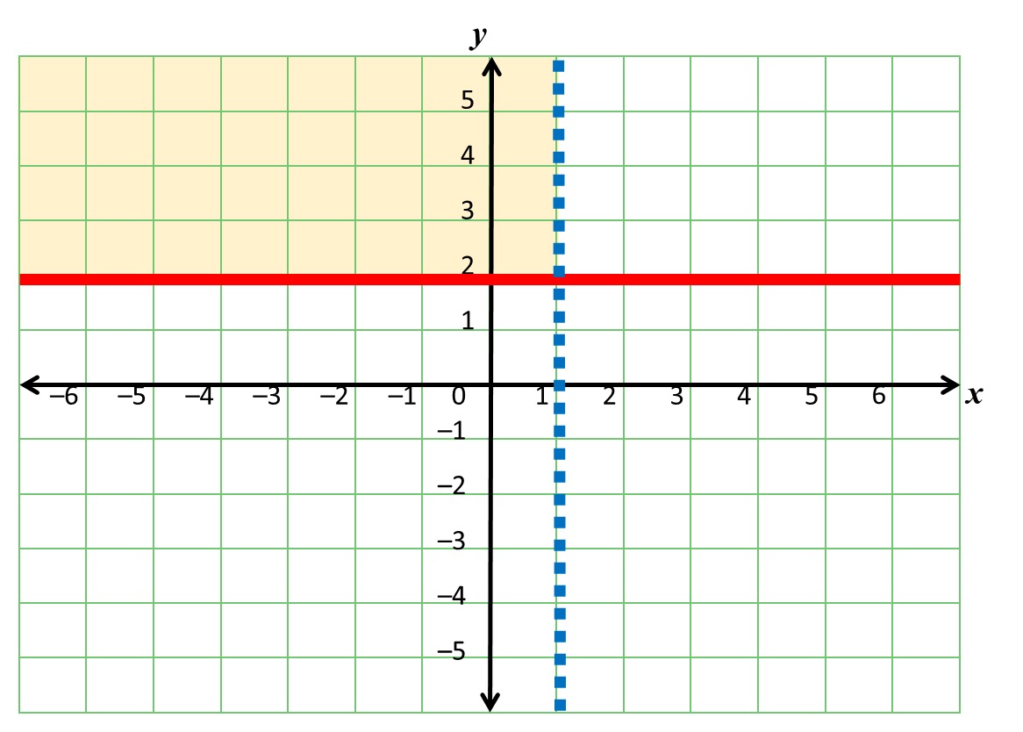
x = 1
y = 2
y ≥ 2
and
x < 1
Notes:
A common mistake is to think that the line x = 2 will be horizontal because the x-axis is horizontal. Show that the line x = 2 is as shown by asking pupils to tell you the coordinates of any point lying on the line.

Slide 6
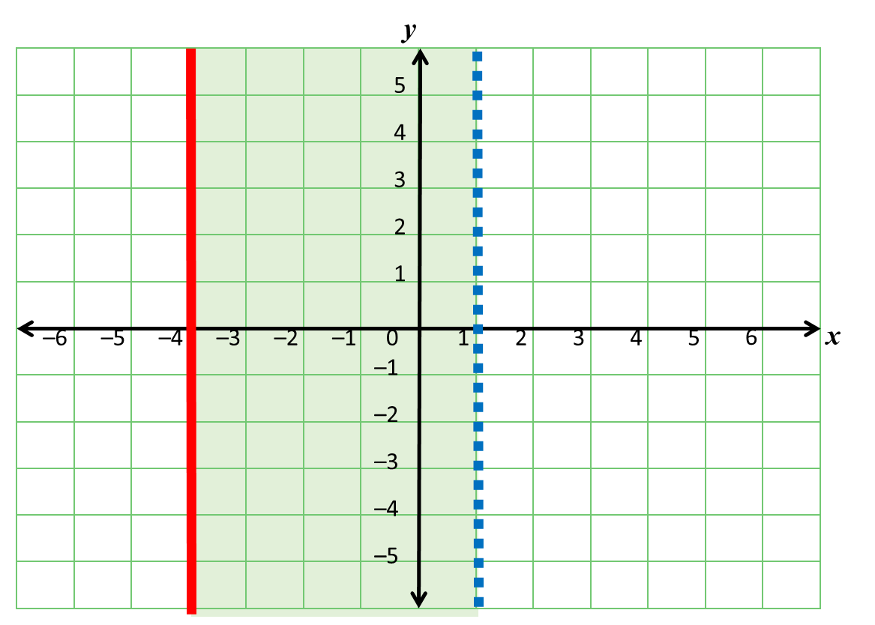
x = 1
x = -4
-4 ≤ x < 1
Notes:
A common mistake is to think that the line x = 2 will be horizontal because the x-axis is horizontal. Show that the line x = 2 is as shown by asking pupils to tell you the coordinates of any point lying on the line.

Slide 7
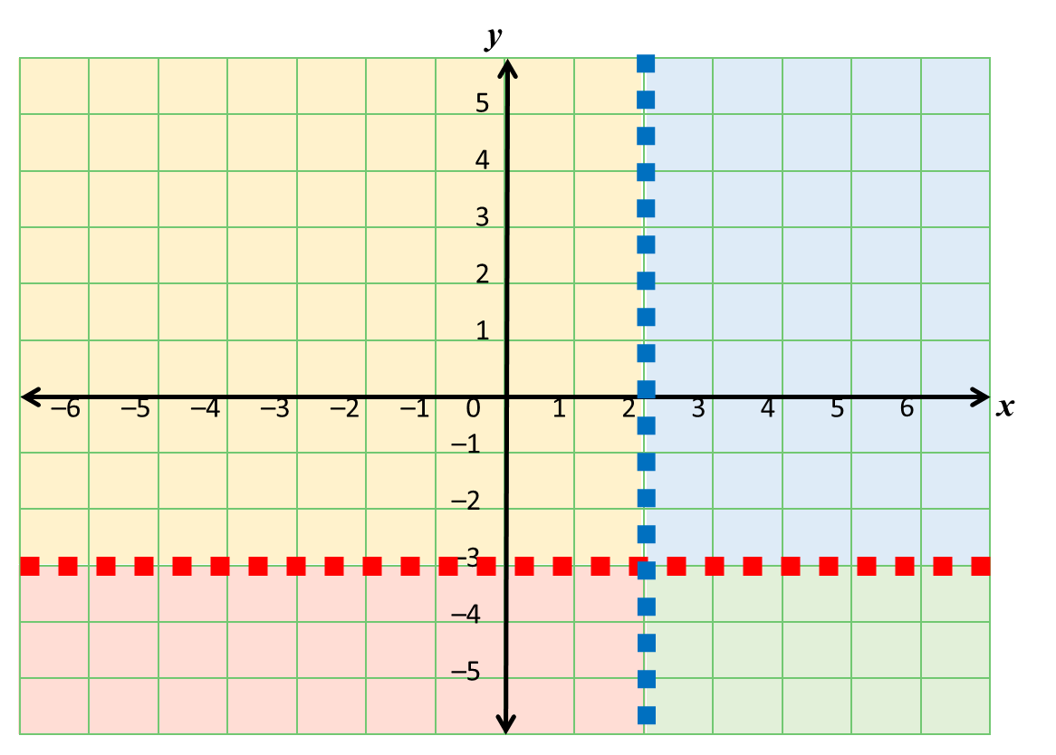
y > -3
and
x > 2
y < -3
and
x < 2
y > -3
and
x < 2
y < -3
and
x > 2
Notes:
A common mistake is to think that the line x = 2 will be horizontal because the x-axis is horizontal. Show that the line x = 2 is as shown by asking pupils to tell you the coordinates of any point lying on the line.

Slide 8
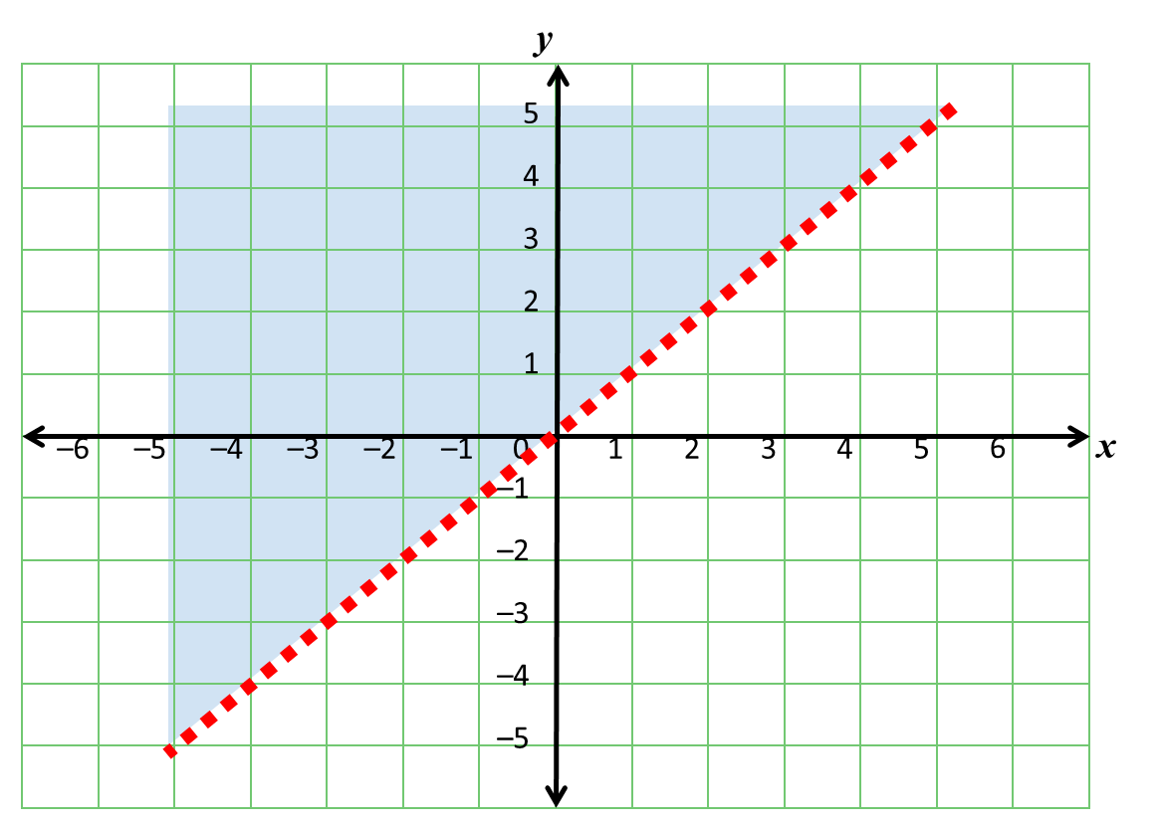
y = x
y > x
Notes:
A common mistake is to think that the line x = 2 will be horizontal because the x-axis is horizontal. Show that the line x = 2 is as shown by asking pupils to tell you the coordinates of any point lying on the line.

Slide 9
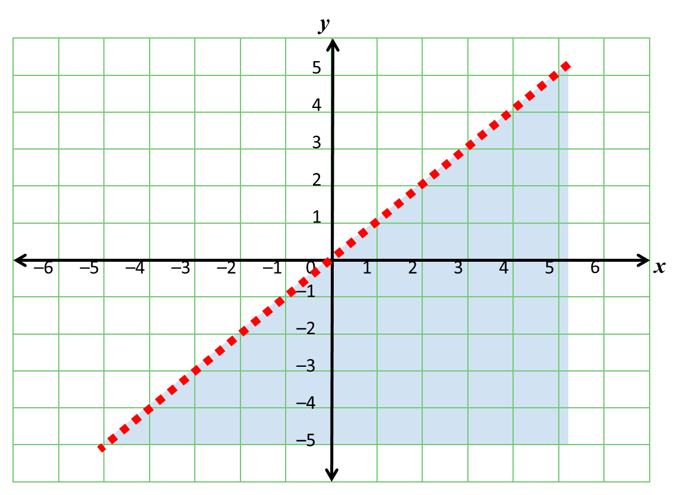
y = x
y < x
Notes:
A common mistake is to think that the line x = 2 will be horizontal because the x-axis is horizontal. Show that the line x = 2 is as shown by asking pupils to tell you the coordinates of any point lying on the line.

