Slide 1
LO: Converting
Units of
Compound Measures

Slide 2
Convert
1 Hour to Minutes
1 hour = 60 mins

Slide 3
Convert
1 Hour to Seconds
1 hour = 3600 sec

Slide 4
Convert
30 seconds to minutes
30 sec = $\frac{1}{2}$ min

Slide 5
Convert
3600 seconds to hours
3600 sec = 1 hours

Slide 6
Convert
1.2 Kilograms to Grams
1 kg = 1200 g

Slide 7
Convert
1 Kilograms to Grams
1 kg = 1000 g

Slide 8
Convert
20 minutes to Seconds
20 mins = 1200 sec

Slide 9
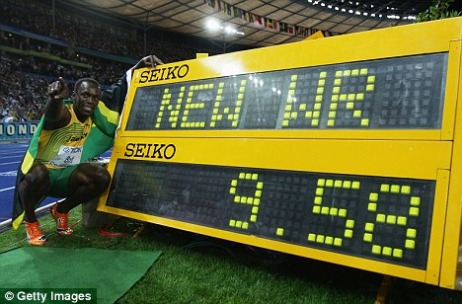
Usain Bolt holds the world record
for the 100 metres.
What is his speed in
km per hour?
37.58 km/hour

Slide 10
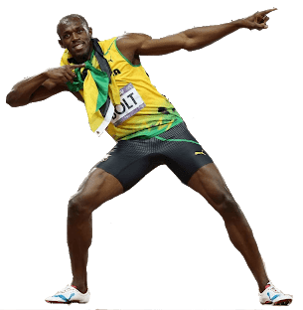
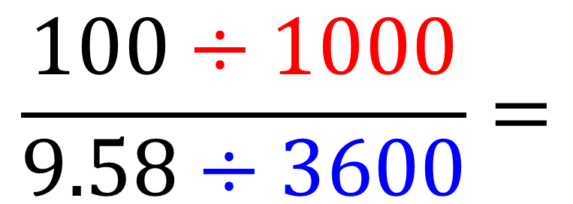
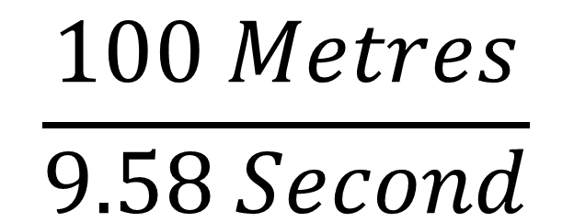
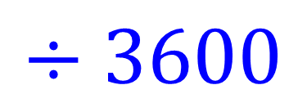
$$\frac{100 Metres}{9.58 Second}$$
Metres to Kilometres
$$÷1000$$
Seconds to Hours
$$÷3600$$
$$\frac{100÷1000}{9.58÷3600}=$$
37.58 km/h

Slide 11
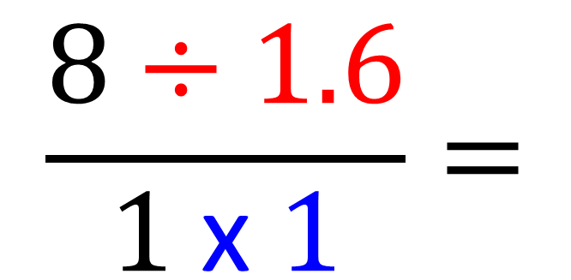
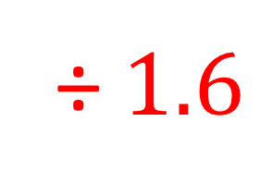
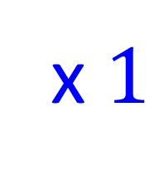
Convert 8km/h to mph
Kilometres to Miles
÷ $1.6$
Hours to Hours
x $1$
$$\frac{8÷1.6}{1 \text{x} 1}=$$
5 mph

Slide 12
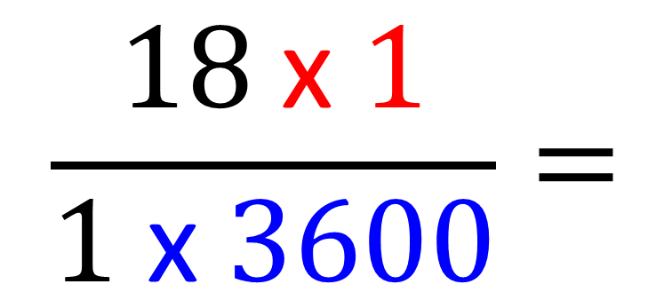
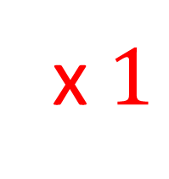
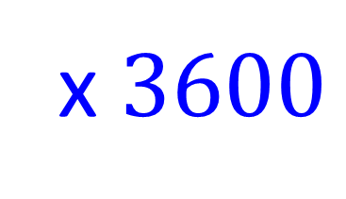
Convert 18km/h to km/s
Kilometres to kilometres
x $1$
Hours to Seconds
x $3600$
$$\frac{18 \text{x} 1}{1 \text{x} 3600}=$$
0.005 km/s

Slide 13
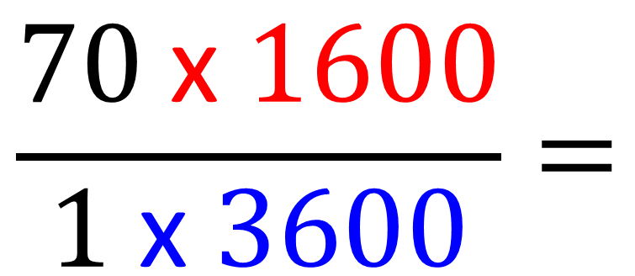
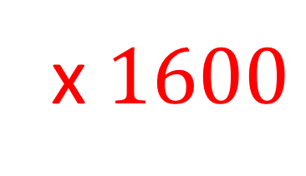
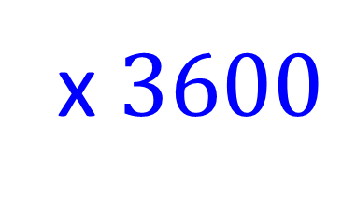
Convert 70mph to m/s
Miles to metres
x $1600$
Hours to Seconds
x $3600$
$$\frac{70 \text{x} 1600}{1 \text{x} 3600}=$$
31.1 m/s

Slide 14
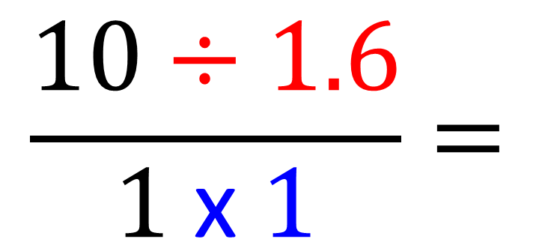
Convert 10km/h to mph
Kilometres to Miles
÷ $1.6$
Hours to Hours
x $1$
$$\frac{10÷1.6}{1 \text{x} 1}=$$
6.25 mph

Slide 15
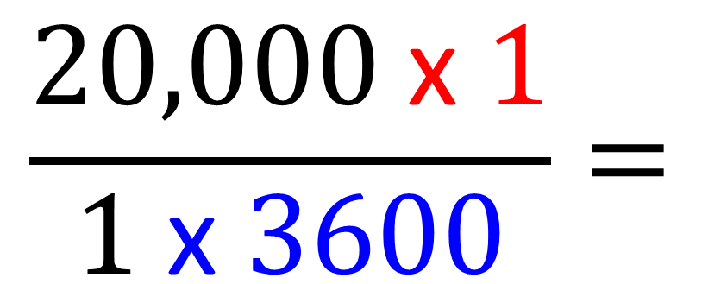
Convert 20,000km/h to km/s
Kilometres to kilometres
x $1$
Hours to Seconds
x $3600$
$$\frac{20,000 \text{x} 1}{1 \text{x} 3600}=$$
5.56 km/s

Slide 16
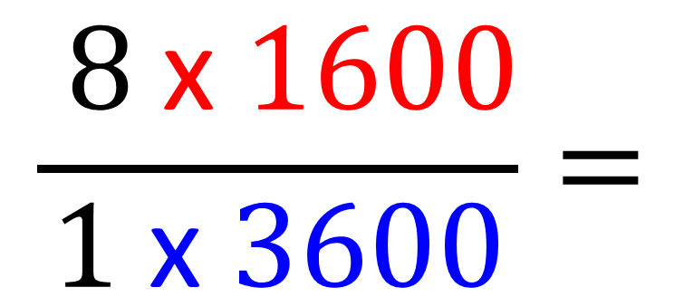
Convert 8mph to m/s
Miles to metres
x $1600$
Hours to Seconds
x $3600$
$$\frac{ 8 \text{x} 1600}{1 \text{x} 3600}=$$
3.56 m/s

Slide 17
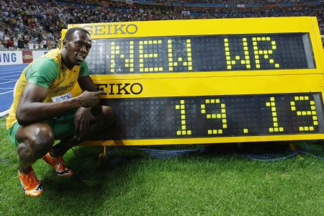
Usain Bolt holds the world record
for the 200 metres.
What is his speed in
km per hour?
$$\frac{ 200÷1000}{19.19÷3600}=$$
37.52 m/s

