Slide 1
LO: Compound
Interest

Slide 2
What is the multiplier
for increasing by 20%?
1.2

Slide 3
What is the multiplier
for decreasing by 20%?
0.8

Slide 4
What is the multiplier
for decreasing by 2%?
0.98

Slide 5
What is the multiplier
for increasing by 3%?
1.03

Slide 6
What is the multiplier
for decreasing by 0.5%?
0.995

Slide 7
What is the multiplier
for increasing by 0.5%?
1.005

Slide 8
When you invest money into a
savings account you can earn interest!
Out
In

Slide 9
There are two types of interests:
Simple
Interest
Compound
Interest

Slide 10
You invest £500 at 10% per year for 3 years.
Simple Interest
Compound Interest
1st Year |  | + |  | =
2nd Year |  | + |  | =
3rd Year |  | + |  | =
1st Year |  | + |  | =
2nd Year |  | + |  | =
3rd Year |  | + |  | =
500
50
550
500
50
550
550
50
600
550
55
605
600
50
650
605
60.5
665.5
How do they work?

Slide 11
You invest £300 at 20% per year for 3 years
using compound interest.
1st Year | 300 | x |  | =
2nd Year |  | x |  | =
3rd Year |  | x |  | =
1.2 |  |  | 360
360 |  | 1.2 |  |  | 432
432 |  | 1.2 |  |  | 518.40

Slide 12
You invest £300 at 20% per year for 3 years
using compound interest.
300 x ${1.20}^{3}$ = £518.40

Slide 13
You buy a house for £50,000.
It increases at 10% per year.
How much is the house worth after 3 years?
50000 x ${1.1}^{3}$ = £66,550

Slide 14
You buy some shares for £3,000.
They increases at 8% per year.
How much are the shares worth after 5 years?
3000 x ${1.08}^{5}$= £4407.98

Slide 15
What is the difference between
each of these calculations?
50000 x ${0.9}^{3}$
50000 x ${1.1}^{3}$
Decreases
by 10%
each year.
Increases
by 10%
each year.

Slide 16
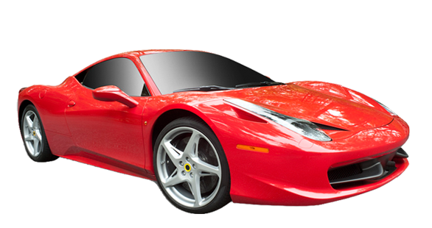
You buy a car for £50,000.
It depreciates at 10% per year.
How much is the car worth after 3 years?
50000 x ${0.9}^{3}$= £36,450

Slide 17
A new computer cost £1200
and loses value by 40% each year.
How much is the computer valued at after 3 years?
1200 x ${0.6}^{3}$ = £259.20

Slide 18
Power of Compound Interest
A £1 investment earning 20% a year,
with compounded interest will grow to
how much in 10 Years?
£6 in a decade
how much in 50 Years?
£9,000 in 50 years
£82,000,000 in a century!
how much in 100 Years?

Slide 19
Compound Interest =
Amount x ${\text{(}\text{\%} \text{M}\text{ultiplier}\text{)}}^{years}$

