Slide 1
LO: Bearings

Slide 2
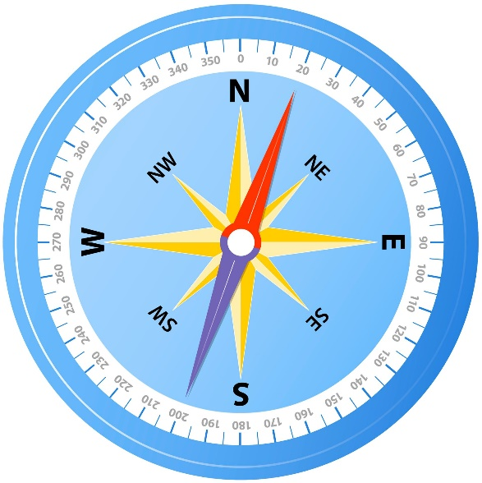
Have you ever lost your bearings!
What is meant by bearings?
Bearings are away of
giving directions.

Slide 3
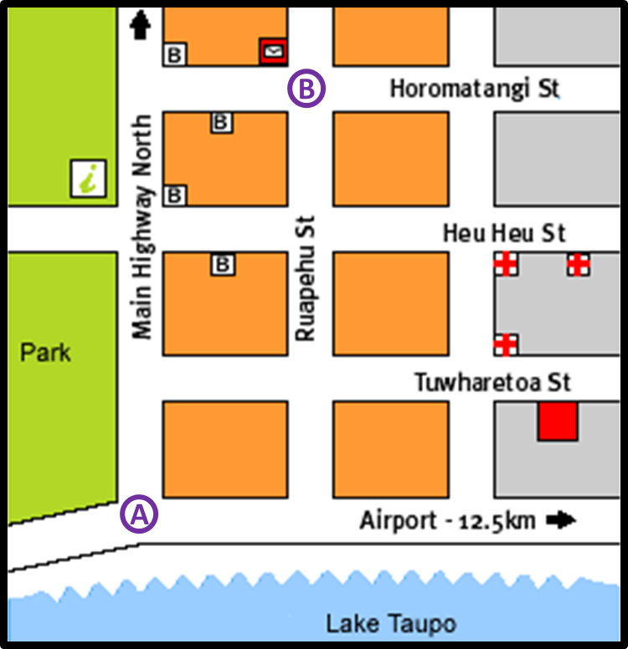
How would you direct someone form A to B?

Slide 4
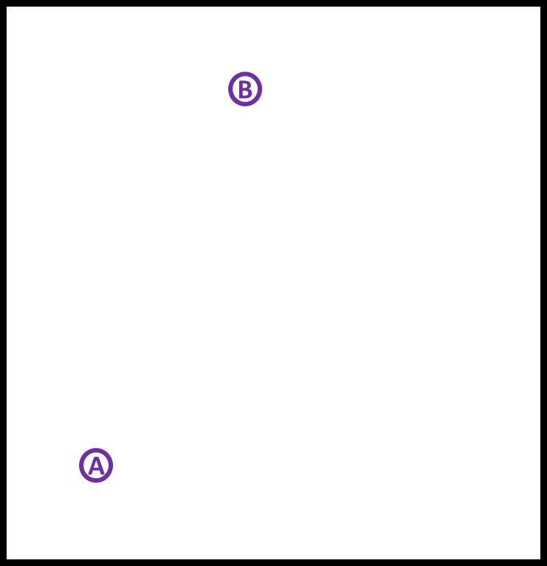
How would you direct someone form A to B?

Slide 5
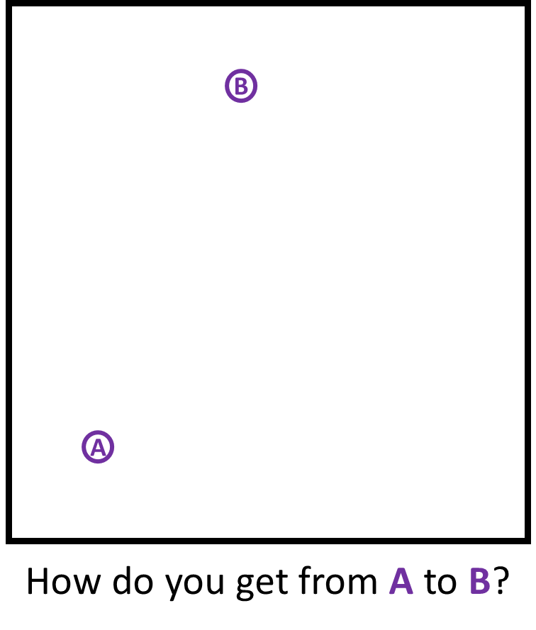
000°
N
315°
045°
NW
NE
270°
W
E
090°
SW
SE
225°
135°
S
180°

Slide 6
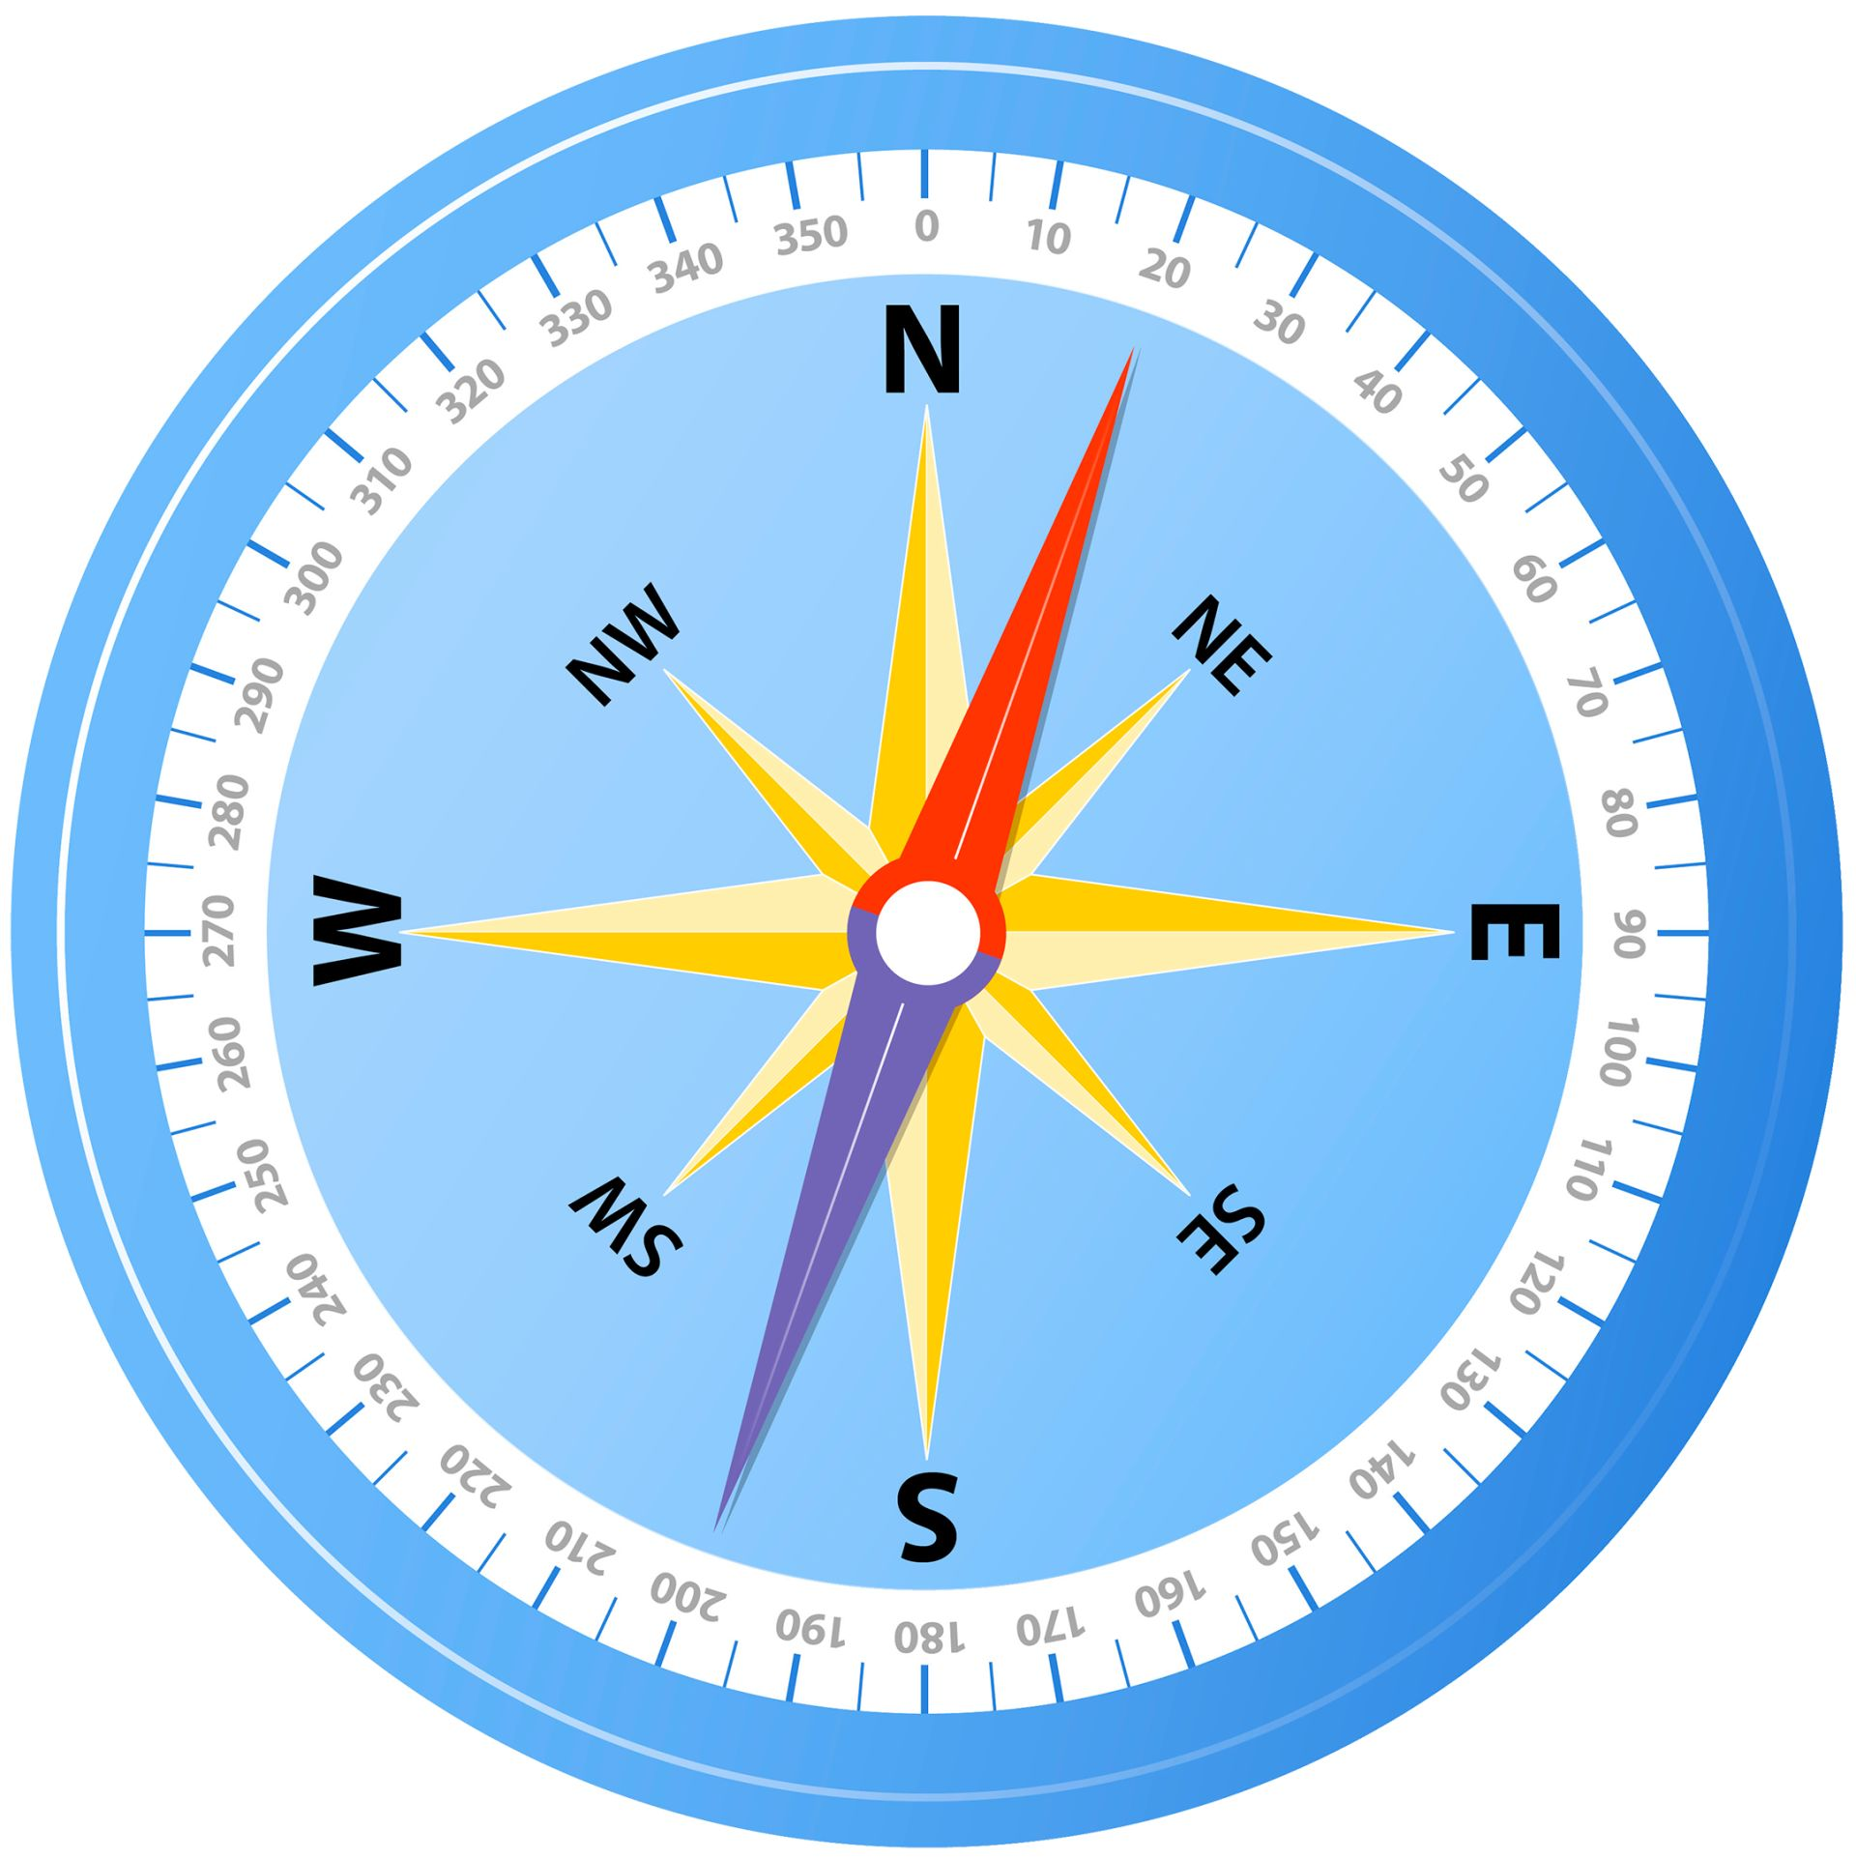

Slide 7
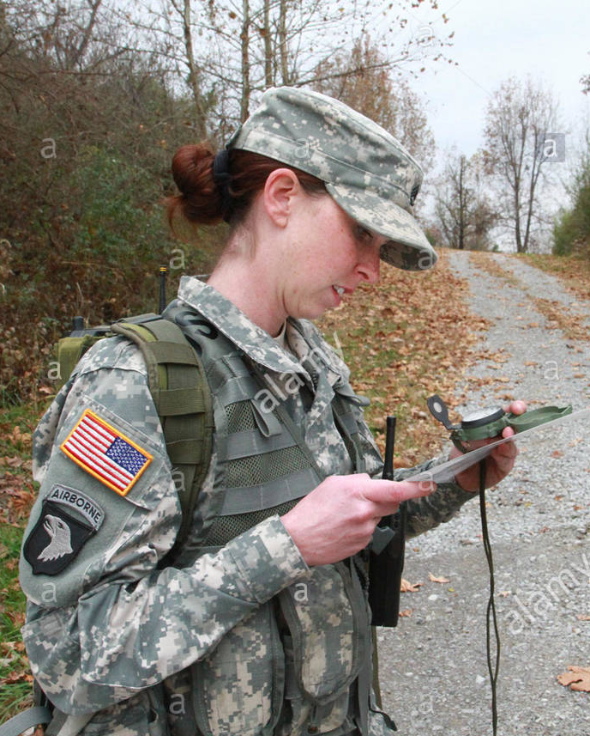
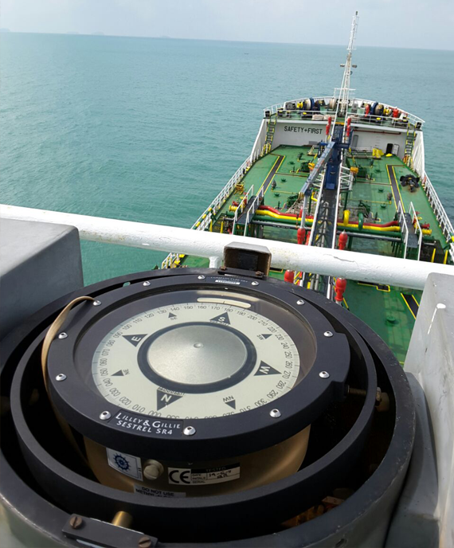
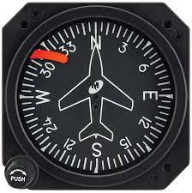
Can you think of different people who
might need to use bearings?

Slide 8
There are the 3 rules that you must
follow when using bearings.
1
Measure from the north line.
2
Measure clockwise.
3
Write with 3 figures.

Slide 9
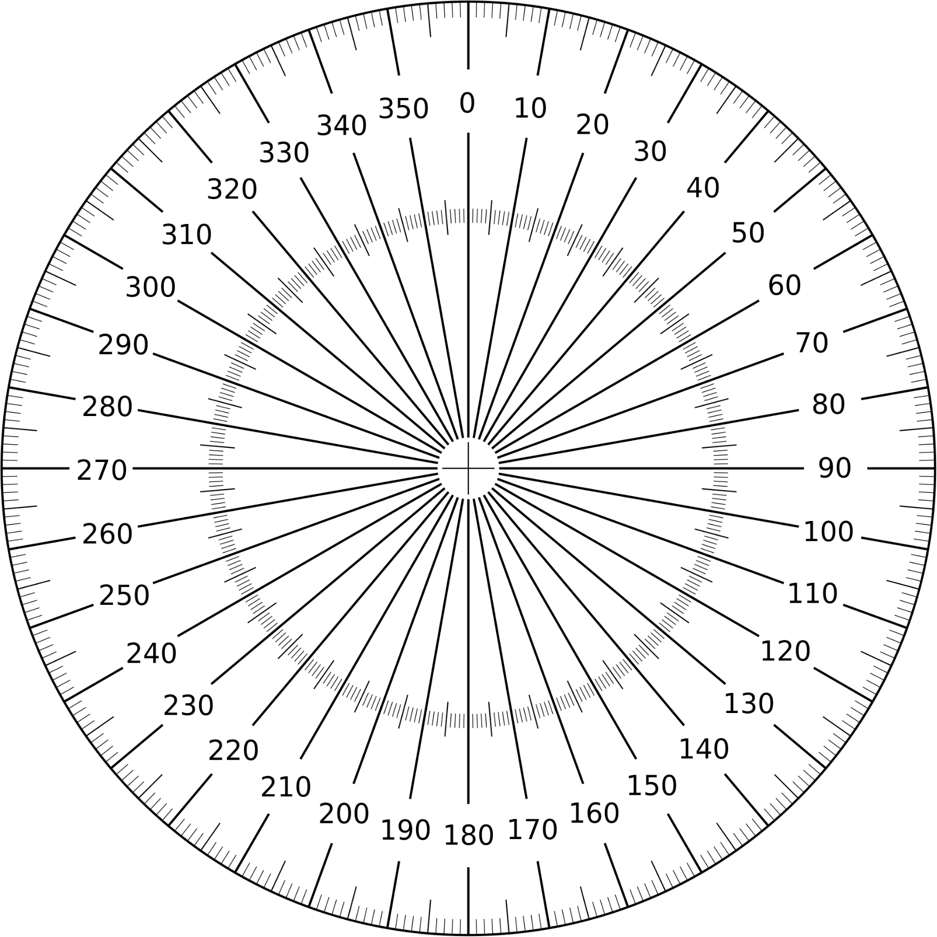
What is the bearing
from A to B?
B
022°
A

Slide 10
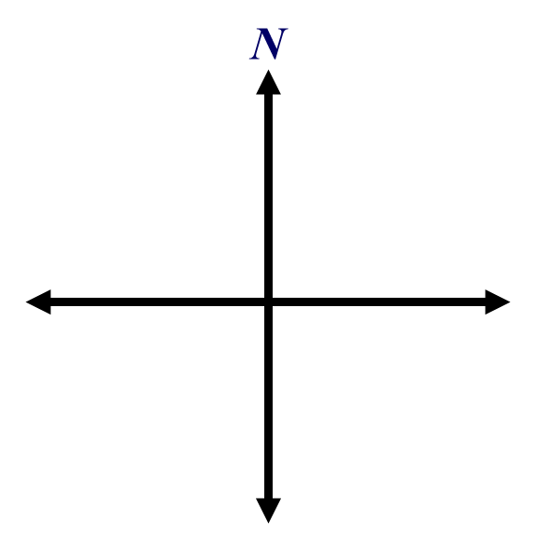
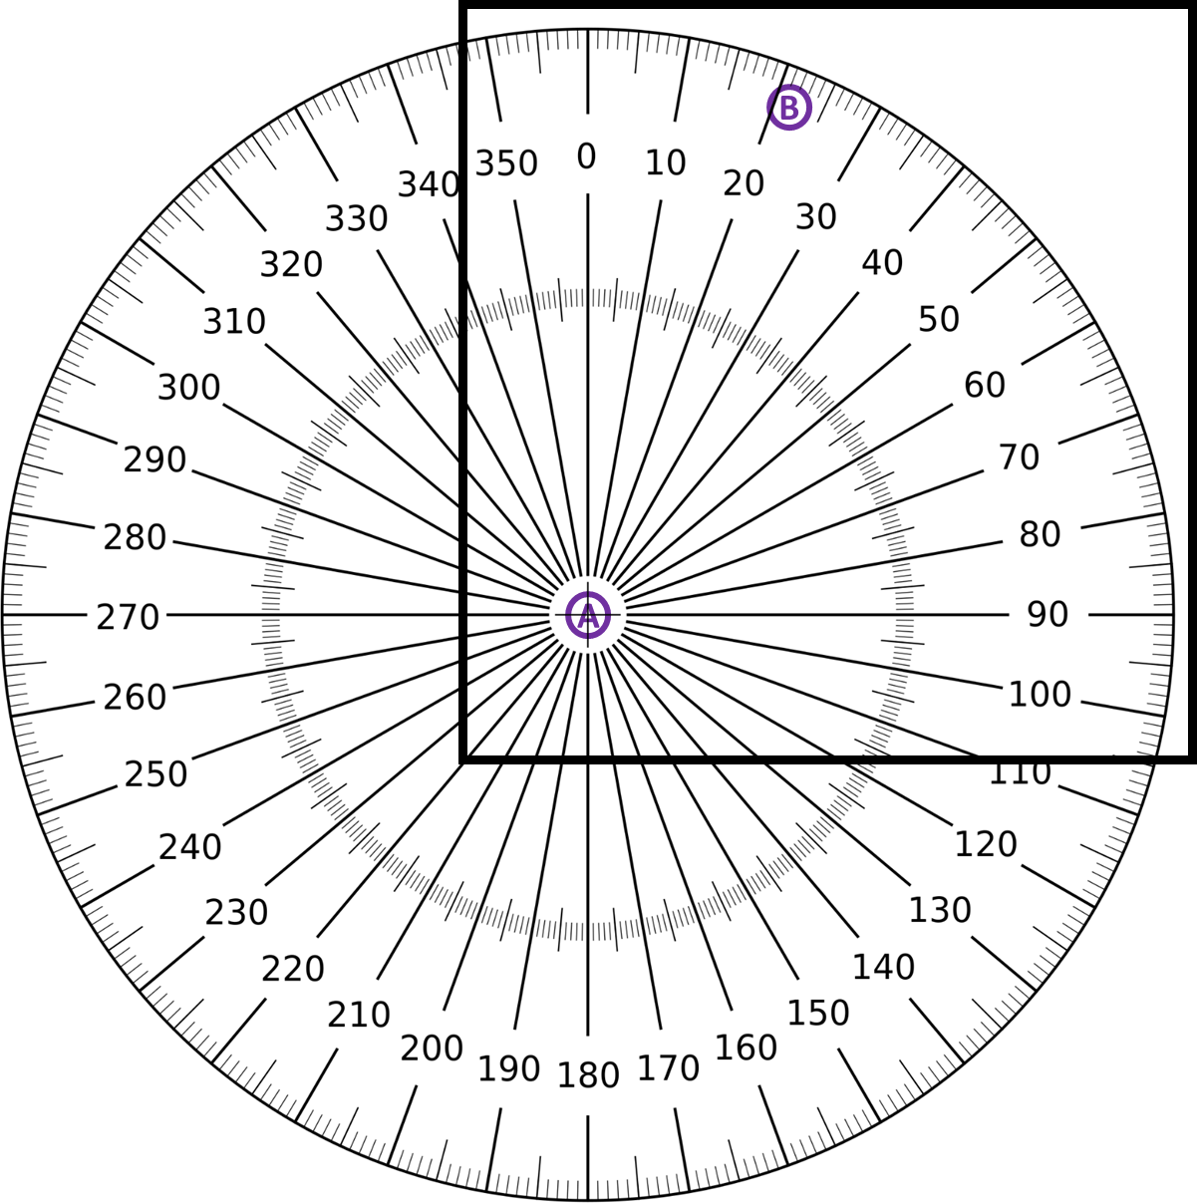

Correct or Not?

Slide 11


Correct and Not?

Slide 12
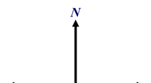
Correct or Not?
What is the bearing
from B to A?
A
B
090°

Slide 13

Correct or Not?
What is the bearing
from B to A?
A
B
270°

Slide 14
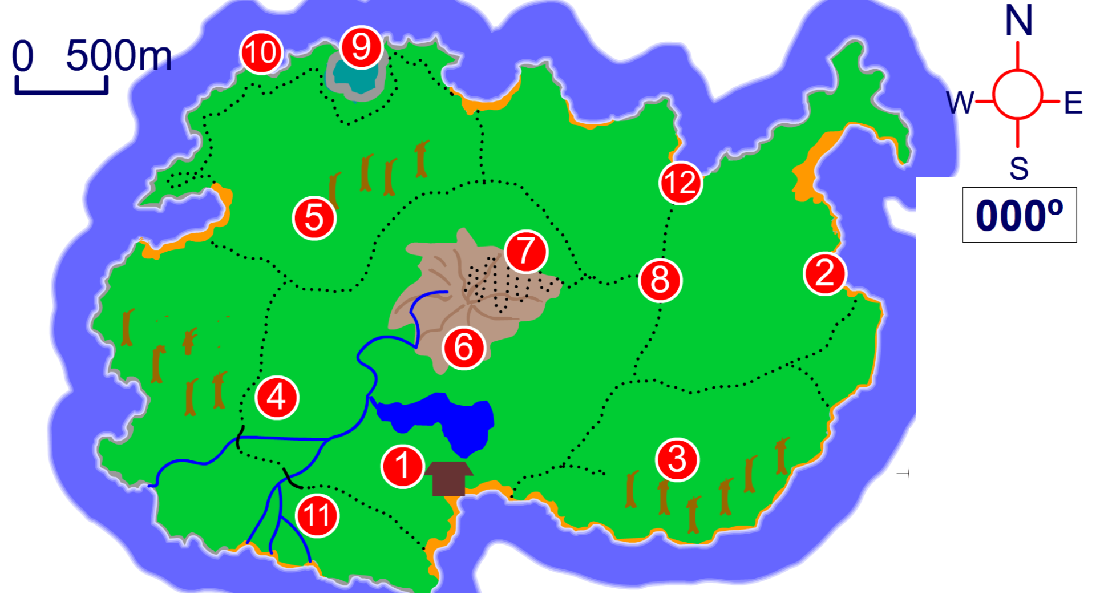
Notes:
Use this activity to demonstrate how to find the bearing from one numbered place on the map to another. Also, ask pupils to use the scale given on the map to estimate the distance between two points.
Ask, for example:
What is the approximate bearing from 6 to 5?
Approximately how far in metres is it between 1 and 3?
What point is on a bearing of 255° from 6?
Find the bearing from 7 to 9. Ask pupils if they can give you the bearing from 9 to 7 without measuring.
Link:
S5 Coordinates and transformations 2 – Scale drawings.

Slide 15
What is the bearing?
040˚

Slide 16
What is the bearing?
007˚

Slide 17
What is the bearing?
070˚

Slide 18
What is the bearing?
120˚

Slide 19
What is the bearing?
335˚

Slide 20
What is the bearing?
307˚

Slide 21
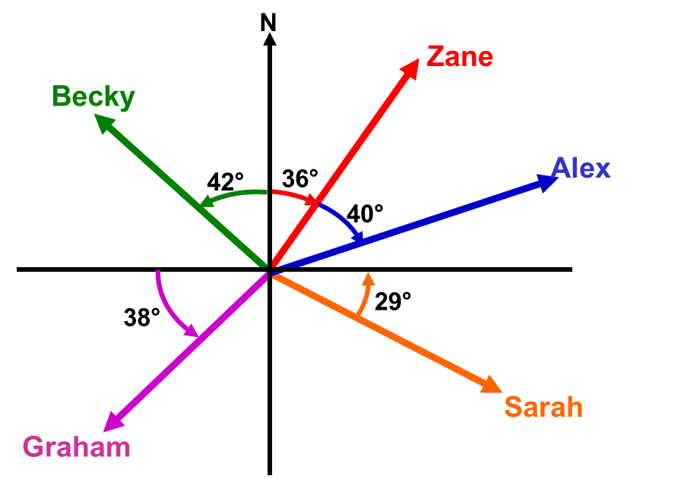
Zane = 036˚
Alex = 076˚
Sarah = 119˚
Graham = 232˚
Becky = 318˚

